Slide 1
ENGINEERING SCIENCES
(BME 2105)
LECTURE 14 MODULE 2
Dinesh Kumar
Assistant Professor
School of Engineering

Slide 2
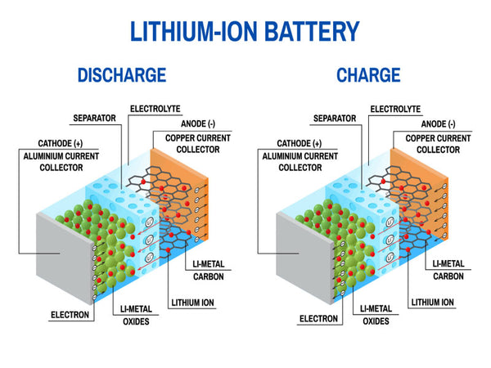
WORKING OF LITHIUM ION BATTERY
A lithium-ion battery is a rechargeable energy storage device utilizing lithium ions moving between electrodes—an anode (negative) and a cathode (positive)—through an electrolyte to generate electrical energy for various applications, known for their high energy density and rechargeability.

Slide 3
CONSTRUCTION OF A LITHIUM-ION BATTERY:
Anode (Negative Electrode): Usually made of graphite, the anode stores lithium ions during the charging process. When the battery discharges, lithium ions move from the anode to the cathode.
Cathode (Positive Electrode): The cathode, typically made of a lithium metal oxide, such as lithium cobalt oxide (LiCoO2), lithium iron phosphate (LiFePO4), or lithium manganese oxide (LiMn2O4), receives and stores lithium ions during discharge. The specific chemistry of the cathode affects the battery's performance characteristics.
Separator: A permeable membrane separates the anode and cathode to prevent short circuits while allowing the flow of lithium ions between the electrodes.

Slide 4
5. Electrolyte: A lithium salt dissolved in an organic solvent forms the electrolyte. It enables the movement of lithium ions between the electrodes during charging and discharging.
6. Current Collectors: Thin foils made of aluminum and copper act as current collectors for the anode and cathode, respectively, facilitating the flow of electrical current.

Slide 5
WORKING OF A LITHIUM-ION BATTERY:
CHARGING:
  When charging, a voltage is applied to the battery, causing lithium ions to move from the positive cathode through the electrolyte to the negative anode.
  At the cathode, lithium ions are extracted from the metal oxide, and the oxide structure accepts these ions.
  Simultaneously at the anode, lithium ions intercalate (or embed) themselves into the graphite structure.

Slide 6
DISCHARGING:
During discharging (when the battery powers a device), the process reverses. Lithium ions move from the anode through the electrolyte to the cathode.
The lithium ions are released from the anode and travel back through the electrolyte to the cathode, providing electrical current to the external circuit.
This movement of ions creates a flow of electrons in the external circuit, producing electrical energy to power devices.

Slide 7
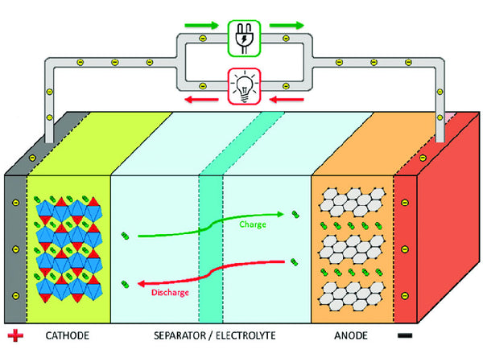

Slide 8
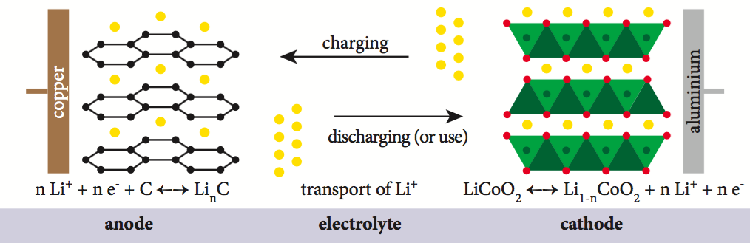

Slide 9
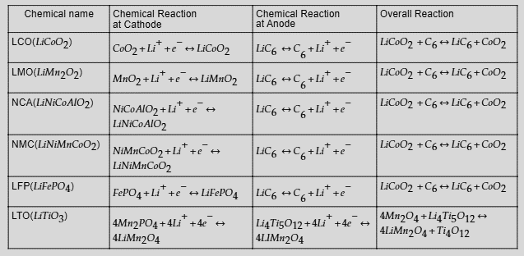

Slide 10
LCO: Lithium-cobalt oxide
LMO: Lithium Manganese Oxide
NCA: Nickel Cobalt Aluminum Oxide batteries
NMC: Nickel Manganese Cobalt
LFP: Lithium iron phosphate battery
LTO: Lithium-titanium-oxide

Slide 11
APPLICATIONS:
Portable Electronics: Powering smartphones, laptops, tablets, and wearable devices due to their high energy density and lightweight nature.
Electric Vehicles (EVs): Providing energy storage for electric cars and hybrid vehicles due to their high power-to-weight ratio and rechargeability.
Renewable Energy Storage: Storing energy from solar panels and wind turbines for later use in homes or grid-scale applications.
Medical Devices: Powering various medical equipment due to their reliability and energy efficiency.

Slide 12
ADVANTAGES:
High Energy Density: Offers a high energy-to-weight ratio, providing more energy storage capacity for their size.
Low Self-Discharge: Holds charge for longer periods when not in use compared to other rechargeable batteries.
Fast Charging: Capable of rapid charging, allowing quick recharges compared to some other battery types.
Longer Lifespan: Lithium-ion batteries can typically endure hundreds to thousands of charge-discharge cycles, depending on the specific chemistry.

