Slide 1
ENGINEERING SCIENCES
(BME 2105)
LECTURE 15 MODULE 3
Dinesh Kumar
Assistant Professor
School of Engineering

Slide 2
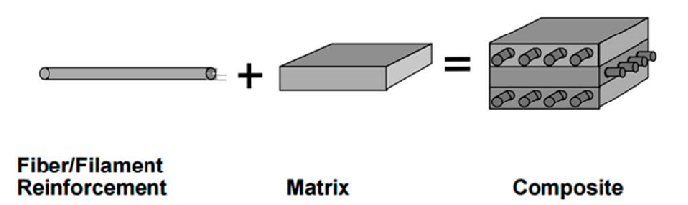
POLYMER COMPOSITES
Polymer composites are materials made by combining two or more constituent materials with significantly different physical or chemical properties to create a new material with enhanced characteristics. These composites typically consist of a polymer matrix reinforced with a filler material. The polymer matrix, usually a plastic resin like epoxy, polyester, or vinyl ester, holds the reinforcement material together, providing shape and structure.

Slide 3
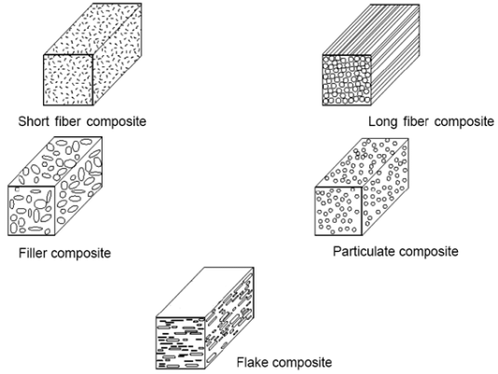
The reinforcement material, which can be in various forms like fibers, particles, or flakes, contributes to the composite's strength, stiffness, and other desirable properties. Common reinforcement materials include carbon fibers, glass fibers, aramid fibers (such as Kevlar), nanoparticles, and more. The choice of reinforcement material depends on the intended application and the specific properties desired.

Slide 4
CONSTITUENTS OF POLYMER COMPOSITES
Polymer composites are typically made up of two primary constituents:
Polymer Matrix:
  The polymer matrix is the continuous phase of the composite material. It's composed of a polymer resin, which can be epoxy, polyester, vinyl ester, polyurethane, or other types of thermosetting or thermoplastic resins.
  This matrix material provides the structure and shape to the composite. It encapsulates and supports the reinforcement material while transferring loads throughout the material.
  The selection of the polymer matrix depends on various factors such as the desired properties of the final composite, the intended application, processing methods, and cost considerations.

Slide 5
CONSTITUENTS OF POLYMER COMPOSITES
2. Reinforcement Material:
The reinforcement material is embedded within the polymer matrix to enhance specific properties like strength, stiffness, toughness, or other characteristics of the composite.
The reinforcement can take various forms, including fibers, particles, flakes, or fillers. Common reinforcement materials include:
  Fiber Reinforcements: Such as carbon fibers, glass fibers, aramid fibers (like Kevlar), natural fibers (like jute or bamboo), and others. These fibers can be continuous or discontinuous and are known for providing excellent strength and stiffness to the composite.

Slide 6
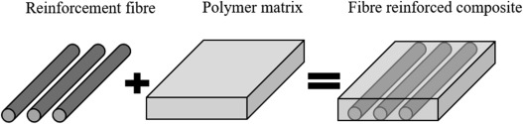
  Particle Reinforcements: These can be nanoparticles or larger particles added to the polymer matrix to improve properties like toughness, thermal conductivity, or electrical properties.
  Flake Reinforcements: These include materials like mica or graphite flakes that can enhance properties like barrier resistance, thermal conductivity, or electrical insulation.

Slide 7
The combination of the matrix and the reinforcement imparts several advantages to polymer composites:
Enhanced Strength and Stiffness: The addition of the reinforcement material significantly improves the strength and stiffness of the composite compared to the polymer matrix alone. For instance, carbon fibers can greatly enhance the strength of a polymer composite.
Reduced Weight: Composite materials are often lighter than metals while maintaining comparable or even superior strength, making them highly desirable for applications where weight reduction is critical, such as aerospace or automotive industries.

Slide 8
3. Improved Durability: The composite's resistance to corrosion, fatigue, and wear can be improved, depending on the materials used in the matrix and reinforcement.
4. Tailored Properties: By varying the type, orientation, and volume fraction of the reinforcement, engineers can tailor the composite's properties to meet specific requirements, such as thermal conductivity, electrical conductivity, or impact resistance.
5. Design Flexibility: Composites offer greater design flexibility compared to traditional materials like metals. They can be molded into complex shapes and structures, allowing for innovative designs.

Slide 9
POLYMER COMPOSITES
Fiber-Reinforced Polymers (FRP):
  Carbon Fiber-Reinforced Polymers (CFRP): Used in aerospace, automotive components, sports equipment (such as bicycles, tennis rackets), and high-performance applications due to their exceptional strength-to-weight ratio.
  Glass Fiber-Reinforced Polymers (GFRP): Commonly used in construction, automotive parts, boat hulls, and panels due to their strength, durability, and corrosion resistance.
Aramid Fiber-Reinforced Polymers (AFRP):
  Kevlar, a well-known aramid fiber, is used in body armor, racing sails, aerospace components, and high-performance tires due to its high strength and resistance to impact.

Slide 10
3. Polymer-Ceramic Composites:
  Used in electronics and engineering for their excellent electrical and thermal insulation properties. Applications include circuit boards, insulators, and high-temperature-resistant components.
4. Particulate-Reinforced Polymers:
  Polymer Nanocomposites: These include polymers reinforced with nanoparticles (like nanoclays or carbon nanotubes) and find applications in automotive parts, packaging materials, and medical devices due to their enhanced mechanical, thermal, and barrier properties.
5. Natural Fiber-Reinforced Polymers:
  Composites incorporating natural fibers (such as jute, hemp, or bamboo) are used in automotive interiors, construction materials, and consumer goods due to their renewable nature and relatively lower cost compared to synthetic fibers.

Slide 11
6. Polymer Matrix Composite Materials in 3D Printing:
  Additive manufacturing or 3D printing utilizes polymer composites to create complex, customized parts for various industries, including aerospace, healthcare (for prosthetics), and automotive sectors.
7. Structural Components in Construction:
  Composites are increasingly used in construction for building panels, bridges, and reinforcement due to their lightweight nature, high strength, and resistance to corrosion.

