Slide 1
ENGINEERING SCIENCES
(BME 2105)
LECTURE 16 MODULE 3
Dinesh Kumar
Assistant Professor
School of Engineering

Slide 2
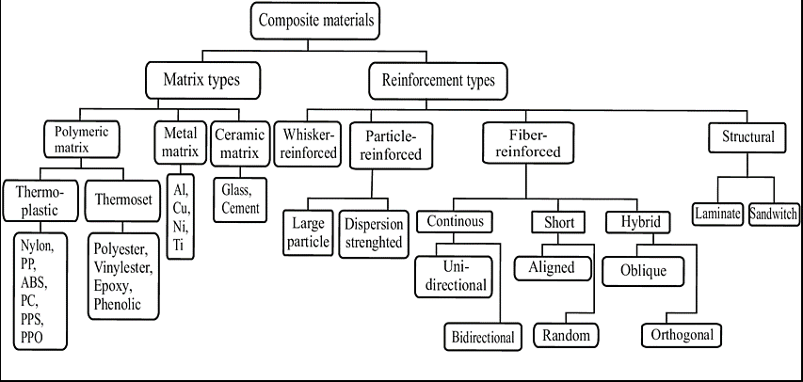
TYPE OF COMPOSITE

Slide 3
BASED ON COMPOSITION:
Fiber-Reinforced Composites: These comprise a matrix material reinforced with fibers, such as carbon fibers, glass fibers, aramid fibers, or natural fibers.
Particulate-Reinforced Composites: Matrix materials reinforced with particles or fillers, like metal matrix composites or polymer nanocomposites.
Laminar Composites: Consist of multiple layers bonded together, each potentially composed of different materials. Examples include laminates in fiberglass or carbon fiber composites.

Slide 4
BASED ON MATRIX MATERIAL:
Polymer Matrix Composites (PMCs): Use polymer resins like epoxy, polyester, or vinyl ester as the matrix material.
Metal Matrix Composites (MMCs): Employ metal matrices, often reinforced with ceramics or fibers.
Ceramic Matrix Composites (CMCs): Utilize ceramic matrices reinforced with ceramic fibers or particles.

Slide 5
BASED ON REINFORCEMENT TYPE:
Continuous Fiber-Reinforced Composites: Utilize long, continuous fibers for reinforcement, providing high strength and stiffness.
Discontinuous (Short) Fiber-Reinforced Composites: Have shorter fibers dispersed within the matrix, offering improved toughness and impact resistance.
Particulate-Reinforced Composites: Incorporate particles or fillers, such as nanoparticles or larger particles, to enhance specific properties.

Slide 6
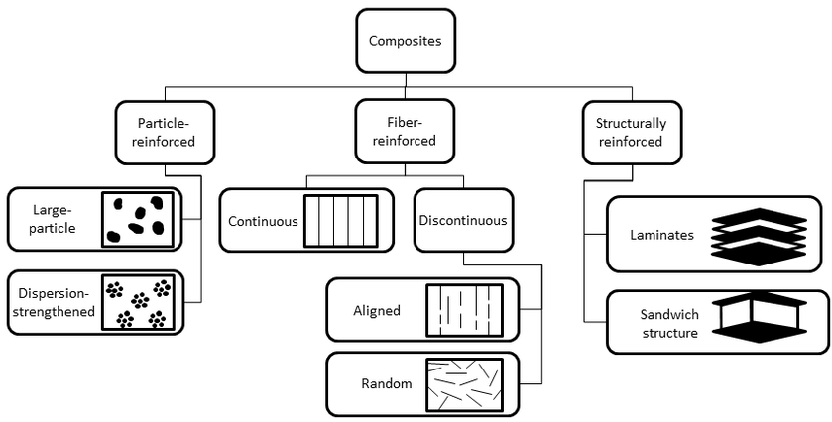

Slide 7
BASED ON APPLICATION:
Structural Composites: Designed for load-bearing applications in industries like aerospace, automotive, marine, and construction.
Functional Composites: Tailored for specific functionalities like electrical conductivity, thermal insulation, or magnetic properties, often used in electronics, energy, and specialized equipment.
Bio composites: Utilize natural fibers or bio-based matrices, finding applications in eco-friendly products, packaging, and construction.

Slide 8
BASED ON MANUFACTURING METHOD:
Continuous vs. Discontinuous Manufacturing: Refers to the method of creating the composite material, whether the reinforcement is continuously or discontinuously introduced into the matrix material.
Moulding Techniques: Includes processes like compression moulding, injection moulding, and filament winding, each offering different advantages in creating composite parts.

Slide 9
COMPONENTS OF A SANDWICH COMPOSITE:
Face Sheets (or Skins): These are the outer layers of the sandwich composite, serving as the primary load-bearing elements. Face sheets are usually thin, high-strength materials, often made of fiber-reinforced polymers (FRPs) like carbon fiber or fiberglass-reinforced plastics. They provide structural integrity, protection from environmental factors, and aesthetic appeal.
Core Material: The core is the central layer between the face sheets and contributes significantly to the sandwich structure's mechanical properties. Core materials are often lightweight and can be rigid, semi-rigid, or flexible, depending on the application requirements. Common core materials include foam (such as polyethylene, PVC, or polyurethane), balsa wood, honeycomb structures (aluminum, Nomex®, or fiberglass), or even engineered lattice structures.

Slide 10

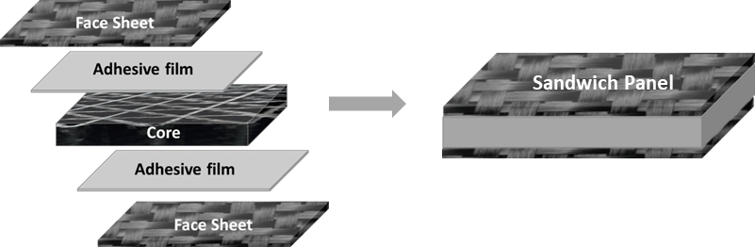

Slide 11
Carbon Fiber Composites:
  Aerospace components
  Automotive high-performance parts
  Sports equipment (bicycles, tennis rackets)
Glass Fiber Composites:
  Construction panels
  Boat hulls
  Automotive body parts
Aramid Fiber Composites:
  Body armor
  Aerospace components
  Racing sails and high-performance tires

Slide 12
Polymer Nanocomposites:
  Automotive parts
  Packaging materials
  Medical devices
  Electronics
Metal Matrix Composites:
  Aerospace (engine components, structural parts)
  Automotive (brake components, engine parts)
  Sporting goods (bicycles, golf clubs)

Slide 13
Fiberglass Laminates:
  Marine applications (boat construction)
  Automotive body panels
  Construction industry (roofing, façade elements)
Carbon Fiber Laminates:
  Aerospace (aircraft structures)
  Automotive racing
  Sports equipment

Slide 14
Polymer Matrix Composites:
  Aerospace (aircraft structures)
  Automotive (body panels, chassis)
  Construction (structural elements)
  Electronics and energy storage
Biocomposites:
  Eco-friendly products
  Packaging materials
  Construction materials

