Slide 1
ENGINEERING SCIENCES
(BME 2105)
LECTURE 17 MODULE 3
Dinesh Kumar
Assistant Professor
School of Engineering

Slide 2
APPLICATION OF DIFFERENT TYPE OF POLYMER COMPOSITES IN AUTOMOTIVE INDUSTRY
CARBON FIBER COMPOSITES:
Application:
  Used in high-end vehicles for body panels, hoods, roofs, and structural components like chassis.
  Found in sports cars, supercars, and luxury vehicles to reduce weight while maintaining strength.
Benefits:
  Offers exceptional strength and stiffness at a reduced weight, enhancing fuel efficiency and performance.
  Provides high impact resistance and structural integrity.

Slide 3
GLASS FIBER COMPOSITES:
Application:
  Used in automotive body panels, interior trim, and under-the-hood components like engine covers and air intake systems.
  Found in bumpers and fenders due to their impact resistance and flexibility.
Benefits:
  Offers durability, corrosion resistance, and a balance between cost-effectiveness and performance.

Slide 4
POLYMER NANOCOMPOSITES:
Application:
  Utilized in various automotive parts, including bumpers, fenders, interior trims, and door panels.
  Found in engine components, offering enhanced thermal stability and mechanical strength.
Benefits:
  Provides improved mechanical properties (strength, stiffness) and impact resistance.
  Reduces weight and enhances fuel efficiency without compromising durability.

Slide 5
POLYMER MATRIX COMPOSITES (GENERAL):
Application:
  Used for a wide array of automotive components such as exterior body panels, chassis parts, and structural elements.
  Found in suspension components and wheels due to their strength and lightweight nature.
Benefits:
  Offers design flexibility, corrosion resistance, and can be tailored for specific mechanical properties.
  Reduces overall vehicle weight, contributing to fuel efficiency and performance.

Slide 6
BIOCOMPOSITES:
Application:
  Increasingly used in eco-friendly vehicles for interior components like door panels, seat structures, and trim parts.
  Found in non-structural parts to enhance sustainability in vehicle manufacturing.
Benefits:
  Offers environmental advantages due to the use of renewable materials.
  Reduces the carbon footprint of vehicles while maintaining adequate performance characteristics.

Slide 7
METAL MATRIX COMPOSITES:
Application:
  Used in brake components (rotors and pads), engine parts, and structural reinforcements.
  Found in high-performance vehicles to improve braking efficiency and reduce weight.
Benefits:
  Provides high-temperature resistance, wear resistance, and improved mechanical properties compared to traditional metals.

Slide 8
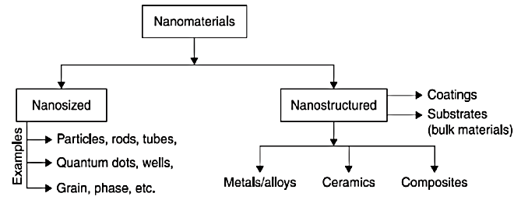
NANO MATERIALS: INTRODUCTION
Nano materials are substances that possess unique properties due to their incredibly small size, typically on the nanometre scale (1 nanometre = 1 billionth of a meter). These materials exhibit distinct physical, chemical, electrical, and optical characteristics compared to their bulk counterparts because of their minute size and high surface area-to-volume ratio.

Slide 9
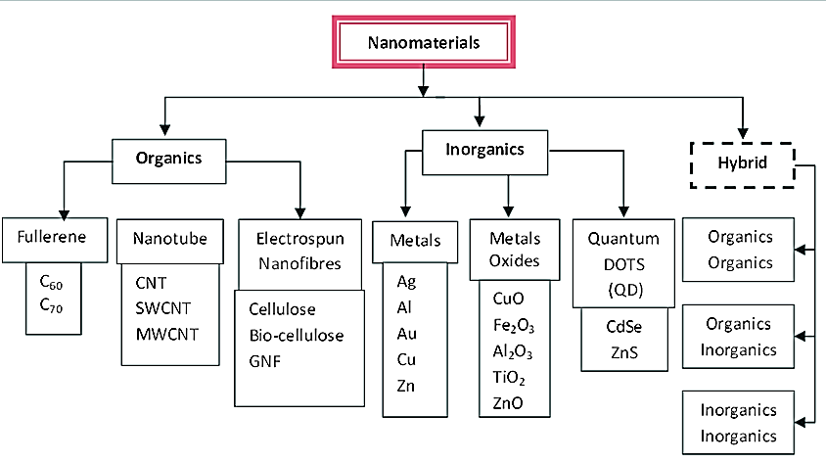

Slide 10
CLASSIFICATION OF NANOMATERIALS
1. Nanoparticles:
Metal-based nanoparticles: Including gold, silver, iron oxide nanoparticles, often used in biomedical applications, catalysis, and sensing.
Metal oxide nanoparticles: Like titanium dioxide, zinc oxide, used in sunscreen, catalysis, and environmental remediation.
Carbon-based nanoparticles: Graphene, carbon nanotubes, and fullerenes, known for their electrical, mechanical, and thermal properties used in electronics, materials science, and medicine.

Slide 11
2. Nanotubes and Nanowires:
Carbon Nanotubes (CNTs): Single-walled (SWCNTs) or multi-walled (MWCNTs) tubes with extraordinary strength and conductivity.
Metallic and Semiconductor Nanowires: Extremely thin wires with unique electronic properties used in Nano electronics and sensors.
3. Quantum Dots:
Semiconductor quantum dots: Nanoscale particles exhibiting quantum effects, crucial in displays, solar cells, biomedical imaging, and quantum computing due to their tunable properties.

Slide 12
4. Nanocomposites:
Polymer Nanocomposites: Blends of polymers with nano-sized additives like nanoparticles or nanotubes, enhancing mechanical, electrical, or thermal properties for various applications in industries.

