Slide 1
ENGINEERING SCIENCES
(BME 2105)
LECTURE 18 MODULE 3
Dinesh Kumar
Assistant Professor
School of Engineering

Slide 2
STUDY OF CHANGE IN PROPERTIES OF NANOMATERIALS
Mechanical properties of nanomaterials refer to how they behave under applied forces or loads. At the nanoscale, materials can display distinct mechanical characteristics compared to their bulk counterparts, offering enhanced strength, flexibility, and other unique attributes.
1. STRENGTH AND STIFFNESS:
Enhanced Strength: Nanomaterials often exhibit exceptional strength compared to bulk materials. For instance, carbon nanotubes, graphene, and some metallic nanoparticles have extremely high tensile strength.
Stiffness: Some nanomaterials also demonstrate increased stiffness, making them suitable for applications where rigidity is crucial.

Slide 3
2. FLEXIBILITY AND DUCTILITY:
Despite their enhanced strength, certain nanomaterials can also maintain flexibility and ductility, allowing them to bend or deform without fracturing. This property is advantageous in various applications, including flexible electronics and lightweight structural materials.
3. TOUGHNESS AND FRACTURE RESISTANCE:
Nanomaterials might exhibit improved toughness, resisting crack propagation and fracture better than bulk materials.
The ability to withstand deformation and absorb energy without failure is particularly important in structural applications and impact-resistant materials.

Slide 4
4. FATIGUE AND WEAR RESISTANCE:
Some nanomaterials have increased resistance to fatigue and wear, making them suitable for components subjected to repetitive stress or abrasive environments.
This property is valuable in manufacturing durable and long-lasting materials for various industries.
5. SIZE-DEPENDENT MECHANICAL PROPERTIES:
The mechanical behavior of nanomaterials is often size-dependent. As the size decreases, the ratio of surface atoms to bulk atoms increases, leading to alterations in mechanical behavior.
Quantum effects and surface energy considerations play a significant role in determining these size-dependent mechanical properties.

Slide 5
The properties of nanomaterials are influenced by various fundamental parameters intrinsic to their structure, composition, and size. These parameters govern the behavior of nanomaterials and dictate their unique properties.
1. SIZE:
Quantum Confinement Effects: As the size decreases to the nanoscale, quantum effects become prominent. This alters electronic, optical, and magnetic properties. For instance, quantum dots exhibit size-dependent optical properties due to quantum confinement.
Surface Area-to-Volume Ratio: Smaller particle sizes lead to larger surface areas per unit volume, impacting reactivity, catalytic activity, and adsorption capacity. This influences chemical and biological interactions.

Slide 6
2. SHAPE AND MORPHOLOGY:
Anisotropy: Different shapes (spheres, rods, tubes) exhibit varying properties due to differences in surface area, packing density, and crystal facets. For instance, nanowires or nanotubes have higher aspect ratios, affecting their mechanical and electrical properties compared to nanoparticles.
3. COMPOSITION:
Chemical Composition: Altering the chemical composition can significantly impact properties. For instance, doping elements into nanomaterials can modify electrical conductivity or catalytic activity.
Alloying and Mixing: Creating alloys or composite nanomaterials can lead to synergistic properties that combine the benefits of different materials.

Slide 7
4. SURFACE AND INTERFACE EFFECTS:
Surface States: Surface atoms in nanomaterials possess different energy states compared to bulk atoms, influencing reactivity, stability, and electronic properties.
Surface Modifications: Functionalizing or modifying the surface of nanomaterials can tailor their properties for specific applications, such as improving biocompatibility or enhancing catalytic activity.
5. CRYSTAL STRUCTURE AND DEFECTS:
Crystal Phase: Changes in crystal structure due to size reduction or surface energy considerations can affect mechanical, optical, and electrical properties.
Defects and Grain Boundaries: At the nanoscale, defects and boundaries have a more pronounced effect on material properties, influencing conductivity, mechanical strength, and catalytic activity.

Slide 8
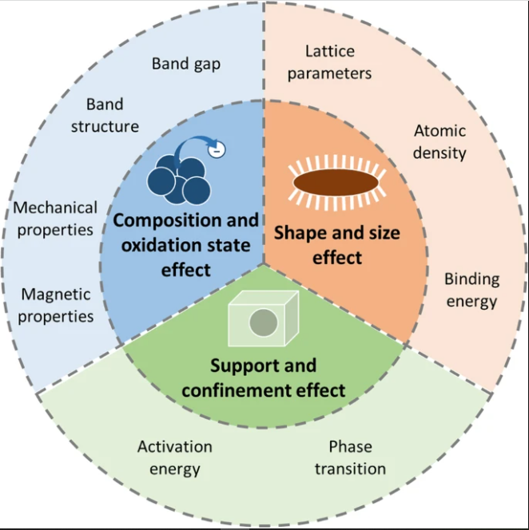

Slide 9
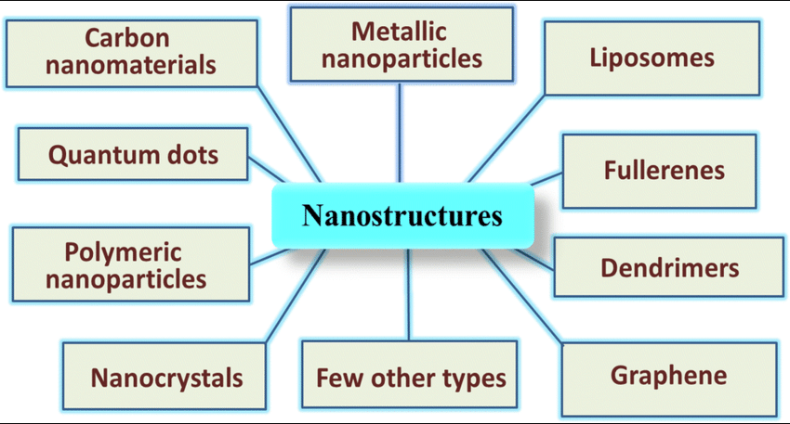

Slide 10
