Slide 1
ENGINEERING SCIENCES
(BME 2105)
LECTURE 19 MODULE 3
Dinesh Kumar
Assistant Professor
School of Engineering

Slide 2
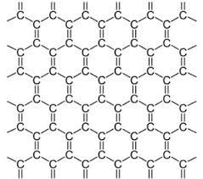
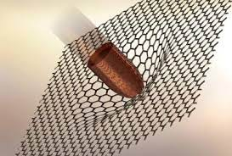
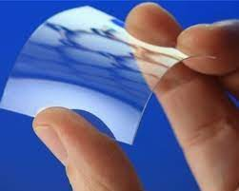
GRAPHENE-STRUCTURE
Graphene is a two-dimensional allotrope of carbon arranged in a single layer of tightly packed carbon atoms bonded together in a hexagonal lattice. It's often described as a "wonder material" due to its remarkable properties and potential applications across various industries.

Slide 3
Two-Dimensional Carbon Structure: Graphene is a single layer of carbon atoms arranged in a two-dimensional honeycomb lattice.
Hexagonal Arrangement: Carbon atoms in graphene form a hexagonal pattern resembling a honeycomb or chicken wire, with each carbon atom bonded to three neighbouring carbon atoms.
Sp2 Hybridization: Each carbon atom in graphene undergoes sp2 hybridization, where three electron orbitals combine to form strong sigma bonds with neighbouring atoms, while the remaining p-orbital creates a delocalized pi-bond above and below the plane of the sheet.
Single Layer: Unlike graphite, which consists of multiple layers of graphene stacked on top of each other, graphene is a monolayer of carbon atoms.

Slide 4
Atomic Thickness: It is incredibly thin, with a thickness of just one atom, providing it with unique properties.
High Surface Area: Due to its two-dimensional structure, graphene possesses an extremely high surface area relative to its volume.
Planar Structure: Graphene's structure is planar, with all carbon atoms lying in a single plane, giving it remarkable electrical, mechanical, and thermal properties.
Flexibility: Despite its strength, graphene is flexible and can be bent or folded without breaking due to its single-layer structure.

Slide 5
Transparency: Graphene is nearly transparent, allowing over 97% of light to pass through, owing to its thinness and arrangement of carbon atoms.
Impermeability: Despite its thinness, graphene is impermeable to gases and liquids due to the strong covalent bonds between carbon atoms.
Exceptional Strength: It exhibits extraordinary mechanical strength, being about 200 times stronger than steel at the same thickness.
High Electrical Conductivity: Graphene displays excellent electrical conductivity due to its unique electronic structure and ability to allow electrons to move rapidly across its surface.

Slide 6
GRAPHENE PROPERTIES
Exceptional Strength: Graphene is incredibly strong due to its tightly packed carbon atoms arranged in a hexagonal lattice. Its strength is about 200 times greater than that of steel at the same thickness. This strength arises from its atomic structure and the strong covalent bonds between carbon atoms.
High Electrical Conductivity: Graphene exhibits exceptional electrical conductivity because of its unique atomic arrangement. The delocalized pi-electrons allow electrons to move rapidly across its surface, making it an excellent conductor of electricity.
High Thermal Conductivity: Graphene demonstrates excellent thermal conductivity, enabling efficient heat transfer. Its two-dimensional structure allows heat to flow rapidly through the material, making it valuable for various thermal management applications.

Slide 7
Flexibility and Lightness: Despite its strength, graphene is incredibly flexible and lightweight. Its single-layer structure allows it to bend and stretch without losing its structural integrity, making it suitable for flexible electronics and various other applications.
Transparency: Graphene is nearly transparent, allowing over 97% of light to pass through. This property, combined with its exceptional conductivity, makes it useful for transparent conductive films, touchscreens, and optoelectronic devices.
Impermeability: Despite being only one atom thick, graphene is impermeable to gases and liquids due to the strong covalent bonds between its carbon atoms. This property makes it valuable for barrier applications in fields such as packaging and membrane technology.

Slide 8
Large Surface Area: Graphene possesses an extraordinarily high surface area relative to its volume. This property is advantageous in applications requiring high surface area materials, such as energy storage devices and sensors.
Mechanical Resilience: Graphene is exceptionally resilient and can withstand deformation and stress without breaking. Its exceptional mechanical properties make it suitable for various structural and engineering applications.
Biocompatibility: Graphene shows good compatibility with biological systems, making it suitable for biomedical applications such as drug delivery systems, biosensors, and tissue engineering.

Slide 9
Chemical Stability: Graphene is highly stable and resistant to many chemicals and environmental factors. Its strong covalent bonds provide stability against chemical reactions, making it durable in various environments.
Tunable Properties: The properties of graphene can be modified and tailored for specific applications through methods such as doping (introducing impurities) or functionalization (adding functional groups). This tunability allows for customization to suit diverse technological needs across different industries.

Slide 10
