Slide 1
ENGINEERING SCIENCES
(BME 2105)
LECTURE 2 MODULE 1
Dinesh Kumar
Assistant Professor
School of Engineering

Slide 2
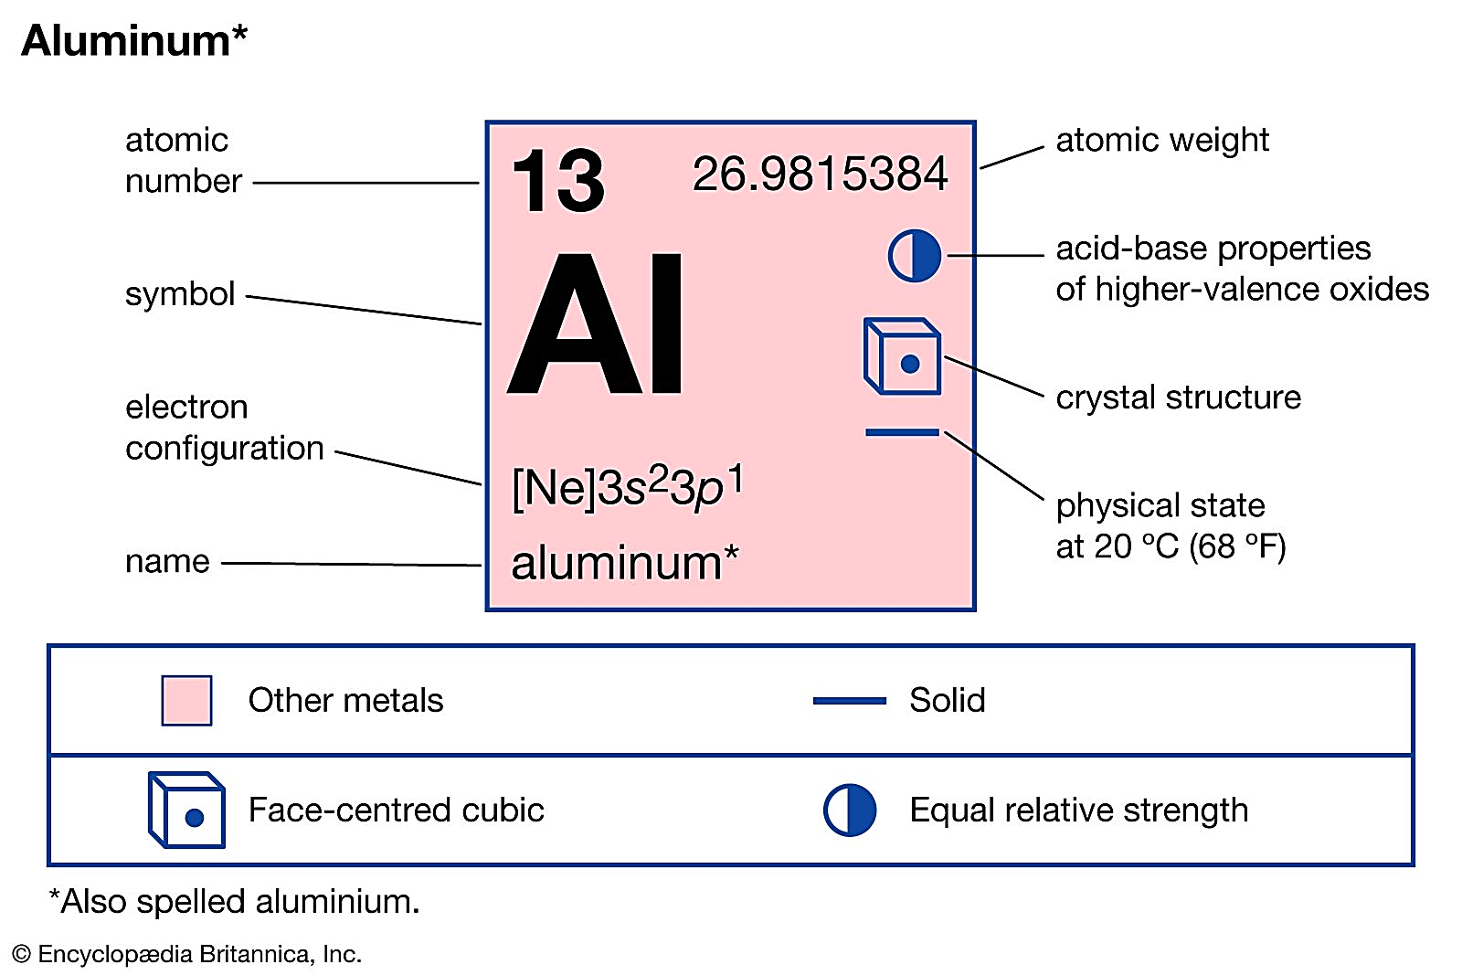
ALUMINIUM
Prepared from a clayey mineral called bauxite
It is a light metal having specific gravity 2.7 and melting point 658°C
The tensile strength of the metal varies from 90 MPa to 150 MPa.

Slide 3
Aluminium
Duralumin
Y-alloy
Magnalium
Hindalium

Slide 4
MAGNALIUM
It is made by melting the aluminium with 2 to 10% magnesium in a vacuum and then cooling it in a vacuum or under a pressure of 100 to 200 atmospheres.
Due to its light weight and good mechanical properties, it is mainly used for aircraft and automobile components.
DURALUMIN
Copper = 3.5 – 4.5%; Manganese = 0.4 – 0.7%; Magnesium = 0.4 – 0.7%, and the remainder is aluminium.
This alloy possesses maximum tensile strength (upto 400 MPa) after heat treatment and age hardening.
It is widely used in wrought conditions for forging, stamping, bars, sheets, tubes and rivets.
Due to its high strength and light weight, this alloy may be used in automobile and aircraft components. It is also used in manufacturing connecting rods, bars, rivets, pulleys, etc.

Slide 5
HINDALIUM
It is an alloy of aluminium and magnesium with a small quantity of chromium.
It is the trade name of aluminium alloy produced by Hindustan Aluminium Corporation Ltd, Renukoot (U.P.).
It is produced as a rolled product in 16 gauge, mainly for anodized utensil manufacture.
Y-ALLOY
It is also called copper-aluminium alloy
Copper = 3.5 – 4.5%; Manganese = 1.2 – 1.7%; Nickel = 1.8 – 2.3%; Silicon, Magnesium, Iron = 0.6% each; and the remainder is aluminium.
It is mainly used for cast purposes
Since Y-alloy has better strength (than duralumin) at high temperature, therefore, it is much used in aircraft engines for cylinder heads and pistons.

Slide 6
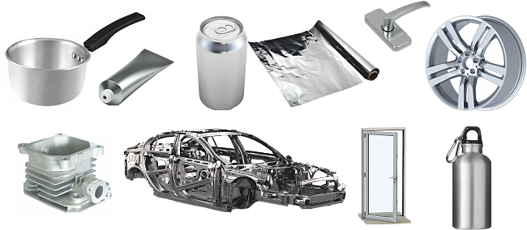
APPLICATIONS OF ALUMINIUM

Slide 7
COPPER
It is a soft, malleable and ductile material with a reddish-brown appearance
Its specific gravity is 8.9 and melting point is 1083°C
The tensile strength varies from 150 MPa to 400 MPa under different conditions
It is used for making useful alloys with tin, zinc, nickel and aluminium.
It is largely used in making electric cables and wires for electric machinery and appliances, in electrotyping and electroplating, in making coins and household utensils.
It is non-corrosive under ordinary conditions and resists weather very effectively.
It is also used for making ammunitions

Slide 8
Copper
Copper-zinc alloys (Brass)
Copper-tin alloys (Bronze)
Phosphor bronze
Silicon bronze
Beryllium bronze
Manganese bronze
Aluminium bronze

Slide 9
COPPER ALLOY
  COPPER-ZINC ALLOYS (BRASS)
    This is fundamentally a binary alloy of copper with zinc each 50%.
    For example, the addition of lead (1 to 2%) improves the machining quality of brass.
    It has a greater strength than that of copper, but have a lower thermal and electrical conductivity.
    Brasses are very resistant to atmospheric corrosion and can be easily soldered.
    Can also be electroplated with metals like nickel and chromium.

Slide 10
COPPER-TIN ALLOYS (BRONZE)
  The alloys of copper and tin are usually termed as bronzes
  The useful range of composition is 75 to 95% copper and 5 to 25% tin
  The metal is comparatively hard, resists surface wear and can be shaped or rolled into wires, rods and sheets very easily.
  In corrosion resistant properties, bronzes are superior to brasses.
PHOSPHOR BRONZE
  When bronze contains phosphorus, it is called phosphor bronze
  Phosphorus increases the strength, ductility and soundness of castings
  The tensile strength of this alloy when cast varies from 215 MPa to 280 MPa but increases upto 2300 MPa when rolled or drawn.
  This alloy possesses good wearing qualities and high elasticity

Slide 11
  The metal is resistant to salt water corrosion
  Copper = 87–90%, Tin = 9–10%, and Phosphorus = 0.1–3%.
  It is used for bearings, worm wheels, gears, nuts for machine lead screws, pump parts, linings and for many other purposes. It is also suitable for making springs.
SILICON BRONZE
  It contains 96% copper, 3% silicon and 1% manganese or zinc
  It has good general corrosion resistance of copper combined with higher strength
  It is widely used for boilers, tanks, stoves or where high strength and good corrosion resistance is required.
  It can be cast, rolled, stamped, forged and pressed either hot or cold

Slide 12
BERYLLIUM BRONZE
  It is a copper base alloy containing about 97.75% copper and 2.25% beryllium.
  It has high yield point, high fatigue limit and excellent cold and hot corrosion resistance.
  It is particularly suitable material for springs, heavy duty electrical switches, cams and bushings.
  it may be used as a bearing metal in place of phosphor bronze.
  It has a film forming and a soft lubricating property, which makes it more suitable as a bearing metal.
MANGANESE BRONZE
  It is an alloy of copper, zinc and little percentage of manganese
  Copper = 60%, Zinc = 35%, and Manganese = 5%
  This metal is highly resistant to corrosion.
  It is generally used for bushes, plungers, feed pumps, rods etc.
  Worm gears are frequently made from this bronze.

Slide 13
GUN METAL
  It is an alloy of copper, tin and zinc.
  It usually contains 88% copper, 10% tin and 2% zinc.
  This metal is also known as Admiralty gun metal.
  The zinc is added to clean the metal and to increase its fluidity.
  The metal is very strong and resistant to corrosion by water and atmosphere.
  Originally, it was made for casting guns.
  It is extensively used for casting boiler fittings, bushes, bearings, glands, etc.

Slide 14
LEAD
  It is a bluish grey metal having specific gravity 11.36 and melting point 326°C
  It is so soft that it can be cut with a knife
  It is extensively used for making solders, as a lining for acid tanks, cisterns, water pipes, and as coating for electrical cables.
  The lead base alloys are employed where a cheap and corrosion resistant material is required
  An alloy containing 83% lead, 15% antimony, 1.5% tin and 0.5% copper is used for large bearings subjected to light service.

Slide 15
TIN
  It is brightly shining white metal. It is soft, malleable and ductile
  It can be rolled into very thin sheets
  It is used for making important alloys, fine solder, as a protective coating for iron and steel sheets and for making tin foil used as moisture proof packing.
  A tin base alloy containing 88% tin, 8% antimony and 4% copper is called Babbit metal

