Slide 1
ENGINEERING SCIENCES
(BME 2105)
LECTURE 20 MODULE 3
Dinesh Kumar
Assistant Professor
School of Engineering

Slide 2
USE OF GRAPHENE OXIDE ANODE IN LI-ION BATTERIES
Graphene oxide (GO) has garnered significant interest in the realm of lithium-ion batteries (LIBs) due to its unique properties, such as high surface area, excellent electrical conductivity (though less than pristine graphene), and tunable functional groups. When utilized as an anode material in LIBs, GO offers several advantages and potential applications:
ENHANCED LITHIUM STORAGE CAPACITY:
GO's high surface area provides more active sites for lithium-ion storage, potentially leading to higher lithium storage capacity compared to conventional graphite-based anodes.

Slide 3
IMPROVED ELECTROCHEMICAL PERFORMANCE:
The presence of oxygen-containing functional groups (like hydroxyl and epoxy groups) in GO assists in stabilizing the electrode-electrolyte interface, enhancing the cycling stability and overall electrochemical performance of the battery.
FACILITATES FASTER ELECTRON TRANSPORT:
Despite having oxygen functional groups that can impede conductivity to some extent, GO's moderately good electrical conductivity still allows for reasonably fast electron transport, supporting efficient charge/discharge processes in the battery.

Slide 4
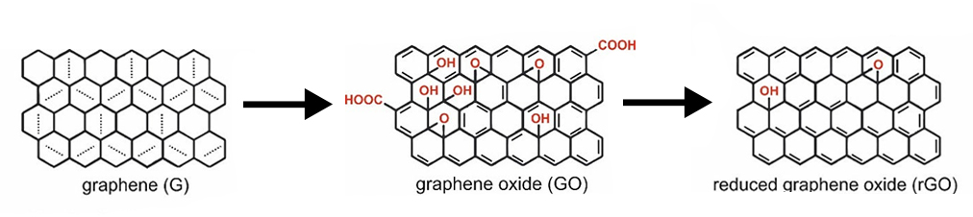
4. Flexibility in Design and Modification:
GO's versatile nature allows for easy functionalization or hybridization with other materials, which can be beneficial for tailoring the anode's properties to specific requirements like further enhancing capacity, cycle life, or rate capability.

Slide 5
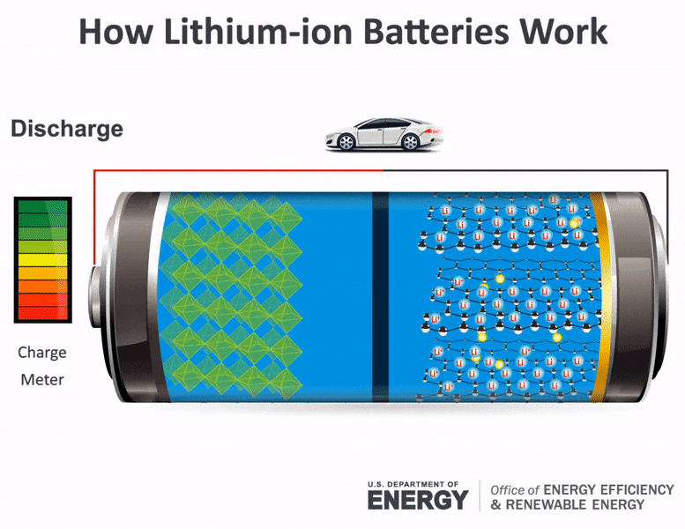

Slide 6
WHY GRAPHENE OXIDE (GO) IS USEFUL FOR LITHIUM-ION BATTERIES (LIBS)
High Surface Area and Porosity: GO possesses a large surface area and porous structure, providing ample active sites for lithium-ion storage, thereby enhancing the battery's capacity.
Tunable Functional Groups: Oxygen-containing functional groups on GO's surface, like hydroxyl and epoxy groups, contribute to stabilizing the electrode-electrolyte interface, improving electrochemical performance, and overall battery stability.
Moderate Electrical Conductivity: Despite reduced conductivity compared to pristine graphene due to oxygen functional groups, GO still maintains reasonably good electrical conductivity, aiding in efficient electron transport during charge and discharge processes.

Slide 7
Compatibility and Hybridization: GO's versatile nature allows for easy functionalization and hybridization with other materials, enabling the customization of the anode's properties for specific requirements, such as increased capacity or cycling stability.
Enhanced Battery Performance: GO shows potential for increasing lithium storage capacity, improving cycling stability, and contributing to longer battery life due to its unique structural and chemical properties.
Scalable Production: GO can be produced from abundant starting materials using scalable chemical processes, suggesting potential for large-scale and sustainable production for LIBs.

Slide 8
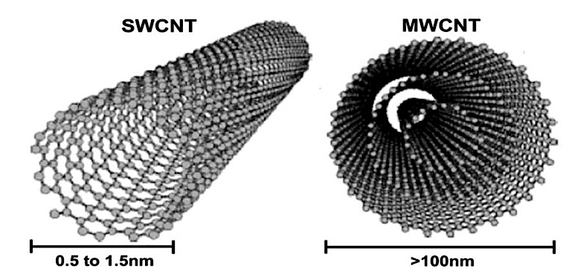
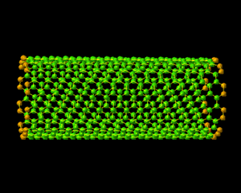
CARBON NANOTUBES
Carbon nanotubes (CNTs) are cylindrical nanostructures made of carbon atoms arranged in a unique tubular configuration. They are one of the most studied and versatile materials in nanotechnology due to their exceptional properties and various potential applications.

Slide 9
KEY FEATURES OF CARBON NANOTUBES:
Atomic Structure: CNTs are composed of carbon atoms bonded together in a hexagonal lattice pattern, forming seamless cylindrical tubes.
Diameter: They can have diameters on the nanometre scale, typically ranging from about 1 to 100 nanometres, while their length can reach several micrometers to millimetres.
Single-Walled and Multi-Walled: CNTs can exist as single-walled carbon nanotubes (SWCNTs) composed of a single layer of carbon atoms or multi-walled carbon nanotubes (MWCNTs) consisting of multiple concentric layers of graphene.

Slide 10
MECHANICAL PROPERTIES OF CARBON NANOTUBES (CNTS)
1. EXCEPTIONAL STRENGTH:
CNTs possess extraordinary tensile strength, making them incredibly robust. They're estimated to be several times stronger than steel at a fraction of the weight. This property is due to the strong sp² carbon-carbon bonds in their structure.
2. HIGH ELASTIC MODULUS:
They have an exceptionally high elastic modulus, indicating their stiffness. This modulus is estimated to be higher than most materials, contributing to their outstanding mechanical rigidity.
3. FLEXIBILITY AND BENDING:
Despite their strength, carbon nanotubes are also remarkably flexible. They can bend and deform without breaking, allowing them to sustain considerable strain and recover their shape.

Slide 11
4. RESILIENCE TO DEFORMATION:
CNTs show resilience to deformation, even under significant mechanical stress. They can withstand considerable forces without permanent damage, owing to their inherent structural stability.
5. TOUGHNESS AND FRACTURE RESISTANCE:
They exhibit toughness and exceptional resistance to fracture. Even when subjected to significant impacts or stress, CNTs can absorb energy without breaking.
6. MECHANICAL ANISOTROPY:
Carbon nanotubes can display mechanical anisotropy, meaning their mechanical properties might vary concerning the direction in which the force is applied. This characteristic depends on factors like the type of nanotube and its structural arrangement.

Slide 12
7. LOAD TRANSFER AND REINFORCEMENT:
CNTs have the potential to act as effective reinforcements in composite materials due to their high strength and ability to transfer loads effectively within the material.
8. SIZE-DEPENDENT PROPERTIES:
The mechanical behavior of carbon nanotubes can vary concerning their dimensions. Smaller-diameter nanotubes, for instance, might exhibit different mechanical properties than larger ones due to quantum effects and surface interactions.

Slide 13
