Slide 1
ENGINEERING SCIENCES
(BME 2105)
LECTURE 22 MODULE 4
Dinesh Kumar
Assistant Professor
School of Engineering

Slide 2
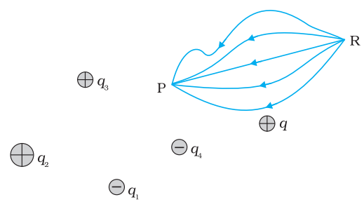
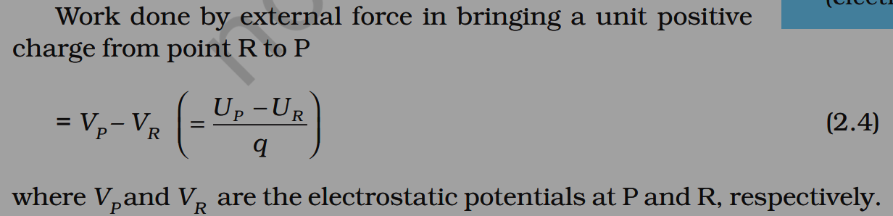
ELECTROSTATIC POTENTIAL
Electrostatic potential, or electric potential, is a measure of potential energy per unit charge at any point in an electric field. It describes the work done per unit charge in moving a positive test charge from infinity to a specific point in the field. It's measured in volts (V) and helps understand the potential energy a charge would have at a certain point in an electric field.

Slide 3
Scalar Quantity: It's a scalar quantity, having magnitude but no direction. This simplifies its mathematical treatment and allows straightforward addition in calculations.
Additivity: In a system with multiple charges, the total electrostatic potential at any point is the algebraic sum of the potentials produced by each individual charge. This principle facilitates the calculation of potential in complex systems.
Work Done and Potential Difference: The work done in moving a charge between two points in an electric field is equal to the change in electrostatic potential energy. The potential difference between two points in an electric field determines the amount of work done in moving a charge between these points.

Slide 4
4. Independence of Path: The electrostatic potential difference between two points in a field is independent of the path taken by the charge. Only the initial and final positions of the charge matter in determining the potential difference.
5. Relation to Electric Field: The electric field (E) at a point in an electrostatic field is the negative gradient of the electrostatic potential (V) at that point: E=−∇V This relationship helps in determining the electric field from knowledge of the potential and vice versa.
6. Equipotential Surfaces: The points in space having the same electrostatic potential form equipotential surfaces. These surfaces are perpendicular to the electric field lines and imply that no work is done in moving a charge along an equipotential surface.

Slide 5
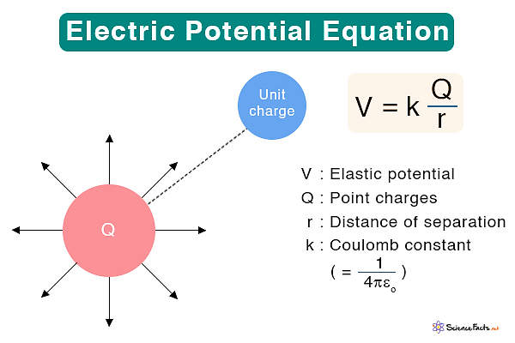

Slide 6
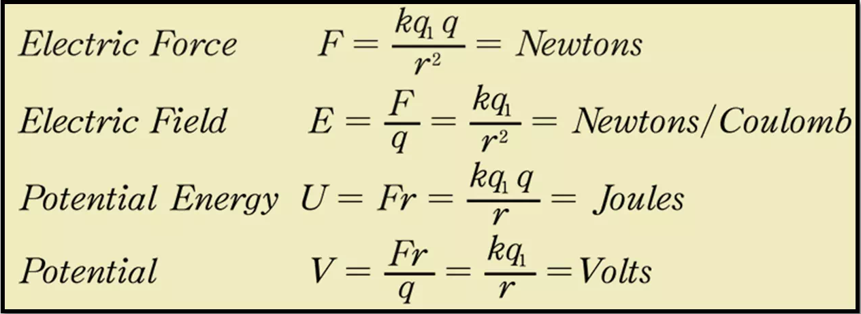

Slide 7
BOUNDARY CONDITIONS
Continuity of Electric Potential: The electric potential V must remain continuous across the boundary. In mathematical terms:
V_{1​} = V₂​
Where V₁​ and V₂​ represent the potentials on either side of the boundary.
2. Normal Component of Electric Field: The normal component of the electric field (E_{n}​) on either side
of the boundary relates to the charge density (σ) at the interface:
σ = ϵ₀ ​( En₁ ​− En_{2 ​})
This equation describes how the charge distribution on the surface (σ) is related to the
discontinuity in the normal component of the electric field across the boundary.

Slide 8
3. Tangential Component of Electric Field for Conductors: For a conductor, the electric field inside the
material must be zero. Therefore, the tangential component of the electric field (E_{t}​) at the boundary
of a conductor is zero:
E_{t}​ = 0
This condition ensures that charges on the surface of a conductor reside in an electrostatic
equilibrium, resulting in zero electric field inside the conductor.
4. Tangential Component of Electric Field for Insulators: At the interface of an insulator, the
tangential component of the electric field (E_{t}​) is continuous:
Et₁​ = Et_{2​}
This condition ensures that the electric field direction remains continuous across the boundary of
an insulator.

Slide 9
5. Discontinuity in Dielectric Mediums: When transitioning between two dielectric materials, the normal component of the electric displacement (D) accounts for the change in dielectric constant (ϵ) across the boundary:
D_{n1}​ − D_{n2} ​= σ_{f}​
Here, σ_{f}​ represents the free charge density at the boundary.

Slide 10
WORK AND ENERGY
Work Done by an External Force:
The work done (W) in moving a test charge (q) from one point to another against an electric field is given by:
W = q⋅ΔV
Where:
q is the test charge.
ΔV is the change in electric potential between the initial and final points

Slide 11
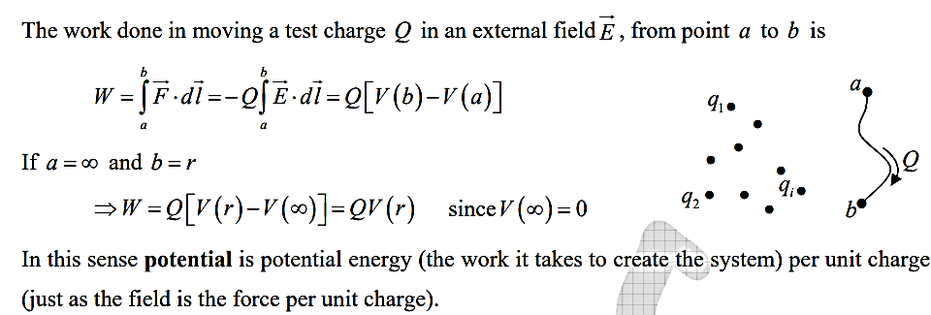

Slide 12
Electric Potential Energy:
The electric potential energy (U) associated with a system of charges in an electric field is given by:
U = q ⋅ V
Where:
q is the charge.
V is the electric potential at the location of the charge.

Slide 13
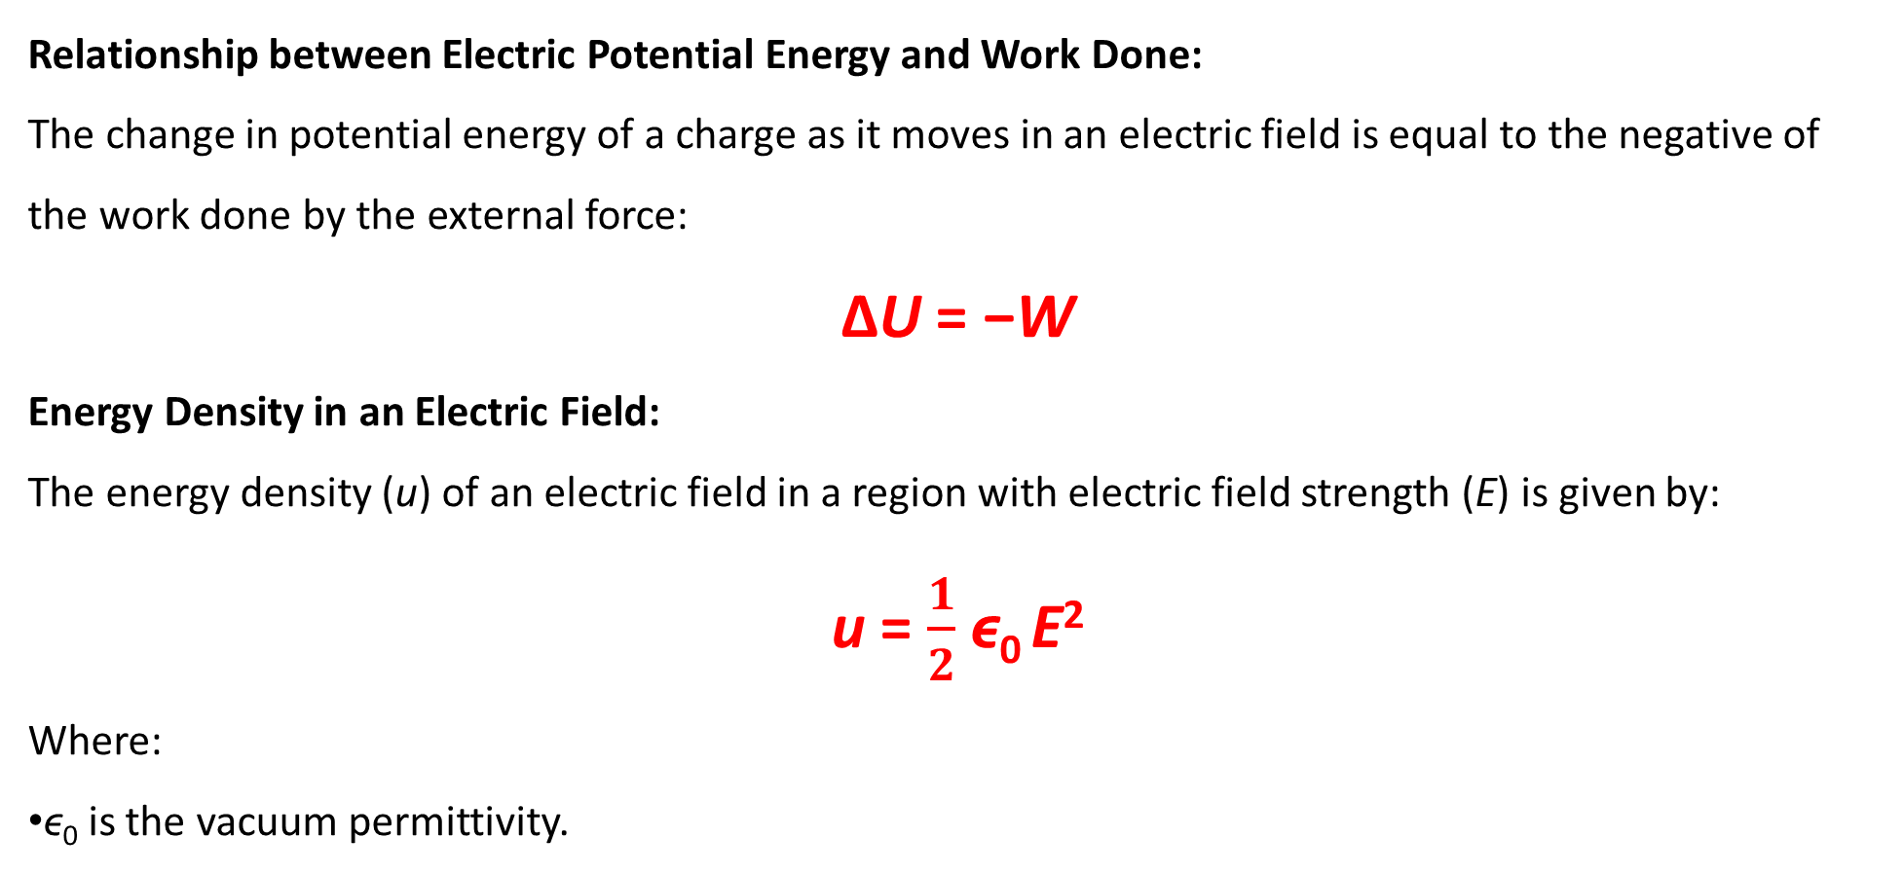
Relationship between Electric Potential Energy and Work Done:
The change in potential energy of a charge as it moves in an electric field is equal to the negative of the work done by the external force:
ΔU = −W
Energy Density in an Electric Field:
The energy density (u) of an electric field in a region with electric field strength (E) is given by:
u = $\frac{1}{2}$​ϵ₀ ​E²
Where:
ϵ₀​ is the vacuum permittivity.

Slide 14
Total Energy of a System:
For a collection of charges and electric fields, the total potential energy (U_{total}​) of the system is the sum of the potential energies of individual charges:
U_{total}​ = ∑ q_{i} ​⋅ V_{i}​

