Slide 1
ENGINEERING SCIENCES
(BME 2105)
LECTURE 23 MODULE 4
Dinesh Kumar
Assistant Professor
School of Engineering

Slide 2
CONDUCTORS
A conductor is a material that allows the easy movement of electric charge, particularly electrons, within its structure. This type of material possesses properties that enable electric current to flow through it with minimal resistance.
Conductors typically have electrons in their outer energy levels that are loosely bound and free to move when influenced by an electric field. Metals like copper, aluminum, and silver are common examples of conductors due to their ability to efficiently conduct electricity.
Conductors are integral in various electrical applications, including wiring, circuits, and transmission lines, as they facilitate the transfer and utilization of electrical energy.

Slide 3
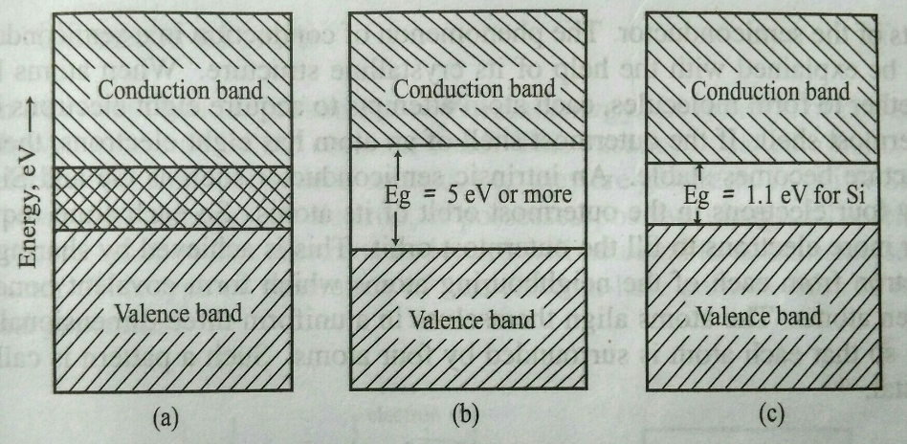
CONDUCTOR INSULATOR SEMICONDUCTOR

Slide 4
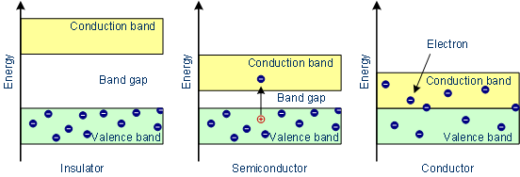

Slide 5
PROPERTIES OF CONDUCTORS:
High Conductivity: Conductors offer low resistance to the flow of electric current due to the abundance of free electrons in their atomic structure.
Low Resistivity: They have low electrical resistance, allowing electricity to pass through them with minimal loss of energy.
Malleability and Ductility: Many conductors, especially metals, are malleable and ductile, allowing them to be shaped into wires or different forms without losing their conductivity.
Good Thermal Conductivity: Conductors often possess good thermal conductivity, making them useful for applications where heat needs to be transferred efficiently.

Slide 6
APPLICATIONS OF CONDUCTORS:
Electrical Wiring: Conductors like copper and aluminum are extensively used in electrical wiring for buildings, homes, and electrical appliances due to their excellent conductivity and flexibility.
Power Transmission: Conductors form the basis of power transmission lines, where materials like aluminum and steel-reinforced conductors efficiently transmit electricity over long distances with minimal loss.
Electronics: They are crucial in the production of electronic components like printed circuit boards (PCBs), connecting components within devices, and forming the pathways for electricity in electronic systems.

Slide 7
4. Motors and Generators: Conductors play a significant role in motors and generators where the movement of electricity creates magnetic fields that lead to mechanical motion or generate electricity.
5. Heat Transfer Applications: In various industries, conductors are used for efficient heat transfer in applications such as heat exchangers and cooling systems due to their good thermal conductivity.

Slide 8
APPLICATIONS OF CONDUCTORS IN AUTOMOBILE
Power distribution within the vehicle for various components and systems.
Connecting sensors and control units for engine management and diagnostics.
Providing pathways for lighting systems including headlights, taillights, and indicators.
Powering and controlling various motors and solenoids in the engine and powertrain.
Charging systems for electric vehicles, connecting charging ports to batteries.

Slide 9
Audio system connections for speakers and entertainment features.
Wiring harnesses for safety systems like airbags and anti-lock braking systems (ABS).
Ignition system, delivering high voltage to spark plugs for engine ignition.
Transmission and shifting mechanisms, facilitating gear changes.
Connecting battery systems to power various electrical components and systems within the vehicle.

