Slide 1
ENGINEERING SCIENCES
(BME 2105)
LECTURE 24 MODULE 4
Dinesh Kumar
Assistant Professor
School of Engineering

Slide 2
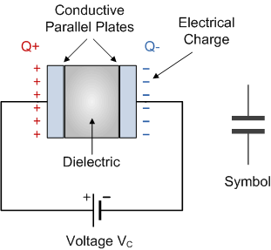
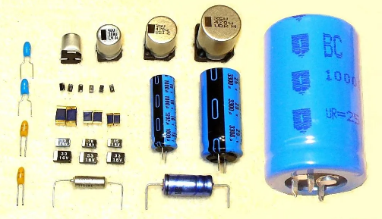
CAPACITORS
Capacitors store electrical energy, consisting of two conductive plates with an insulator between them. They release stored energy when connected in a circuit, serving various purposes in electronics, like filtering and energy storage.

Slide 3
The simplest construction of a capacitor is by using two parallel conducting metal plates separated through a distance by an insulating material. This insulating material is called the “dielectric”. the dielectric plays an important role in the electrical operation of a capacitor
A capacitor consists of two metal plates separated by a dielectric.
The dielectric can be made of many insulating materials such as air, glass, paper, plastic etc.
A capacitor is capable of storing electrical charge and energy.
The higher the value of capacitance, the more charge the capacitor can store.

Slide 4
The larger the area of the plates or the smaller their separation the more charge the capacitor can store.
A capacitor is said to be “Fully Charged” when the voltage across its plates equals the supply voltage.
The symbol for electrical charge is Q and its unit is the Coulomb.
Electrolytic capacitors are polarized. They have a +ve and a -ve terminal.
Capacitance is measured in Farads, which is a very large unit so micro-Farad ( μF ), nano-Farad ( nF ) and pico-Farad ( pF ) are generally used.

Slide 5
Capacitors that are daisy chained together in a line are said to be connected in Series.
Capacitors that have both of their respective terminals connected to each terminal of another capacitor are said to be connected in Parallel.
Parallel connected capacitors have a common supply voltage across them.
Series connected capacitors have a common current flowing through them.

Slide 6
BASED ON CONSTRUCTION:
Electrolytic Capacitors: Utilize an electrolyte as the dielectric.
Ceramic Capacitors: Made from ceramic materials.
Film Capacitors: Use a thin film as the dielectric.
Tantalum Capacitors: Employ tantalum for the dielectric.

Slide 7
BASED ON DIELECTRIC MATERIAL:
Ceramic Capacitors: Dielectric made of ceramic materials.
Polyester Capacitors: Use polyester as the dielectric.
Polypropylene Capacitors: Employ polypropylene for the dielectric.
Aluminum Electrolytic Capacitors: Use aluminum oxide as the dielectric.

Slide 8
BASED ON CAPACITANCE VALUE:
Variable Capacitors: Adjustable capacitance values.
Fixed Capacitors: Set capacitance values.
BASED ON APPLICATION:
Filtering Capacitors: Used for filtering out noise.
Decoupling Capacitors: Stabilize voltage in circuits.
Timing Capacitors: Used in timing circuits.
Energy Storage Capacitors: Store electrical energy temporarily.

Slide 9
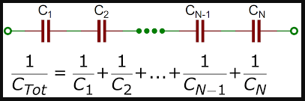
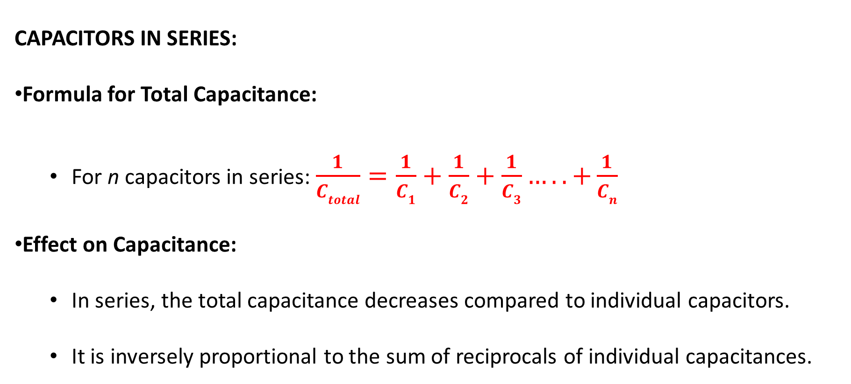
CAPACITORS IN SERIES AND PARALLEL
CAPACITORS IN SERIES:
Formula for Total Capacitance:
  For n capacitors in series: $\frac{1}{Ctotal}=\frac{1}{C1}+\frac{1}{C2}+\frac{1}{C3}…..+\frac{1}{Cn}$
Effect on Capacitance:
  In series, the total capacitance decreases compared to individual capacitors.
  It is inversely proportional to the sum of reciprocals of individual capacitances.

Slide 10
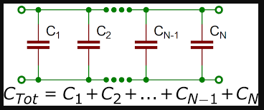
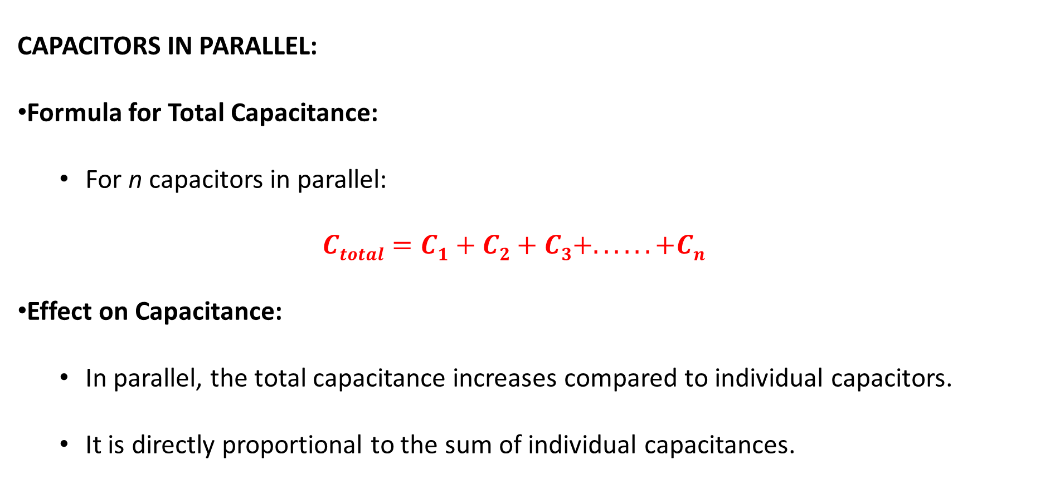
CAPACITORS IN PARALLEL:
Formula for Total Capacitance:
  For n capacitors in parallel: ​
  $$Ctotal=C1+C2+C3+. . . . . . +Cn$$
Effect on Capacitance:
  In parallel, the total capacitance increases compared to individual capacitors.
  It is directly proportional to the sum of individual capacitances.

Slide 11
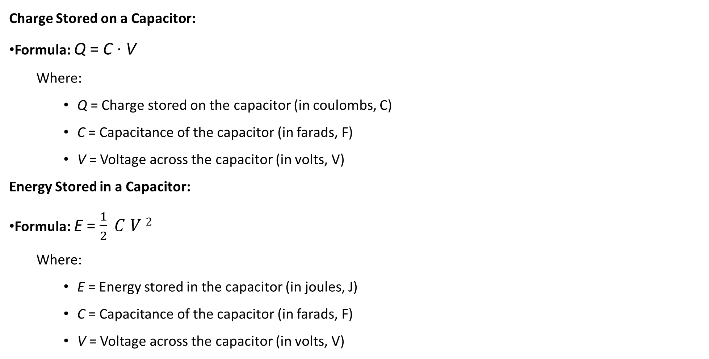
Charge Stored on a Capacitor:
Formula: Q = C ⋅ V
  Where:
    Q = Charge stored on the capacitor (in coulombs, C)
    C = Capacitance of the capacitor (in farads, F)
    V = Voltage across the capacitor (in volts, V)
Energy Stored in a Capacitor:
Formula: E = $\frac{1}{2} C V 2$
  Where:
    E = Energy stored in the capacitor (in joules, J)
    C = Capacitance of the capacitor (in farads, F)
    V = Voltage across the capacitor (in volts, V)

Slide 12
Time Constant in a RC Circuit:
Formula: τ = R ⋅ C
  Where:
    τ = Time constant (in seconds, s)
    R = Resistance in the circuit (in ohms, Ω)
    C = Capacitance of the capacitor (in farads, F)

Slide 13
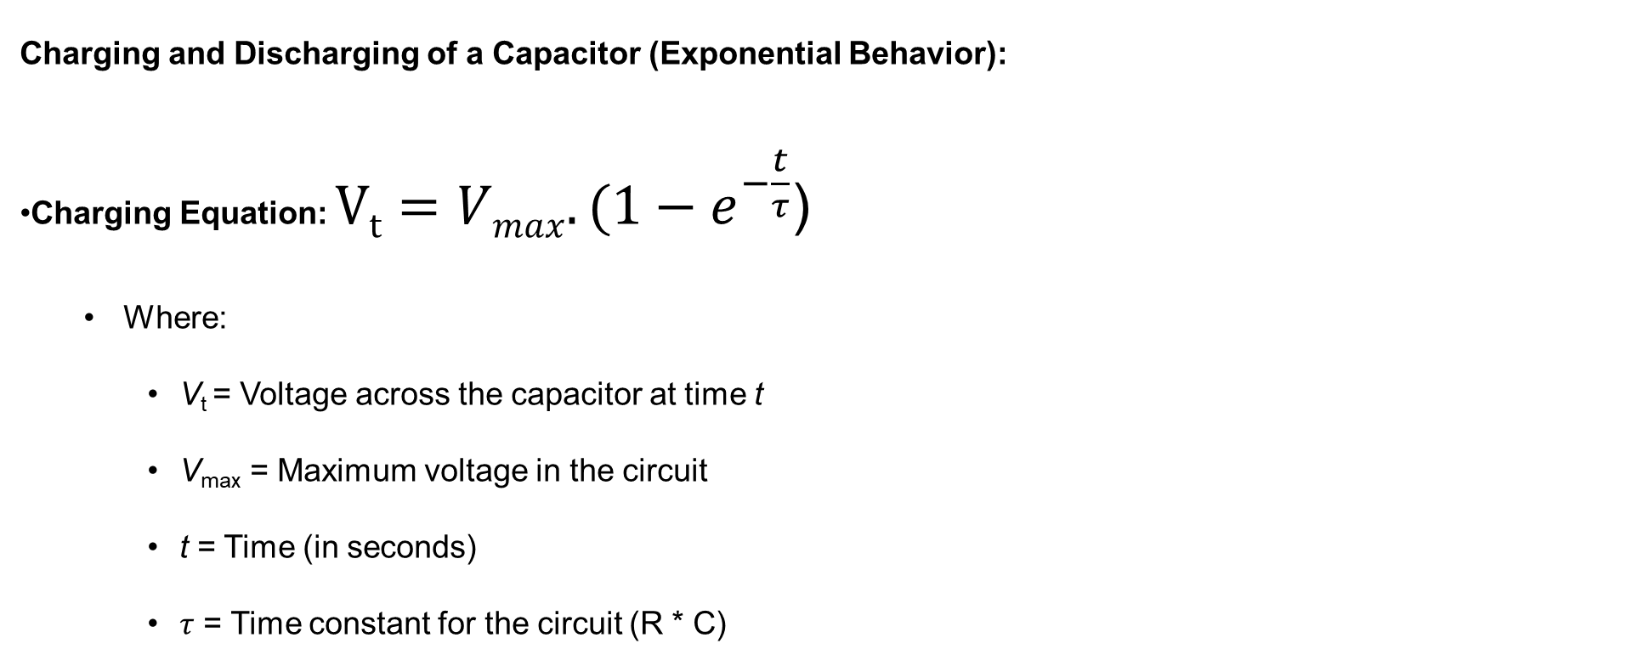
Charging and Discharging of a Capacitor (Exponential Behavior):
Charging Equation: $Vt=Vmax.(1−e^{−\frac{t}{τ}}$)
  Where:
    V_{t} = Voltage across the capacitor at time t
    V_{max}​ = Maximum voltage in the circuit
    t = Time (in seconds)
    $τ$ = Time constant for the circuit (R * C)

Slide 14
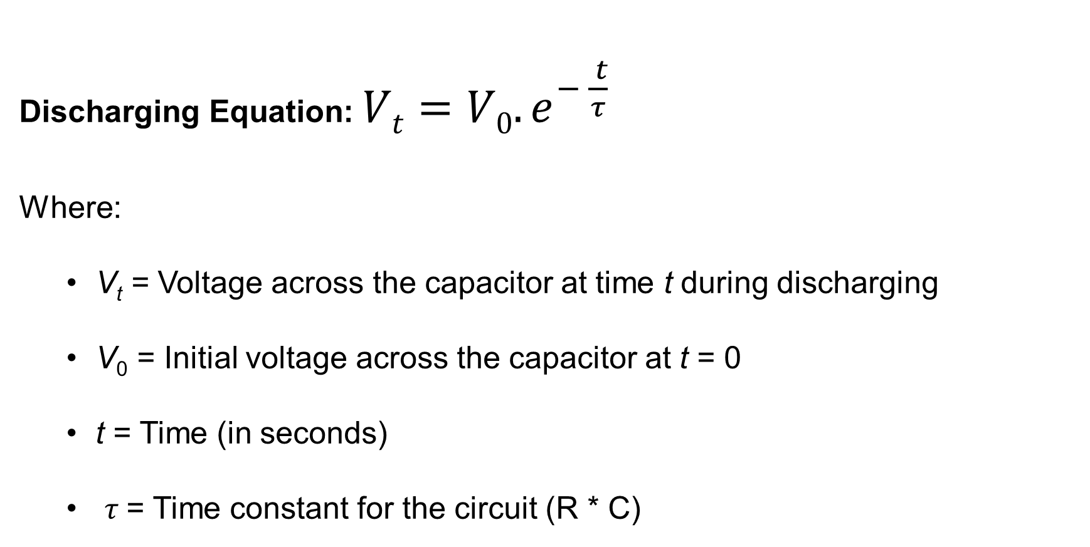
Discharging Equation: $Vt=V0.e^{− \frac{ t}{τ}}$
Where:
  V_{t} = Voltage across the capacitor at time t during discharging
  V₀​ = Initial voltage across the capacitor at t = 0
  t = Time (in seconds)
  $τ$= Time constant for the circuit (R * C)

