Slide 1
ENGINEERING SCIENCES
(BME 2105)
LECTURE 25 MODULE 4
Dinesh Kumar
Assistant Professor
School of Engineering

Slide 2
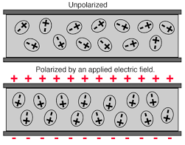
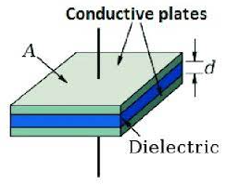
DIELECTRICS
Dielectrics are insulating materials placed between the plates of a capacitor that modify the electric field and increase the capacitance. They're crucial in enhancing a capacitor's efficiency and performance.

Slide 3
PROPERTIES AND ROLE OF DIELECTRICS:
Insulating Properties: Dielectrics prevent the flow of direct current (DC) while allowing the displacement of charges.
Polarization: When a dielectric is placed in an electric field, its atoms or molecules polarize, aligning themselves with the field and enhancing the electric field's effect.
Increased Capacitance: Dielectrics significantly increase a capacitor's capacitance compared to an air-gap capacitor of the same physical size due to their higher permittivity.

Slide 4
TYPES OF DIELECTRICS:
Polar Dielectrics: These dielectrics have permanent dipoles, which align themselves with an external electric field. Examples include:
  Water: Exhibits a permanent dipole moment.
  Barium Titanate: Used in ceramic capacitors for its high dielectric constant.
Non-Polar Dielectrics: Dielectrics without permanent dipoles. When subjected to an electric field, their atoms polarize, creating an induced dipole moment. Examples include:
  Air: Low dielectric constant, often used as a reference for other dielectrics.
  Mica: Offers good insulation and stability, used in high-frequency circuits.

Slide 5
3. Ferroelectric Dielectrics: Display spontaneous polarization and retain their polarization even after removing the external electric field. They're used in:
  Lead Zirconate Titanate (PZT): Utilized in sensors, actuators, and memory devices.
  Barium Strontium Titanate: Employed in capacitors and memory devices due to its high dielectric constant and ferroelectric properties.
4. High-K Dielectrics: Materials with a high dielectric constant (relative permittivity), allowing for smaller, higher-capacity capacitors. Examples include:
  Barium Titanate: Used in high-K ceramic capacitors.
  Tantalum Pentoxide (Ta₂O₅): Applied in tantalum capacitors for high capacitance in a small size.

Slide 6
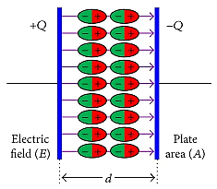
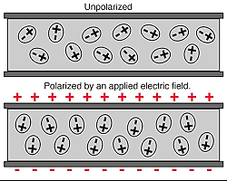
POLARIZATION
Polarization in dielectric materials involves the alignment of electric dipoles with an applied electric field, enhancing the material's charge storage capacity. This phenomenon is crucial for the functionality of capacitors and other electronic components. Parameters like permittivity quantify the material's responsiveness to polarization.

Slide 7
Electronic Polarization: Involves the displacement of electrons within atoms or molecules.
Ionic Polarization: Occurs in materials with ions, where positive and negative ions shift in opposite directions.
Orientational Polarization: Happens in materials with permanent dipoles, such as polar molecules, where these dipoles align with the electric field.
Space Charge Polarization: Arises from the movement of charge carriers within a material.

Slide 8
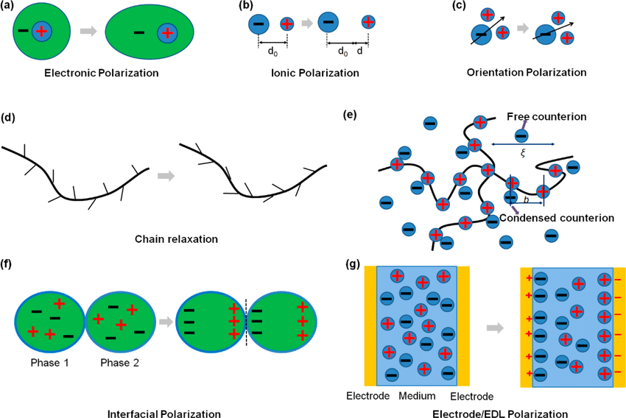

Slide 9
+---------------------------------------+----------------------------------------------------------------------------------+
| Advantages of Dielectric Polarization | Applications of Dielectric Polarization
+---------------------------------------+----------------------------------------------------------------------------------+
| Capacitor Functionality | Capacitors in Electronic Circuits
| Insulation and Electrical Safety | Electrical Insulation in Cables and Devices
| Energy Storage Devices | Supercapacitors for Rapid Energy Release
| Dielectric Heating | Microwave Ovens for Food Cooking and Heating
| Dielectric Resonators | Microwave and RF Antennas and Filters
+---------------------------------------+-----------------------------------------------------------------------------------+

Slide 10
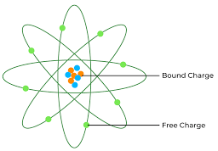
BOUND CHARGES
Bound charges refer to electric charges that are constrained or bound within the structure of a material, such as atoms or molecules. These charges are associated with the displacement of electrons within an atom or molecule in response to an external electric field.
Bound charges play a significant role in the polarization of the material.
When an external electric field is applied to a dielectric, the electrons in the atoms or molecules of the material are displaced, causing the material to become polarized.
This displacement of charges leads to the separation of positive and negative charges within the material.

Slide 11
There are two main types of bound charges:
Bound Positive Charges:
  These result from the displacement of positively charged atomic nuclei or ions toward one direction within a material.
Bound Negative Charges:
  These result from the displacement of negatively charged electrons toward the opposite direction within a material.

Slide 12
ELECTRIC DISPLACEMENT
Electric displacement is a vector field in electromagnetism that represents the ability of a dielectric material to support the formation of an electric field within it. It is denoted by the symbol D and is related to both free and bound charge distributions. Electric displacement accounts for the polarization of dielectric materials and is a key parameter in Maxwell's equations, describing how electric fields interact with materials.

