Slide 1
ENGINEERING SCIENCES
(BME 2105)
LECTURE 4 MODULE 1
Dinesh Kumar
Assistant Professor
School of Engineering

Slide 2
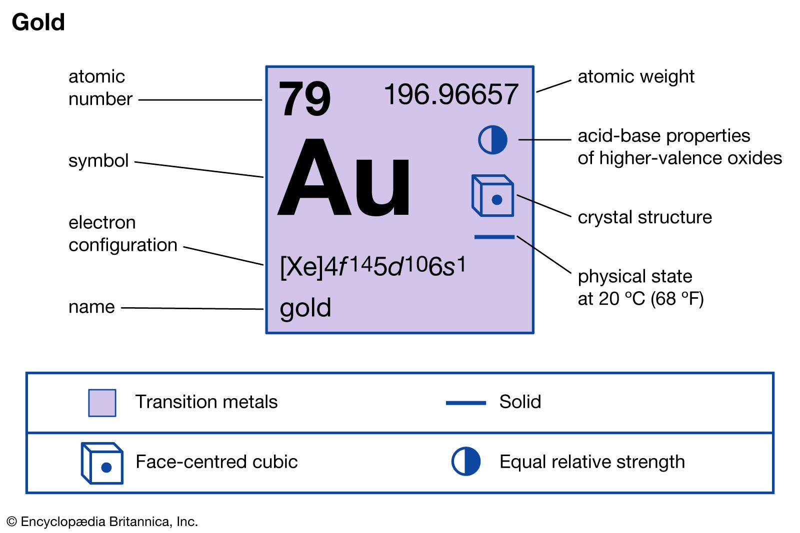
GOLD
Gold is one of the densest of all metals.
It is a good conductor of heat and electricity.
It is also soft and the most malleable and ductile of the elements
The tensile strength of gold is 120 Mpa.

Slide 3
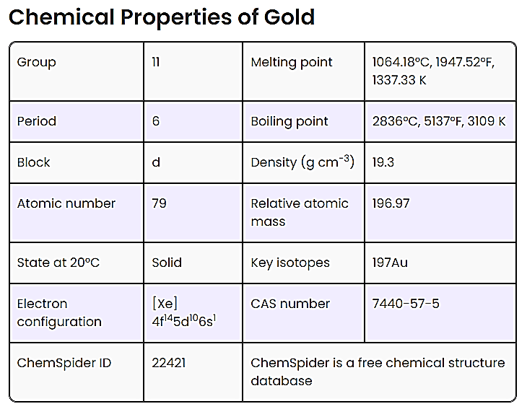

Slide 4
Hardness: Gold is relatively soft with a hardness range of 2.5 to 3 on the Mohs scale.
Malleability: Highly malleable; it can be hammered into sheets as thin as a few atoms.
Ductility: Highly ductile; can be drawn into wires over several kilometres from a single gram.
Density: High density with a specific gravity of around 19.3 g/cm³.
Melting Point: High melting point, approximately 1,947°C to 1,948°C (3,537°F to 3,538°F).
Conductivity: Good electrical conductivity, though not as high as some other metals.
Corrosion Resistance: Excellent resistance to corrosion.
Magnetic Properties: Non-magnetic.
Resilience: Resilient and maintains properties over time.

Slide 5
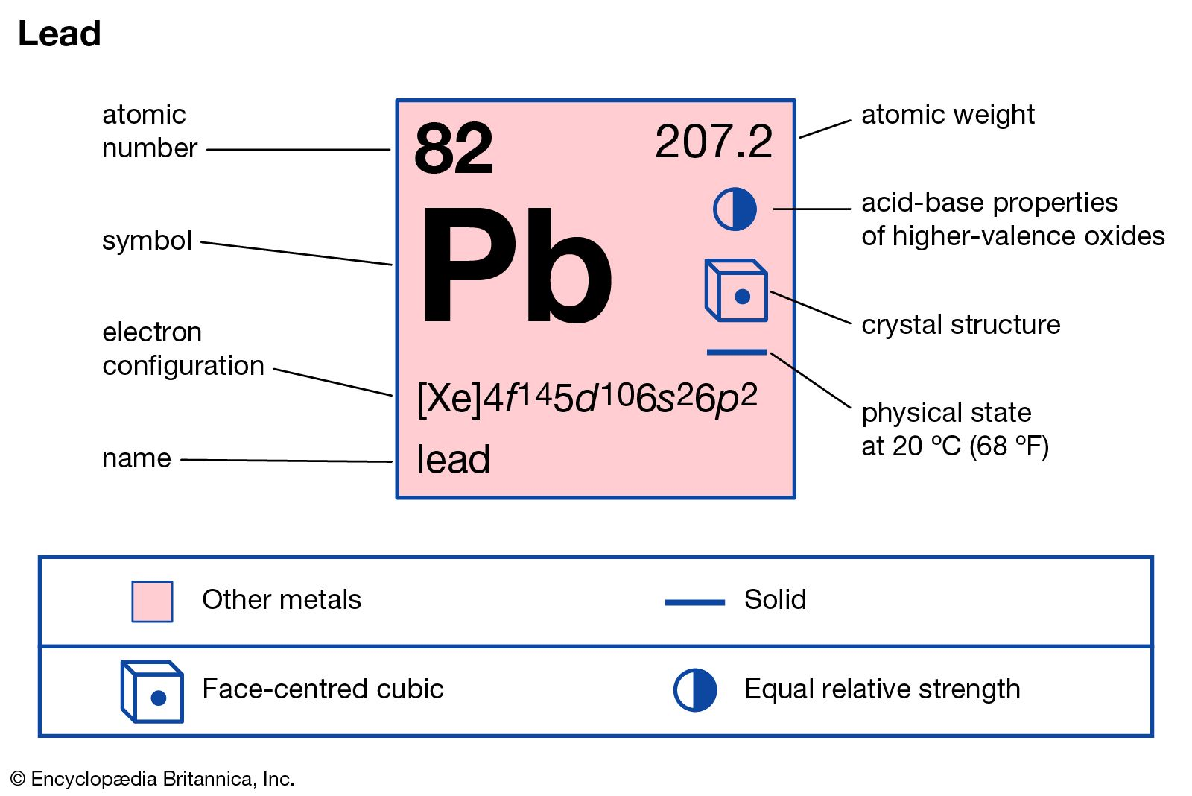
LEAD
  It is a bluish grey metal having specific gravity 11.36 and melting point 326°C
  It is so soft that it can be cut with a knife
  It is extensively used for making solders, as a lining for acid tanks, cisterns, water pipes, and as coating for electrical cables.
  The lead base alloys are employed where a cheap and corrosion resistant material is required
  An alloy containing 83% lead, 15% antimony, 1.5% tin and 0.5% copper is used for large bearings subjected to light service.

Slide 6
CHEMICALS USED IN THE AUTOMOTIVE INDUSTRY

Slide 7
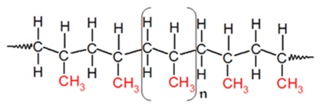
POLYPROPYLENE
Polypropylene (PP) is a tough, rigid, and crystalline thermoplastic. It is made from propene (or propylene) monomer. This linear hydrocarbon resin is the lightest polymer among all commodity plastics.
Polypropylene (PP) is a type of polyolefin that is slightly harder than polyethylene. It is a commodity plastic with low density and high heat resistance. Its chemical formula is (C₃H₆)n.

Slide 8
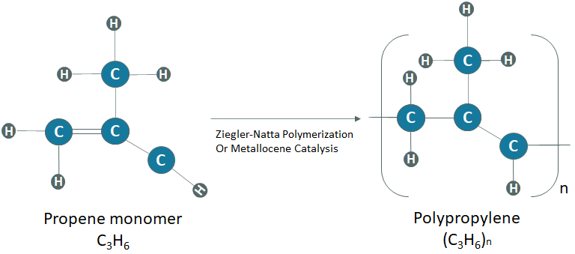

Slide 9
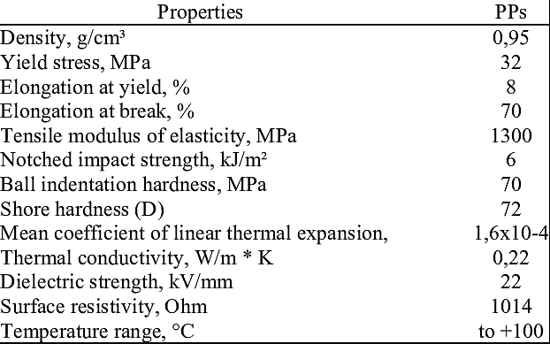

Slide 10
Mechanism Of Ziegler–Natta Catalyst
Polymerisation usually takes place by the insertion of monomers where the transition metal ions are attached to the end of the growing chain. The incoming monomers are simultaneously coordinated at vacant orbital sites, and there is a formation of long polymer chains.

Slide 11


Slide 12
POLYURETHANE
Polyurethane is a versatile material made by mixing chemicals to create a strong and flexible substance.
It can be found in various forms, from soft and cushiony to rigid and tough, making it suitable for a wide range of applications.
Its durability, resistance to chemicals and moisture, and flexibility make it valuable in industries such as furniture, automotive, insulation, and more.
Most polyurethanes do not melt upon heating and can, therefore, be classified as thermosetting polymers.

Slide 13
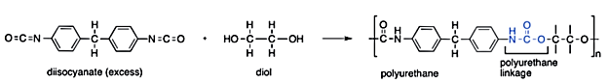
PREPARATION OF POLYURETHANE
They can be prepared via the chemical reactions between diisocyanates (that contain at least two isocyanate groups per molecule) and polyols (that contain at least two hydroxyl groups per molecule). These reactions usually require the presence of a catalyst or some ultraviolet light in order to overcome the activation energy barrier.

Slide 14
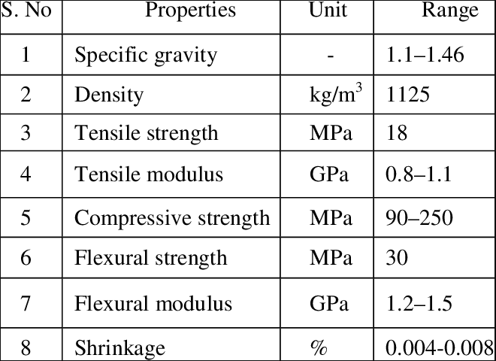

Slide 15
PROPERTIES OF POLYURETHANE
if the polyol chain (which is used as a raw material for the preparation of the polyurethane) is long and flexible, the final product will be soft and elastic.
On the other hand, if the extent of cross-linking is very high, the final polyurethane product will be tough and rigid.
This structure also accounts for the thermosetting nature of the polymer, since polyurethane typically does not soften or melt when exposed to heat.

Slide 16
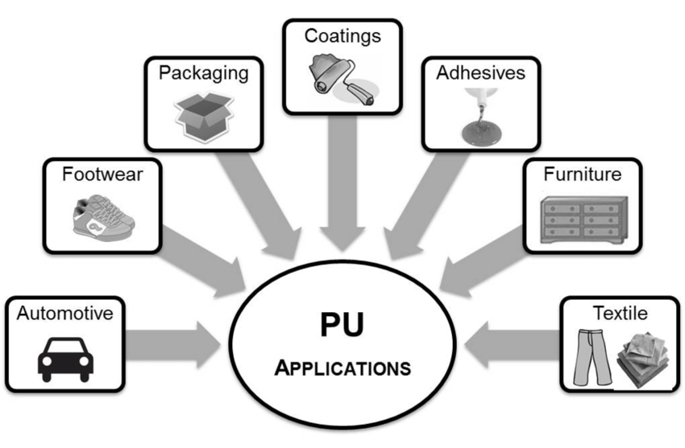
APPLICATIONS OF POLYURETHANE

