Slide 1
ENGINEERING SCIENCES
(BME 2105)
LECTURE 5 MODULE 1
Dinesh Kumar
Assistant Professor
School of Engineering

Slide 2
ACRYLONITRILE BUTADIENE STYRENE (ABS)
Acrylonitrile butadiene styrene (ABS) is a thermoplastic polymer made from three monomers: acrylonitrile, butadiene, and styrene. It's strong, durable, and impact-resistant. ABS is used to make light, rigid, molded products such as:
Pipe
Automotive body parts
Wheel covers
Enclosures
Protective head gear

Slide 3
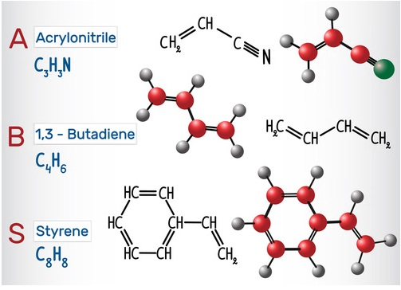
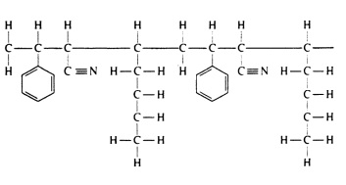
MOLECULAR STRUCTURE OF
ACRYLONITRILE BUTADIENE STYRENE

Slide 4
PROPERTIES OF ABS
High rigidity, good weldability, and insulating properties
Good impact resistance, even at low temperatures
Good abrasion and strain resistance
High dimensional stability (Mechanically strong and stable over time)
High surface brightness and excellent surface aspect

Slide 5
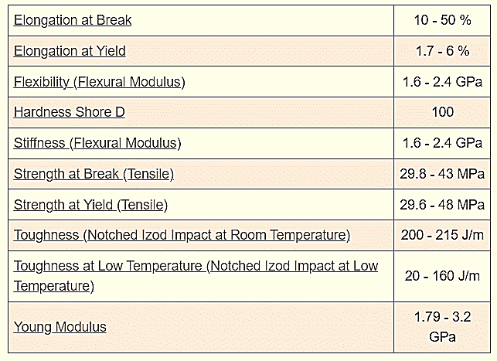

Slide 6
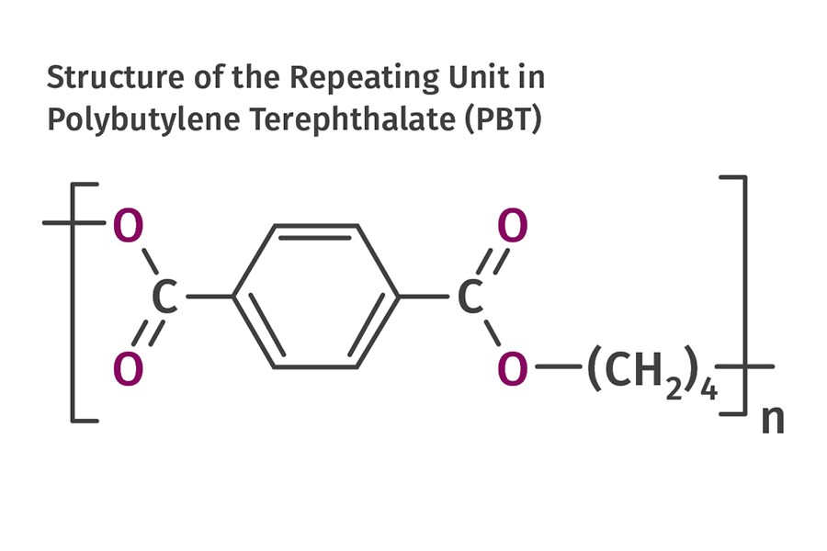
POLYBUTYLENE TEREPHTHALATE (PBT)
Polybutylene terephthalate (PBT) is a semi-crystalline engineering thermoplastic material. It's a member of the polyester family of polymers. PBT is produced by the polymerization of butanediol and terephthalic acid.

Slide 7
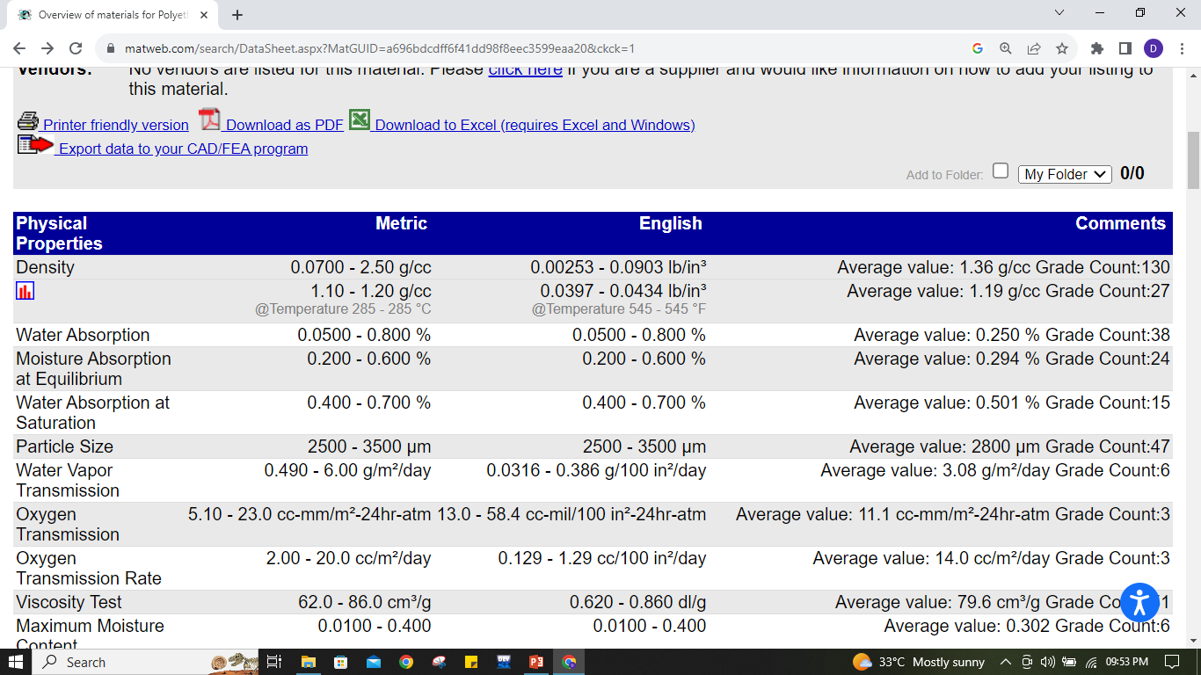
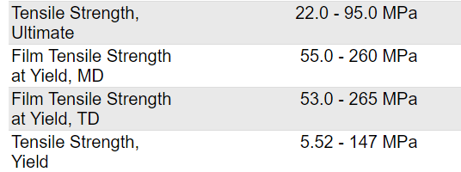

Slide 8
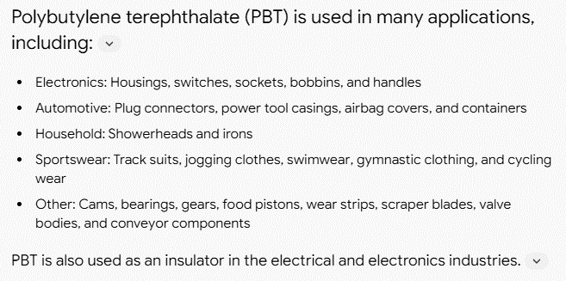

Slide 9
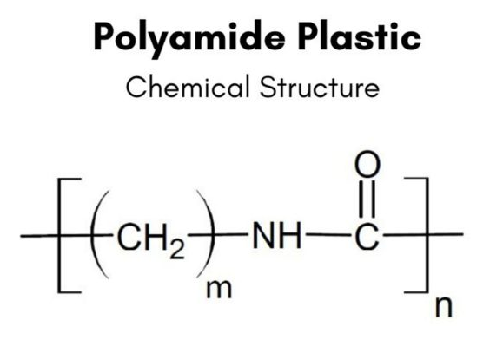
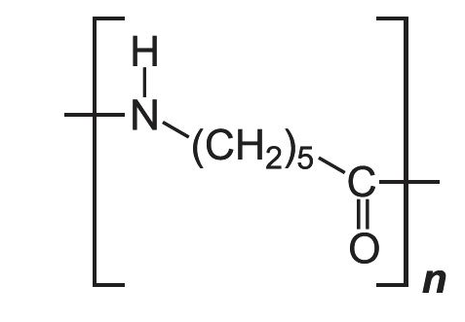
POLYAMIDES
Polyamides are among the most important and useful technical thermoplastics due to their outstanding wear resistance, good coefficient of friction, and very good temperature and impact propertiess

Slide 10
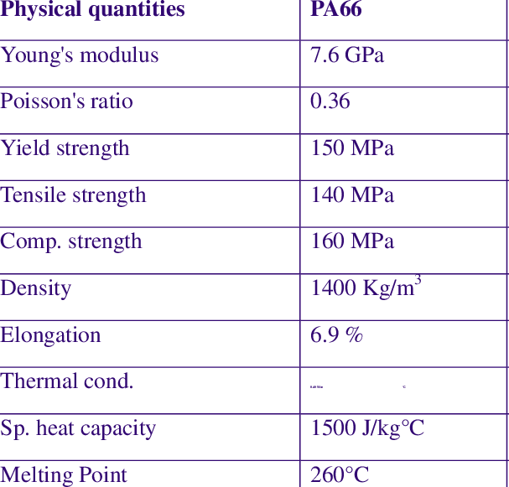

Slide 11
