Slide 1
ENGINEERING SCIENCES
(BME 2105)
LECTURE 9 MODULE 2
Dinesh Kumar
Assistant Professor
School of Engineering

Slide 2
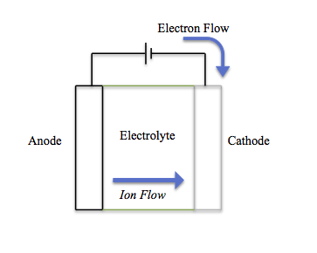
EV BATTERY CHEMISTRY AND ITS IMPACT ON THE ELECTRONICS INDUSTRY
A battery is a device that stores chemical energy and converts it into electrical energy. It typically consists of one or more electrochemical cells, each of which comprises positive and negative terminals (anode and cathode) separated by an electrolyte. When the battery is connected to an external circuit, a chemical reaction occurs within the cell, generating electrons that flow through the circuit, producing electricity.

Slide 3
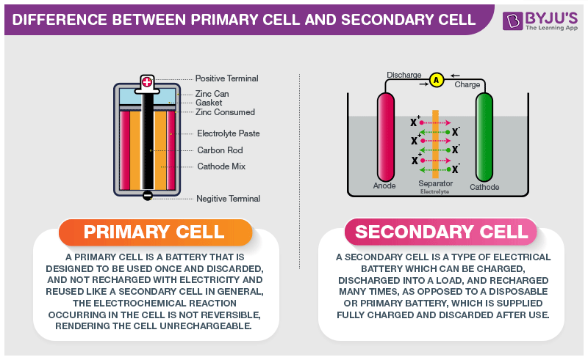

Slide 4
CLASSIFICAITION
1. Chemical Composition:
Lithium-ion Batteries: Widely used in portable electronics, EVs, and renewable energy storage systems due to their high energy density.
Lead-Acid Batteries: Commonly used in automotive applications and backup power systems.
Nickel-Metal Hydride (NiMH) Batteries: Found in older-generation rechargeable batteries for devices like digital cameras and power tools.
Alkaline Batteries: Often used in household devices and toys; they are non-rechargeable.
Lithium Polymer Batteries: Similar to Li-ion batteries but with a different electrolyte, found in various consumer electronics.

Slide 5
2. Application-Based Classification:
Automotive Batteries: Specifically designed for vehicles, including lead-acid, nickel-metal hydride, and lithium-ion batteries.
Portable Electronics Batteries: Compact and lightweight batteries for devices like smartphones, laptops, tablets, and wearables.
Industrial Batteries: Designed for heavy-duty applications, such as forklifts, renewable energy storage, and backup power systems.

Slide 6
3. Rechargeable vs. Non-Rechargeable:
Rechargeable Batteries: Can be recharged multiple times, such as lithium-ion, lead-acid (in certain cases), nickel-metal hydride batteries.
Non-Rechargeable Batteries: Designed for single-use applications, like alkaline batteries and certain types of lithium batteries.
4. Construction:
Cylindrical Batteries: Common in many household applications and electronics.
Pouch/Prismatic Batteries: Thin and flexible, often used in smartphones, tablets, and other slim devices.
Button Cell Batteries: Small and flat, commonly used in watches, calculators, and small medical devices.

Slide 7
PRIMARY BATTERY WORKING
In an alkaline battery, the chemical reaction occurs between manganese dioxide (MnO2), zinc powder, and potassium hydroxide (KOH) electrolyte. Here's the basic reaction that takes place:
At the cathode (positive terminal): 2MnO₂ + 2H₂O + 2e⁻ → Mn₂O₃ + 2OH⁻
At the anode (negative terminal): Zn + 2OH⁻ → ZnO + H₂O + 2e⁻
Overall reaction: 2MnO₂ + Zn + 2H₂O → Mn₂O₃ + ZnO + 2H₂O

Slide 8
This chemical reaction results in the production of electrons at the anode and the absorption of these electrons at the cathode. The flow of electrons from the anode to the cathode through an external circuit creates an electrical current, which can power devices connected to the battery.
As the reaction progresses, the reactants (such as zinc and manganese dioxide) are consumed and transformed into different chemical compounds (like zinc oxide and manganese oxide). Eventually, when the reactants are fully depleted, the battery no longer produces a sufficient voltage or current and is considered dead or discharged. Since this chemical reaction is not reversible, primary batteries cannot be recharged for reuse.

Slide 9
SECONDARY BATTERY WORKING
In a Li-ion battery, the reaction occurs between lithium cobalt oxide (LiCoO2) at the cathode and graphite carbon at the anode, separated by an electrolyte containing lithium salts.
During discharging (when the battery is in use), the following reactions take place:
At the cathode (positive terminal): LiCoO₂ → Li⁺ + CoO₂ + e⁻
At the anode (negative terminal): LiC₆ + e⁻ → Li + C₆
Overall reaction: LiCoO₂ + C₆ → LiC₆ + CoO₂

Slide 10
SECONDARY BATTERY WORKING
When the battery is charged, the reactions occur in the opposite direction. Lithium ions move from the positive electrode (cathode) through the electrolyte to the negative electrode (anode), where they are stored in the layers of graphite carbon. Electrons are released in this process and flow through the external circuit, powering the device. Meanwhile, at the cathode, lithium ions and electrons recombine to form lithium cobalt oxide, storing energy.
During charging, the reactions are reversed:
At the cathode (LiCoO₂): Li⁺ + CoO₂ → LiCoO₂ + e⁻
At the anode (LiC₆): Li + C₆ → LiC₆ + e⁻
Overall reaction (during charging): LiC₆ + CoO₂ → LiCoO₂ + C₆

