Slide 1
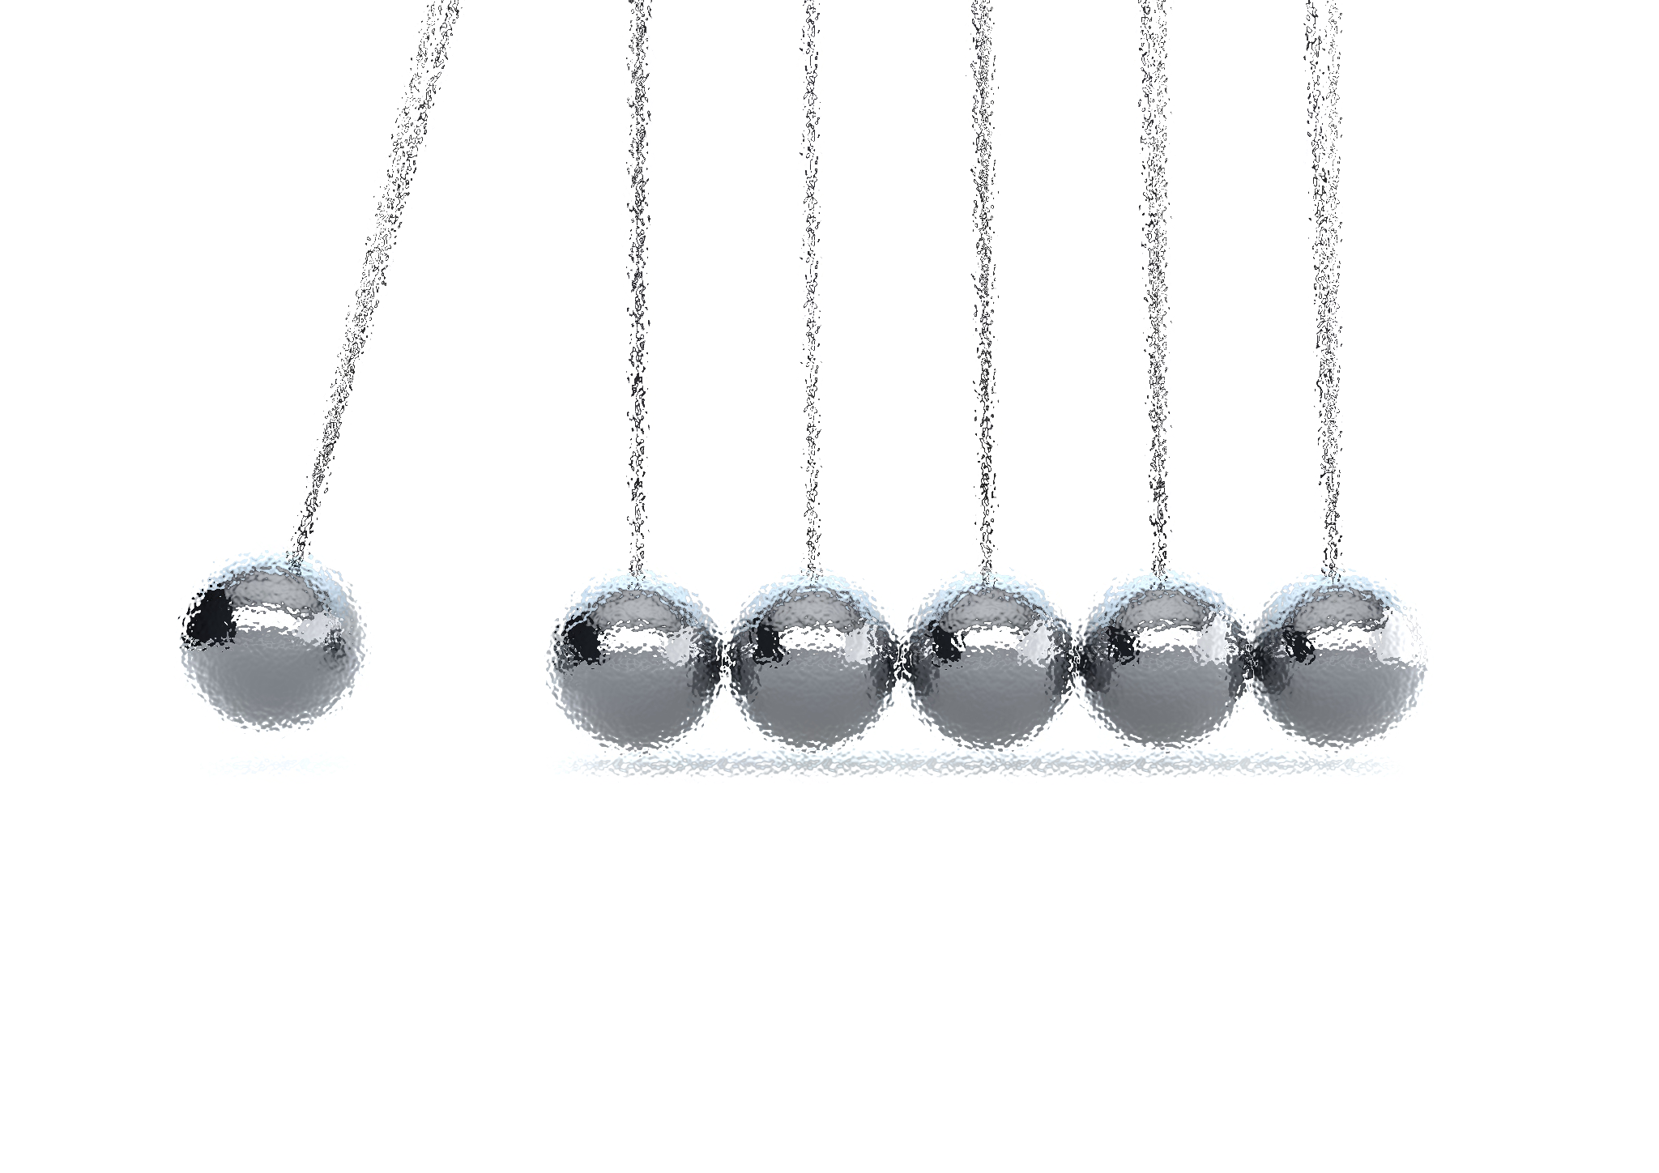
NOISE VIBRATION AND HARSHNESS
LECTURE 1 MODULE 1
Prepared By:
Dinesh Kumar
Assistant Professor
School of Continuing Education
DYPIU

Slide 2
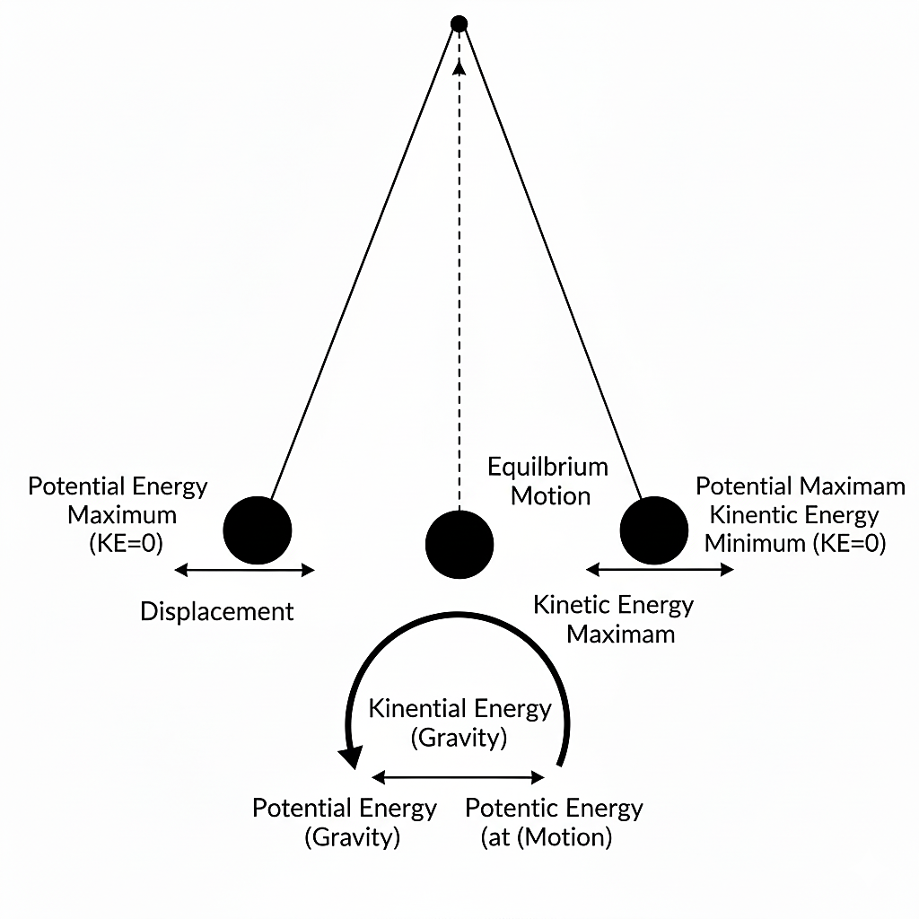

INTRODUCTION
Definition: Vibration is the oscillatory motion of a body or system about an equilibrium position.
The Physics: It involves the transfer of potential energy (spring) to kinetic energy (mass) and back.
Requirement: Any system possessing Mass (inertia) and Elasticity (stiffness) is capable of vibrating.

Slide 3
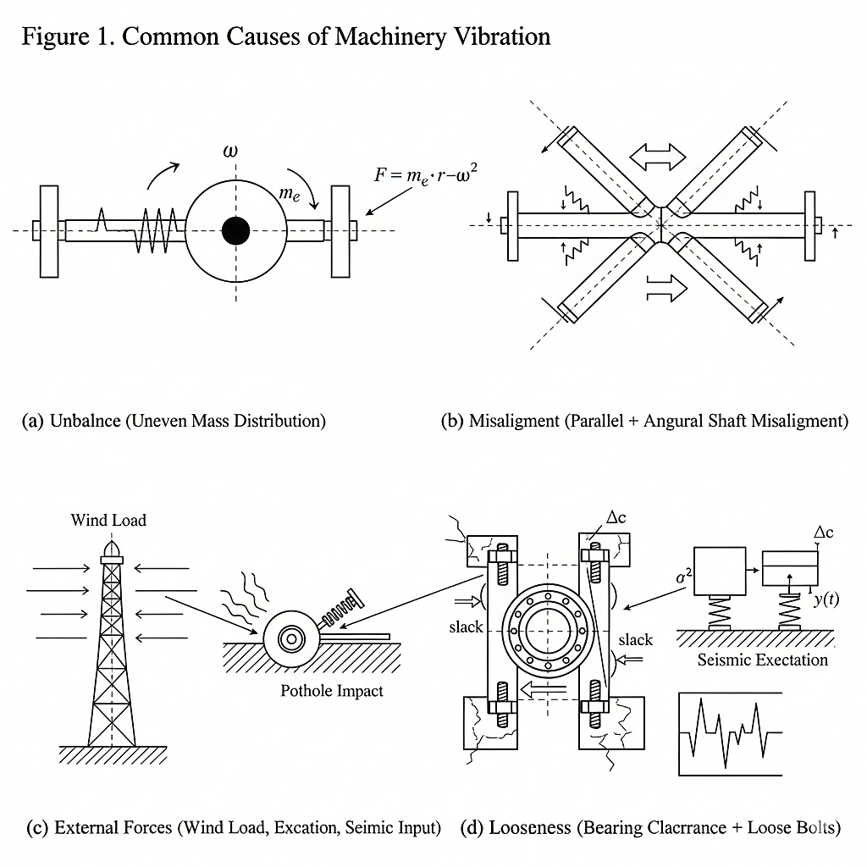
CAUSES OF VIBRATION
Unbalance: Uneven mass distribution in rotating machinery (e.g., car tires, turbine rotors).
Misalignment: Shafts not centred properly.
External Forces: Wind loads, road irregularities (potholes), seismic waves.
Looseness: Worn-out bearings or loose bolts.

Slide 4
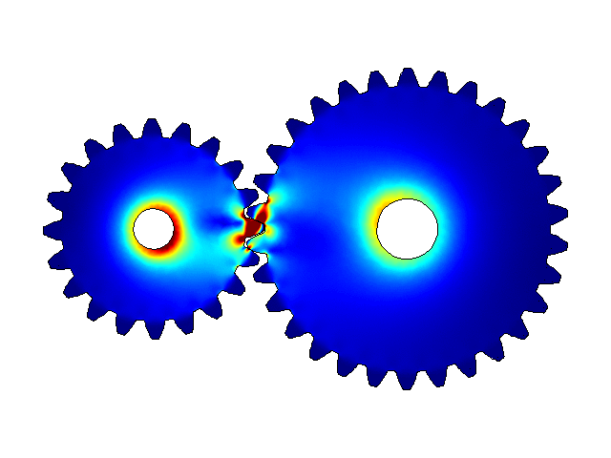
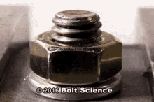
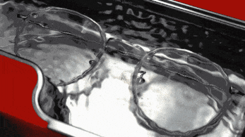

EFFECTS OF VIBRATION (THE GOOD & THE BAD)
Undesirable Effects (The "Noise & Harshness"):
Structural fatigue and failure (cracks).
Wear of gears and bearings.
Human discomfort (NVH issues in vehicles).
Loss of precision in machining.
Desirable Applications:
Musical instruments (Guitar strings).
Vibrating screens/conveyors (Sorting materials).
Ultrasonic cleaning.

Slide 5
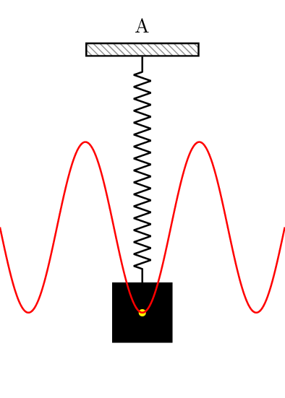
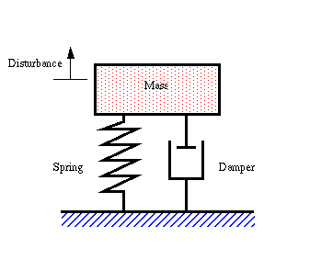
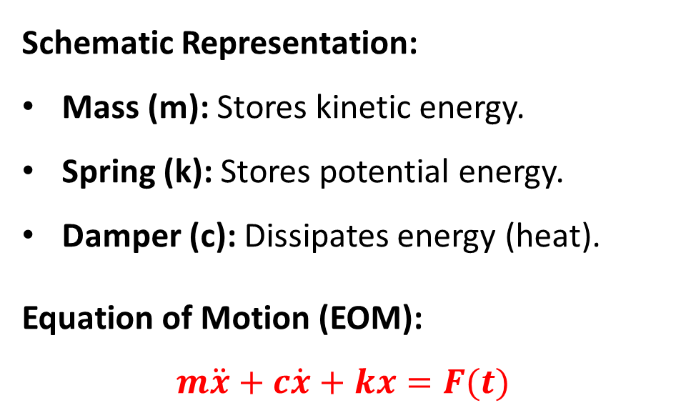
THE SIMPLEST MODEL (SPRING-MASS-DAMPER)
Schematic Representation:
Mass (m): Stores kinetic energy.
Spring (k): Stores potential energy.
Damper (c): Dissipates energy (heat).
Equation of Motion (EOM):
$$m\ddot{x}+c\dot{x}+kx=F(t)$$
Undamped Vibrations
Damped Vibrations

Slide 6
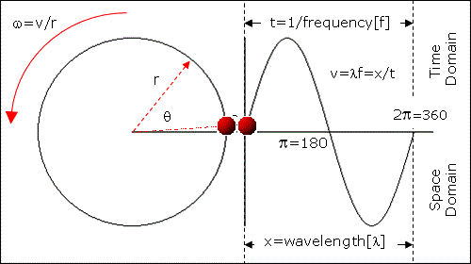
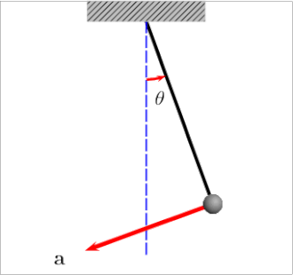
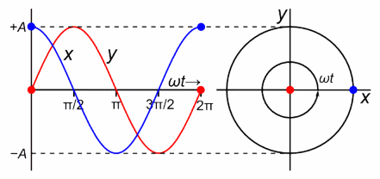
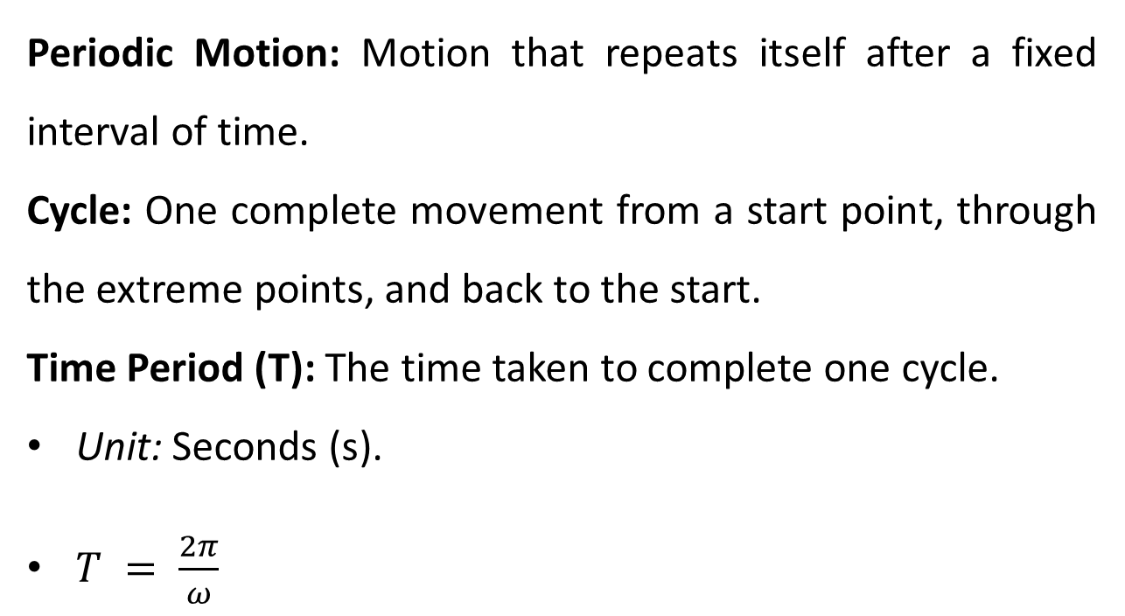
BASIC TERMINOLOGY
Periodic Motion: Motion that repeats itself after a fixed interval of time.
Cycle: One complete movement from a start point, through the extreme points, and back to the start.
Time Period (T): The time taken to complete one cycle.
Unit: Seconds (s).
$T = \frac{2π}{ω}$

Slide 7
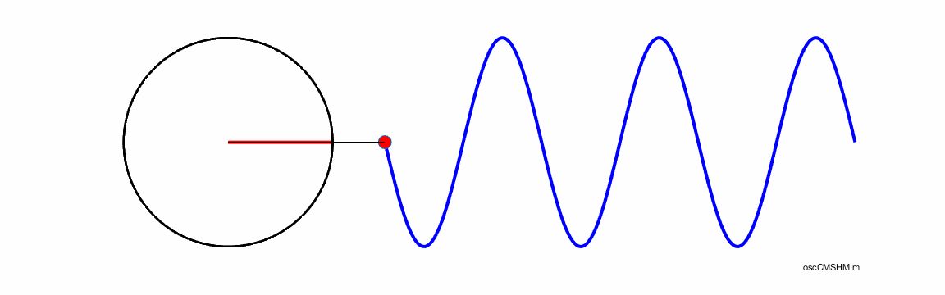
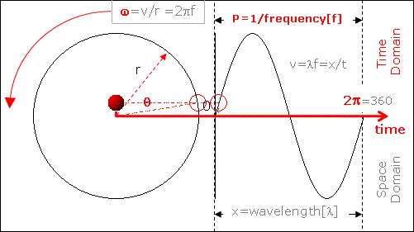
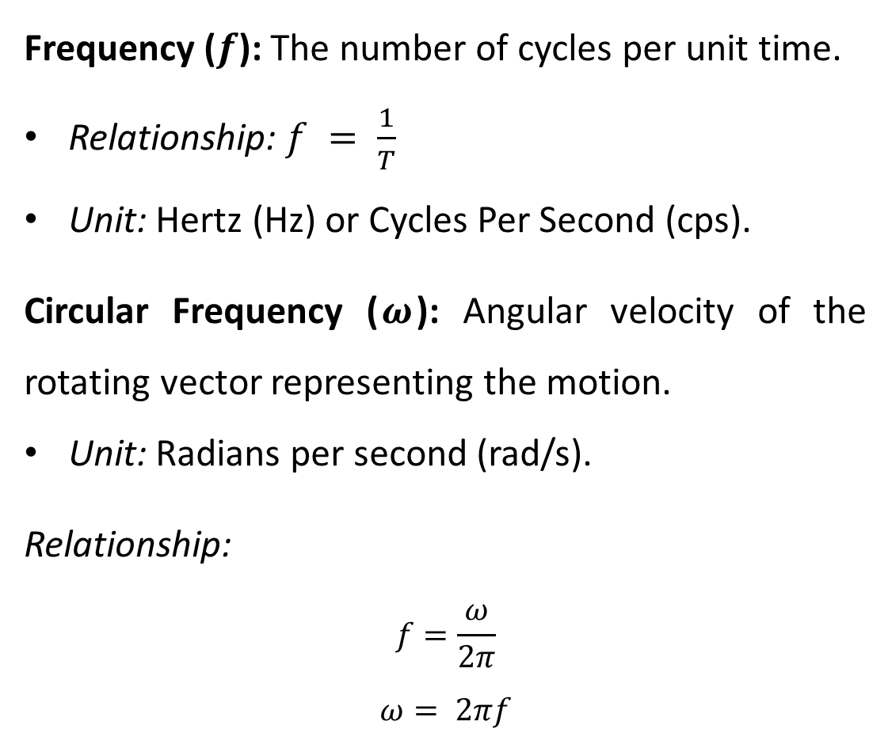
BASIC TERMINOLOGY- FREQUENCY
Frequency ($f$): The number of cycles per unit time.
Relationship: $f = \frac{1}{T}$
Unit: Hertz (Hz) or Cycles Per Second (cps).
Circular Frequency ($ω$): Angular velocity of the rotating vector representing the motion.
Unit: Radians per second (rad/s).
Relationship:
$$f=\frac{ω}{2π}$$
$$ω= 2πf$$

