Slide 1

NOISE VIBRATION AND HARSHNESS
LECTURE 10 MODULE 1
Prepared By:
Dinesh Kumar
Assistant Professor
School of Continuing Education
DYPIU

Slide 2
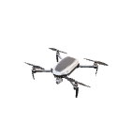
TRANSMISSIBILITY AND ISOLATION

