Slide 1

NOISE VIBRATION AND HARSHNESS
LECTURE 2 MODULE 1
Prepared By:
Dinesh Kumar
Assistant Professor
School of Continuing Education
DYPIU

Slide 2
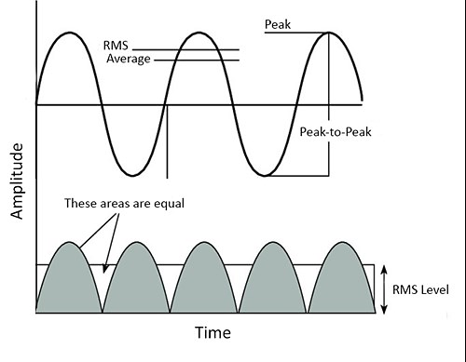
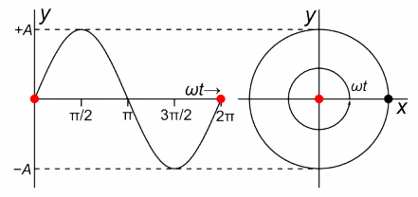

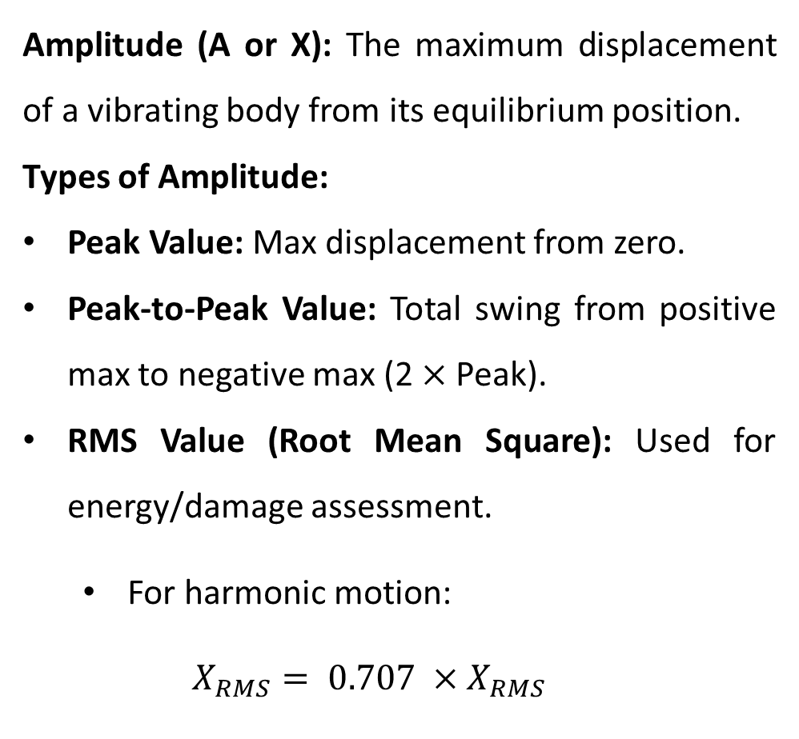
BASIC TERMINOLOGY- AMPLITUDE
Amplitude (A or X): The maximum displacement of a vibrating body from its equilibrium position.
Types of Amplitude:
Peak Value: Max displacement from zero.
Peak-to-Peak Value: Total swing from positive max to negative max (2 $×$ Peak).
RMS Value (Root Mean Square): Used for energy/damage assessment.
  For harmonic motion:
  $$X_{RMS}= 0.707 ×X_{RMS}$$

Slide 3
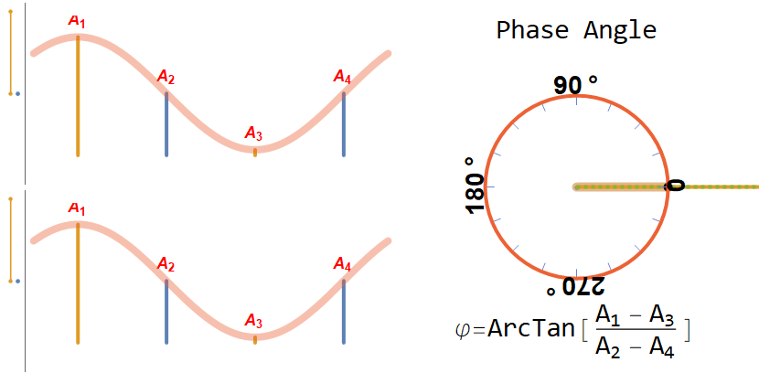

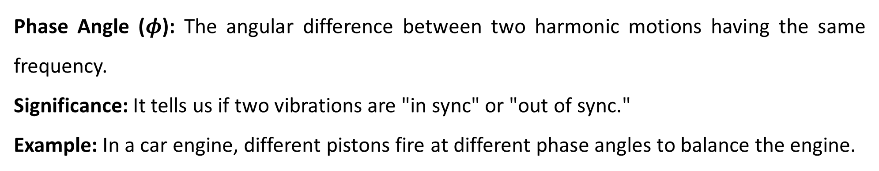
BASIC TERMINOLOGY- PHASE
Phase Angle ($φ$): The angular difference between two harmonic motions having the same frequency.
Significance: It tells us if two vibrations are "in sync" or "out of sync."
Example: In a car engine, different pistons fire at different phase angles to balance the engine.

Slide 4
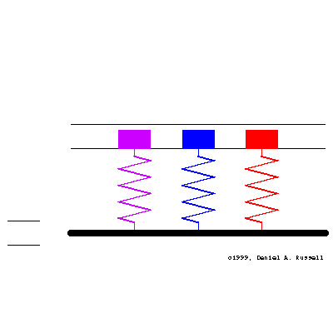
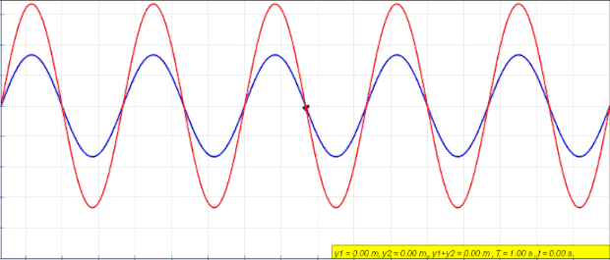
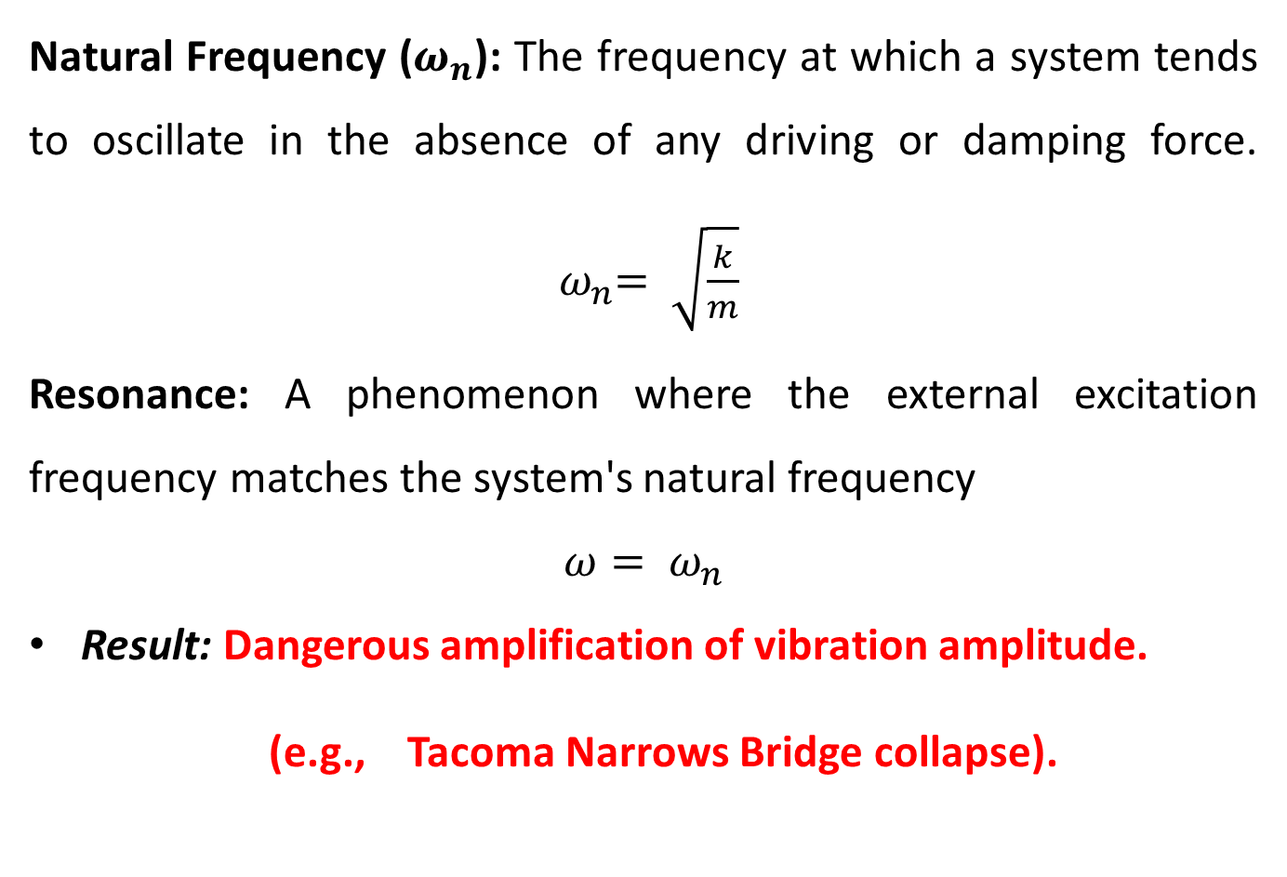
BASIC TERMINOLOGY- NATURAL FREQUENCY AND RESONANCE
Natural Frequency ($ω_{n}$): The frequency at which a system tends to oscillate in the absence of any driving or damping force. ${ ω}_{n}= \sqrt{\frac{k}{m}}$
Resonance: A phenomenon where the external excitation frequency matches the system's natural frequency
$$ω= ω_{n}$$
Result: Dangerous amplification of vibration amplitude.
(e.g., Tacoma Narrows Bridge collapse).

Slide 5
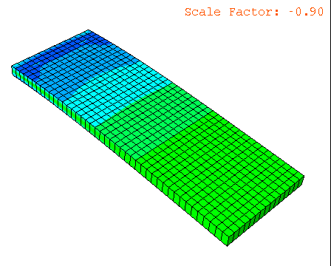
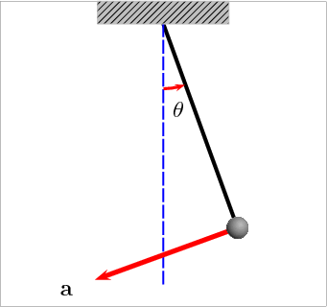
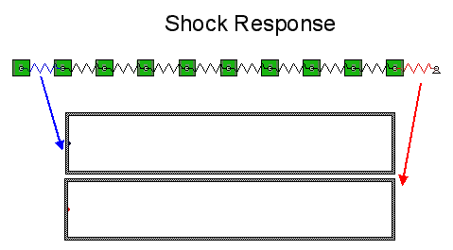
BASIC TERMINOLOGY- DEGREE OF FREEDOM (DOF)
Definition: The minimum number of independent coordinates required to determine completely the positions of all parts of a system.
SDOF (Single Degree of Freedom): One coordinate (e.g., simple pendulum).
MDOF (Multi-Degree of Freedom): Multiple coordinates (e.g., a car suspension with chassis and wheel motion).
Continuous System: Infinite DOF (e.g., a cantilever beam).

Slide 6
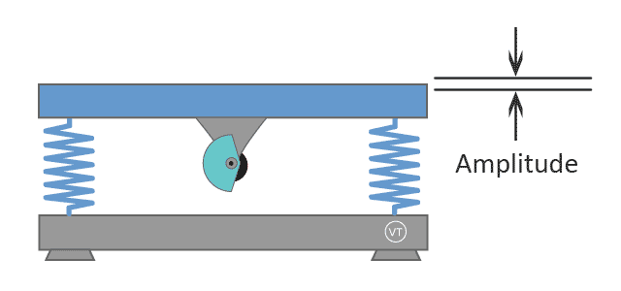
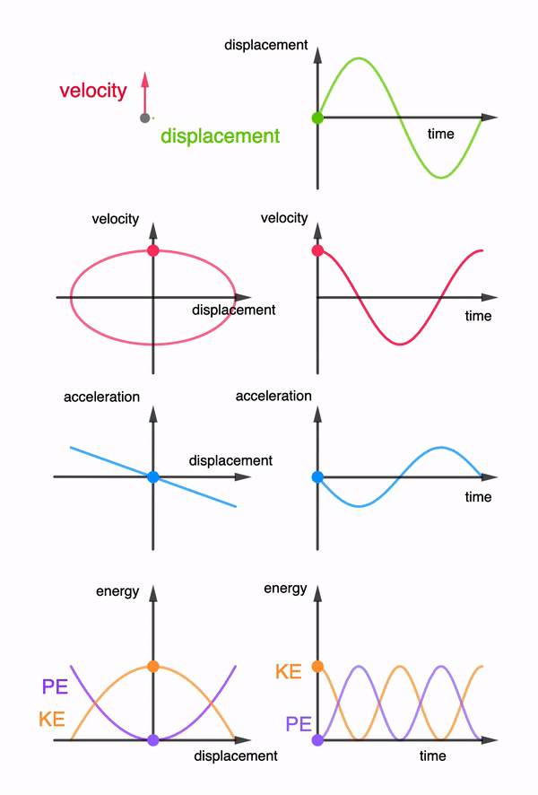
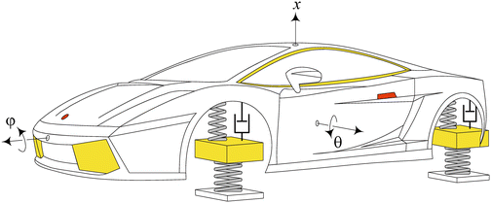
VIBRATIONS BASICS AND APPLICATION

Slide 7
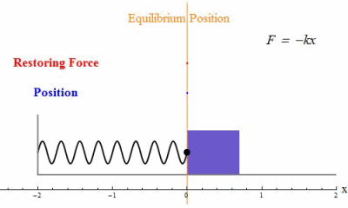
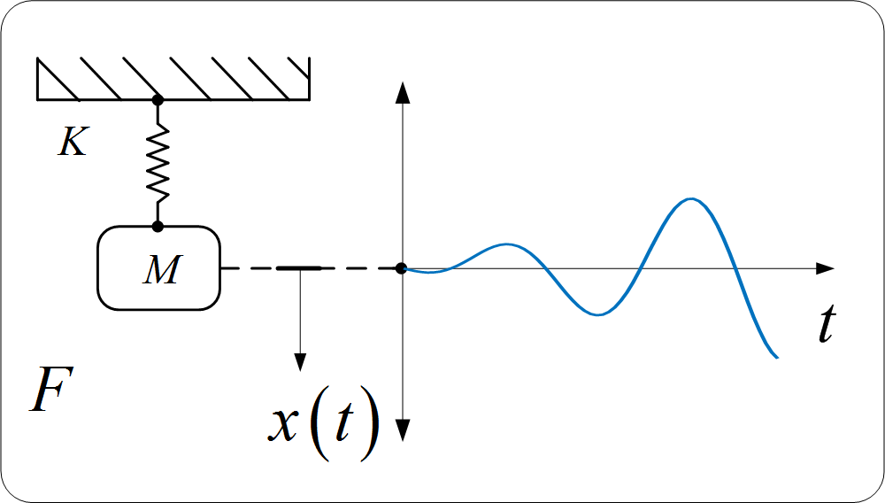

CLASSIFICATION OF VIBRATIONS – BASED ON FORCE
Free Vibration:
Vibration caused by an initial disturbance (displacement or velocity) with no external force acting afterward.
Example: Plucking a guitar string.
Forced Vibration:
Vibration driven by a continuous external force.
Example: Vibration of a washing machine while running.

Slide 8
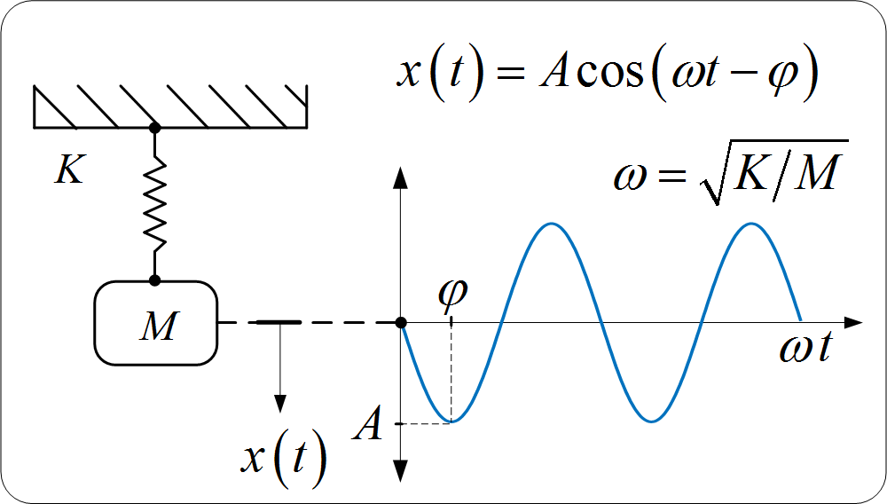
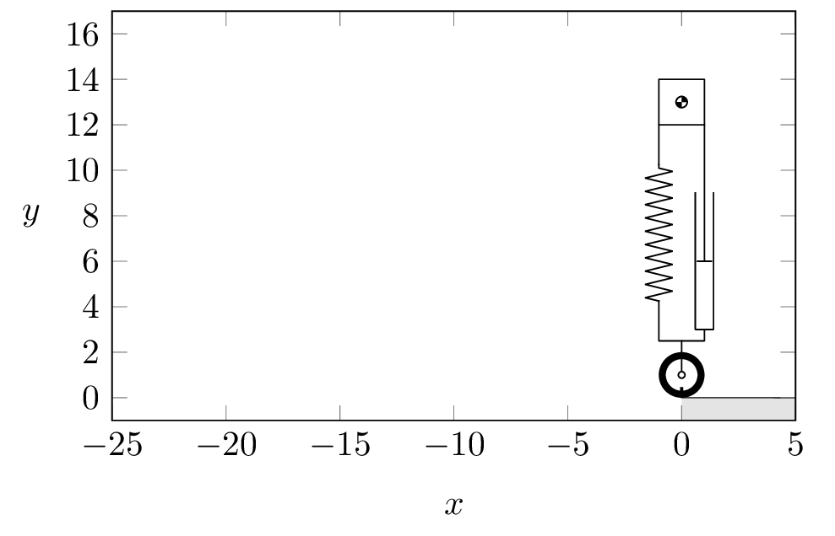
CLASSIFICATION OF VIBRATIONS – BASED ON DAMPING
Undamped Vibration:
No energy is lost; the system oscillates indefinitely (Theoretical).
Example: Ideal spring-mass in a vacuum.
Damped Vibration:
Energy is dissipated due to friction or fluid resistance; amplitude decreases over time.
Example: Car suspension with shock absorbers.

Slide 9
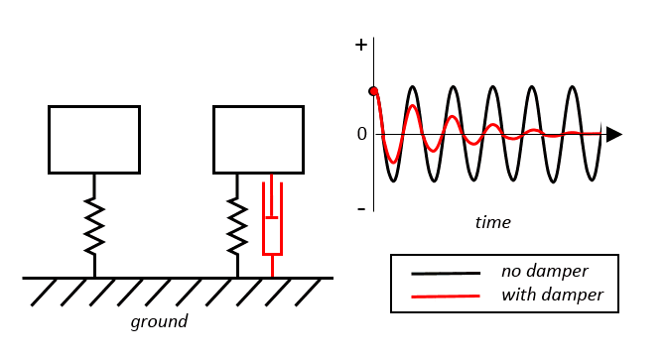
UNDAMPED VS DAMPED VIBRATIONS

Slide 10
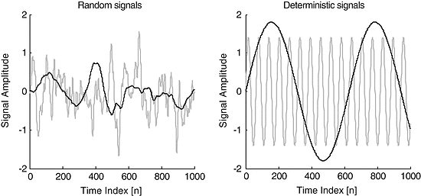
CLASSIFICATION OF VIBRATIONS – BASED ON DETERMINACY
Deterministic Vibration:
The value of vibration (magnitude) is known at any given time t.
Example: Sine wave, rotating unbalance.
Random Vibration:
The value cannot be predicted precisely; described statistically.
Example: A car driving over a rough road; wind gusts on a building.

Slide 11
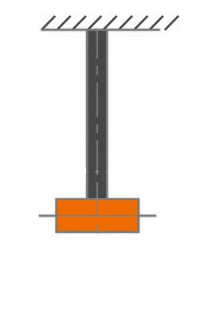
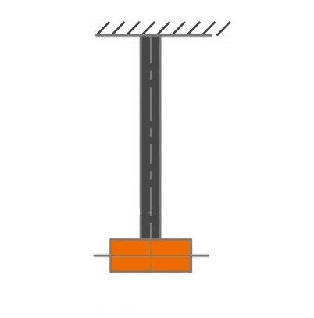
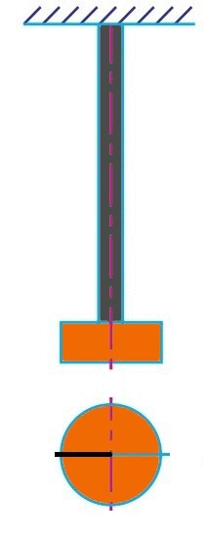
CLASSIFICATION OF VIBRATIONS – BASED ON STRESS DIRECTION
Longitudinal Vibration: Particles move parallel to the axis of the shaft (compression/extension).
Transverse Vibration: Particles move perpendicular to the axis (bending).
Torsional Vibration: Particles rotate/twist around the axis.
Critical in: Crankshafts and drive shafts.
LONGITUDINAL VIBRATION
TRANSVERSE VIBRATION
TORSIAONAL VIBRATION

