Slide 1
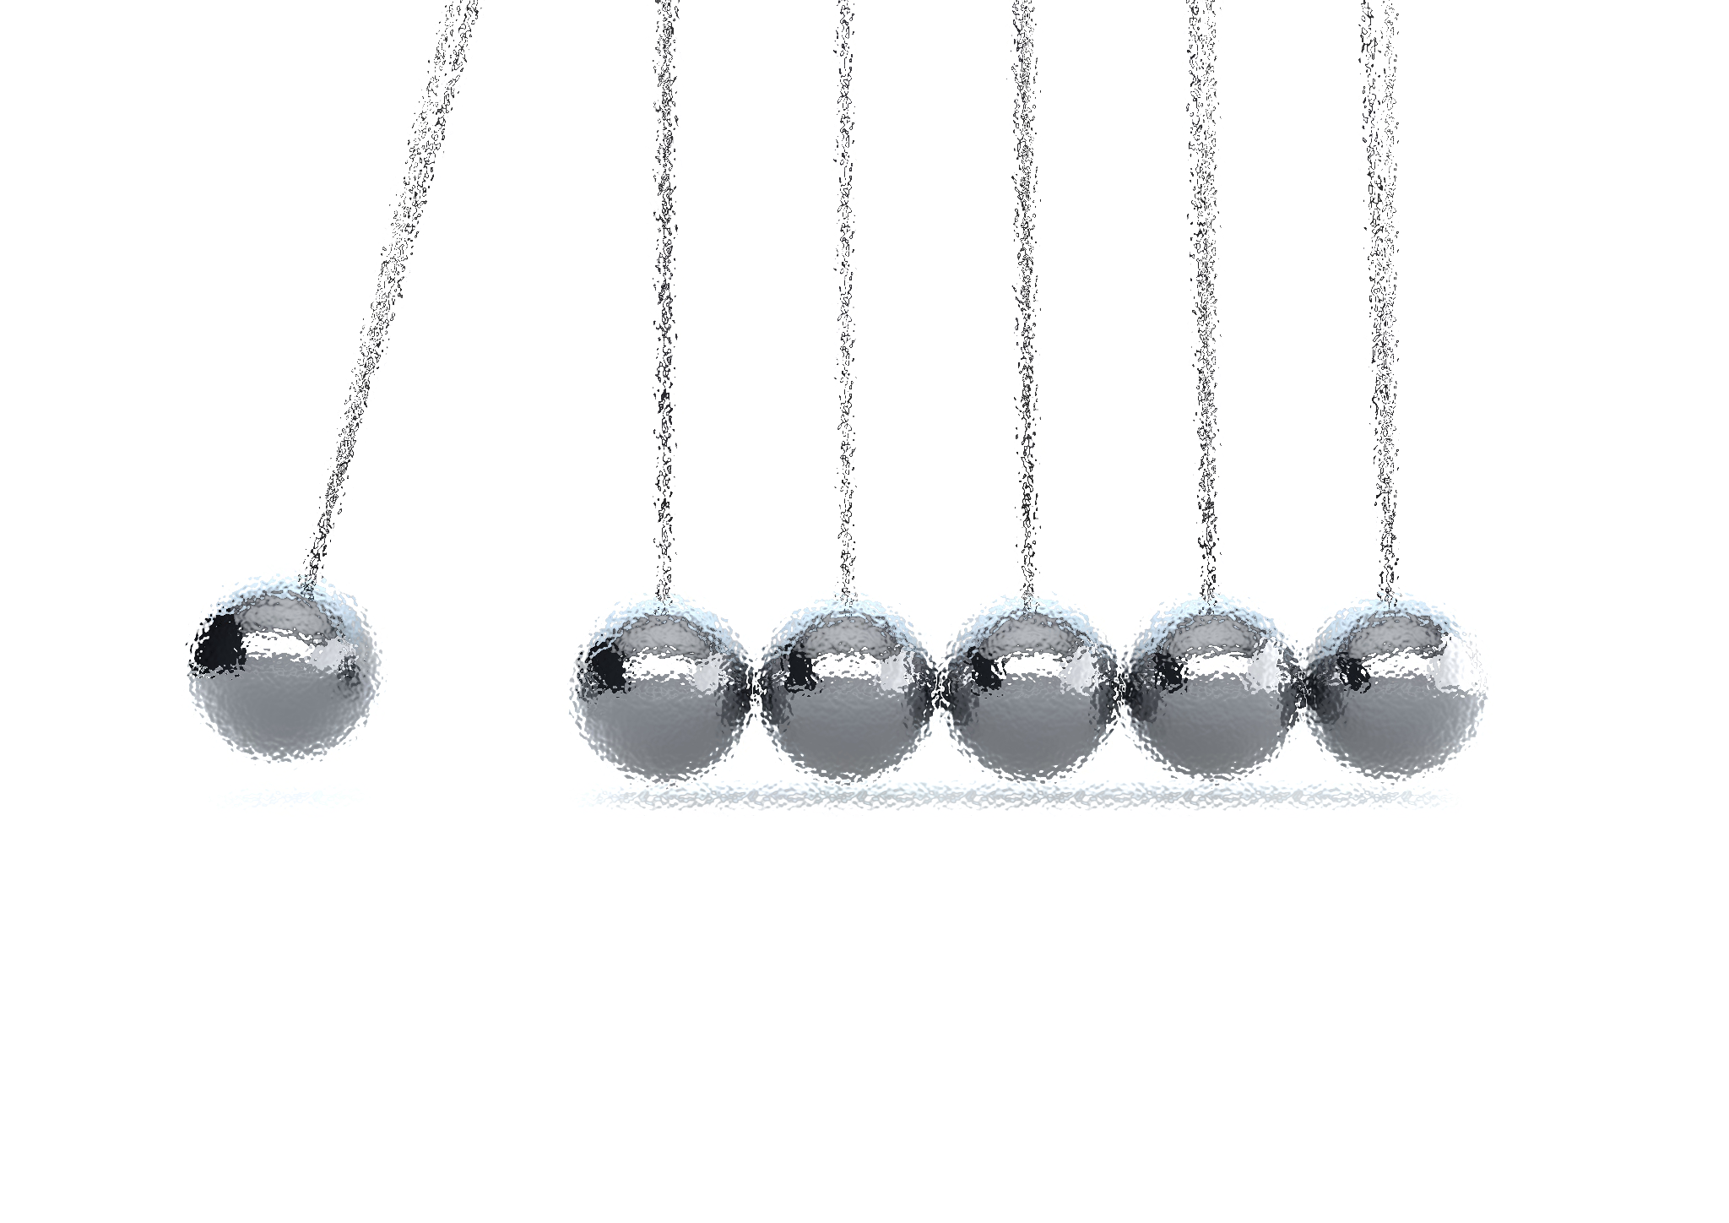
NOISE VIBRATION AND HARSHNESS
LECTURE 3 MODULE 1
Prepared By:
Dinesh Kumar
Assistant Professor
School of Continuing Education
DYPIU

Slide 2
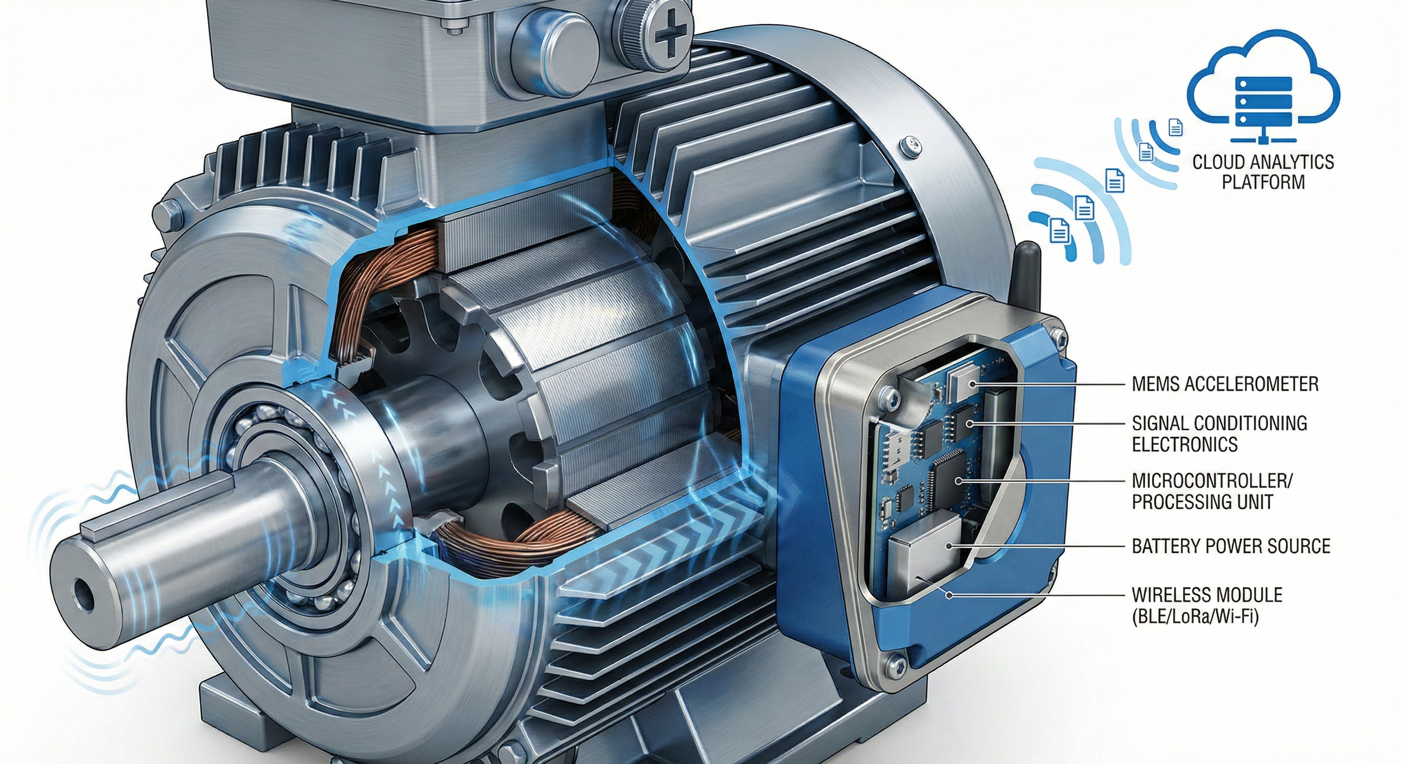

RELEVANCE OF VIBRATION IN SMART MANUFACTURING
Machine Health Monitoring & Part Quality Improvement
Smart Factories (Industry 4.0) depend on high precision
Vibration is both a problem and a powerful diagnostic tool
Lecture Focus:
✔ Machine condition monitoring
✔ Product quality assurance
✔ Predictive maintenance

Slide 3
WHY VIBRATION MATTERS IN MANUFACTURING
Vibration = Key Indicator of Machine Behavior
Definition:
Vibration is the repetitive oscillation of machine parts about an equilibrium position.
In Smart Manufacturing:
Machines run at high speed
Even small vibrations affect accuracy
Vibration carries hidden fault information
Main Causes:
Unbalance in rotating parts
Shaft misalignment
Bearing wear
Gear defects
Cutting tool chatter
Core Idea:
Vibration tells us how healthy a machine is.

Slide 4
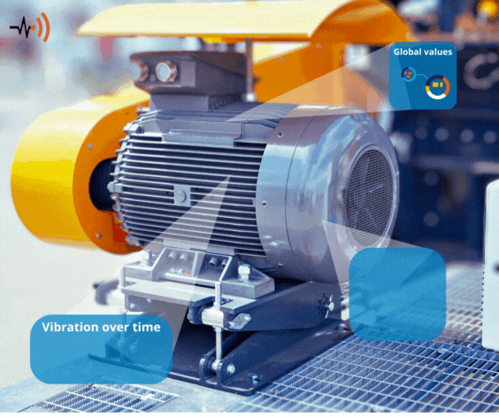
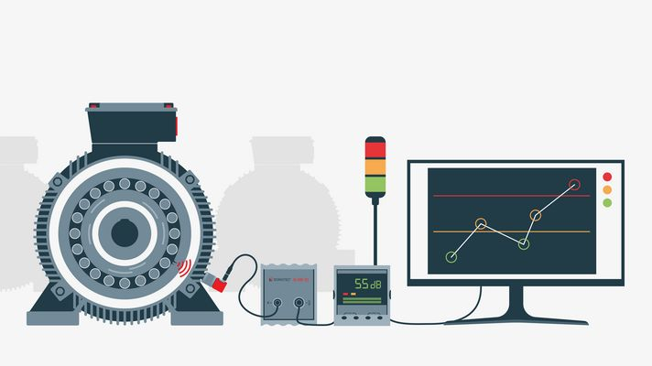
CLASSIFICATION OF VIBRATIONS – BASED ON STRESS DIRECTION

Slide 5
VIBRATION AS A MACHINE HEALTH SIGNAL
Machine Health Monitoring (Condition Monitoring)
Vibration analysis helps detect faults before failure occurs.
Common Faults Identified:
Bearing damage
Gear tooth wear
Loose bolts and joints
Rotor imbalance
Motor defects
Why It’s Critical:
Faults grow silently over time
Vibration provides early warning signals
Outcome:
✔ Prevent breakdowns
✔ Extend machine life

Slide 6
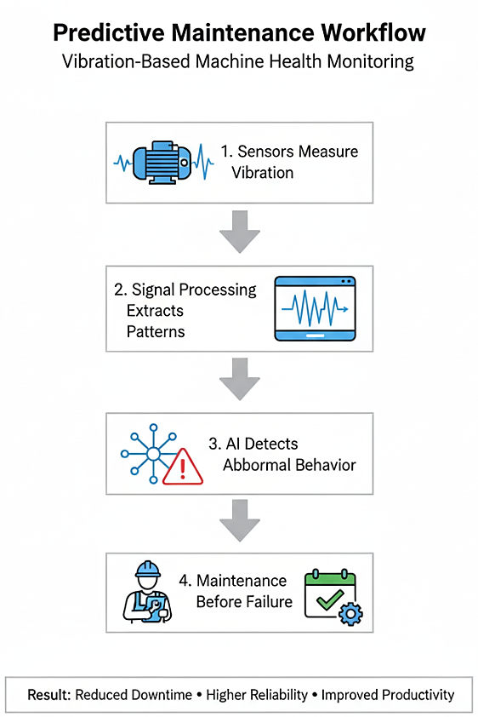
PREDICTIVE MAINTENANCE IN SMART FACTORIES
From Reactive to Intelligent Maintenance
Traditional Maintenance:
Fix after breakdown
Scheduled servicing (even if unnecessary)
Smart Manufacturing Maintenance:
Condition-based
Predictive using vibration data
Benefits:
Reduced downtime
Lower cost
Higher reliability

Slide 7
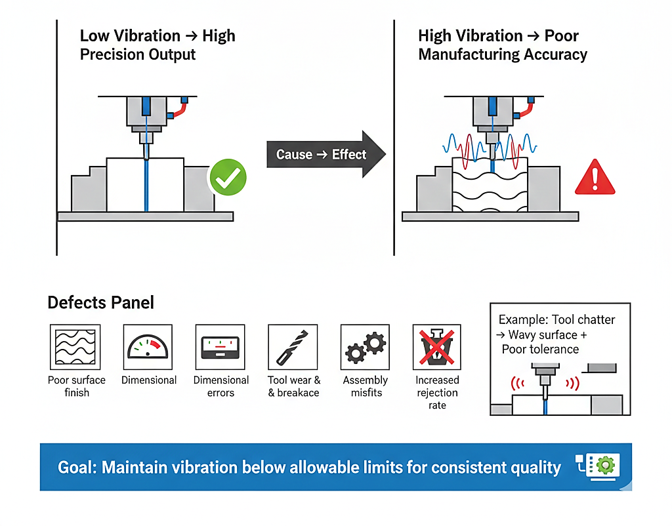
VIBRATION IMPACT ON PART QUALITY
Quality Depends on Stable Machine Operation
Excess vibration directly affects manufacturing accuracy.
Quality Problems Caused:
Poor surface finish
Dimensional errors
Tool wear and breakage
Assembly misfits
Increased rejection rate

Slide 8
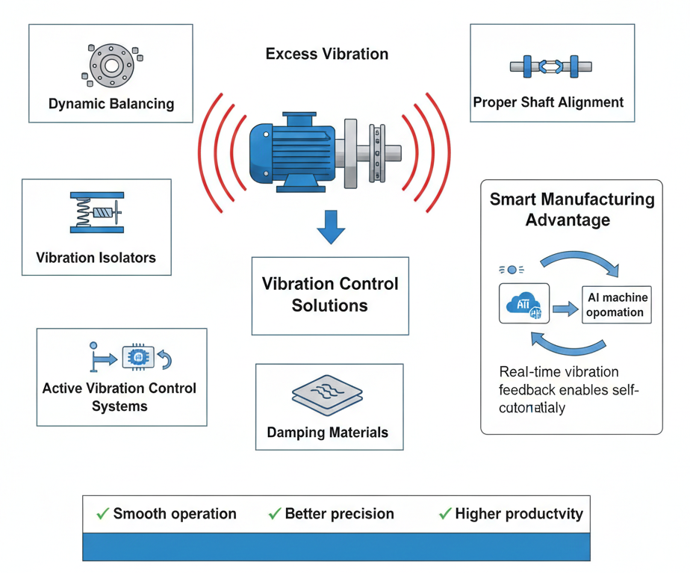
VIBRATION CONTROL FOR BETTER PRODUCTION
Smart Factories Must Control Vibration
Engineering Solutions:
Dynamic balancing
Proper shaft alignment
Vibration isolators
Damping materials
Active vibration control systems
Smart Manufacturing Advantage:
Real-time vibration feedback allows machines to self-correct.

Slide 9
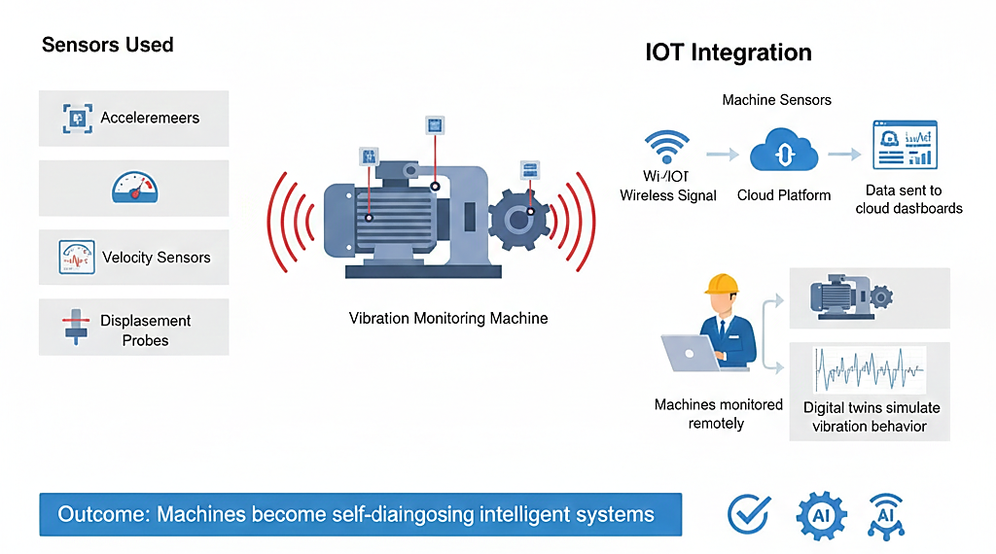
ROLE OF SENSORS + IOT IN SMART MANUFACTURING
Connected Vibration Monitoring Systems
Sensors Used:
Accelerometers
Velocity sensors
Displacement probes
IoT Integration:
Data sent to cloud dashboards
Machines monitored remotely
Digital twins simulate vibration behaviour
Outcome:
Machines become self-diagnosing intelligent systems.

Slide 10
KEYS POINTS TO REMEMBER
Vibration is unavoidable but measurable
It is the most powerful indicator of machine condition
Monitoring vibration prevents failures (predictive maintenance)
Controlling vibration ensures part quality
Smart manufacturing uses IoT + AI for vibration-based intelligence
Final Statement:
Vibration analysis is a foundation of Industry 4.0 and smart production.

Slide 11
ELEMENTS OF A VIBRATORY SYSTEM (INTRODUCTION)
What is a Vibratory System?
A vibratory system is a mechanical system that undergoes oscillatory motion about an equilibrium position when subjected to a disturbance.
In mechanical vibration theory, the simplest and most fundamental model is the Single Degree of Freedom (SDOF) system, consisting of three basic elements:
Mass element (m)
Spring element (k)
Damping element (c)
These elements together determine how a system vibrates, how energy is stored, and how vibration decays with time.

Slide 12
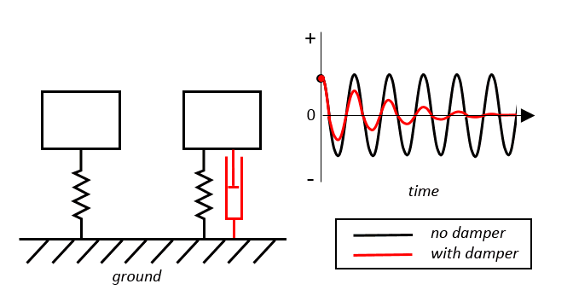
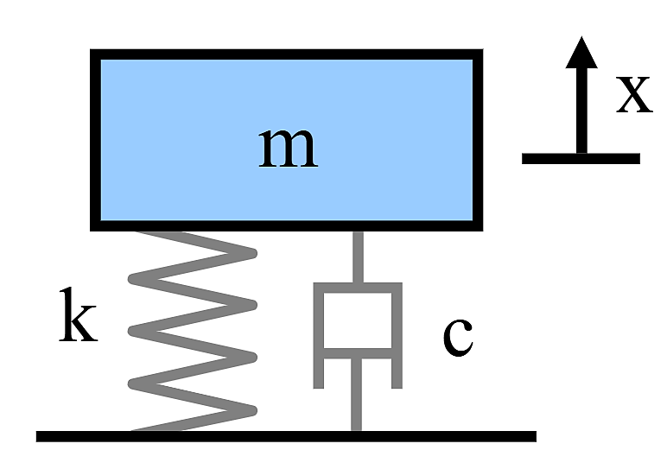
WHY THESE ELEMENTS ARE IMPORTANT
They form the foundation of vibration modeling
Almost all real mechanical systems can be approximated using these components
Used to derive natural frequency, damping ratio, and response behavior

Slide 13
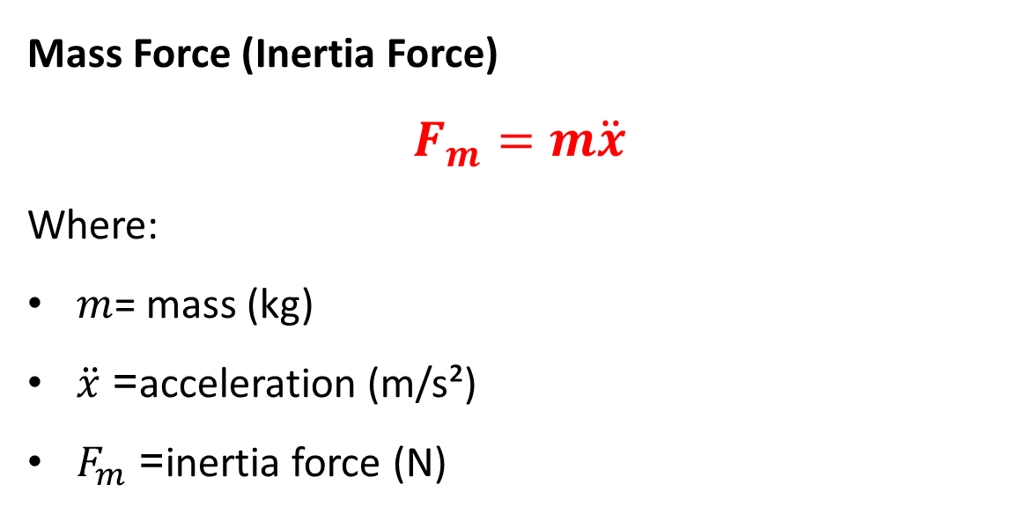
MASS ELEMENT (M): INERTIA COMPONENT
Definition
The mass element represents the inertia of the system. It resists any change in motion due to Newton’s second law.
Mass Force (Inertia Force)
$$F_{m}=m\ddot{x}$$
Where:
$m$= mass (kg)
$\ddot{x}$= acceleration (m/s²)
$F_{m}$= inertia force (N)
Physical Concept
Mass stores kinetic energy
It does not generate restoring force
Larger mass → slower vibration response

Slide 14
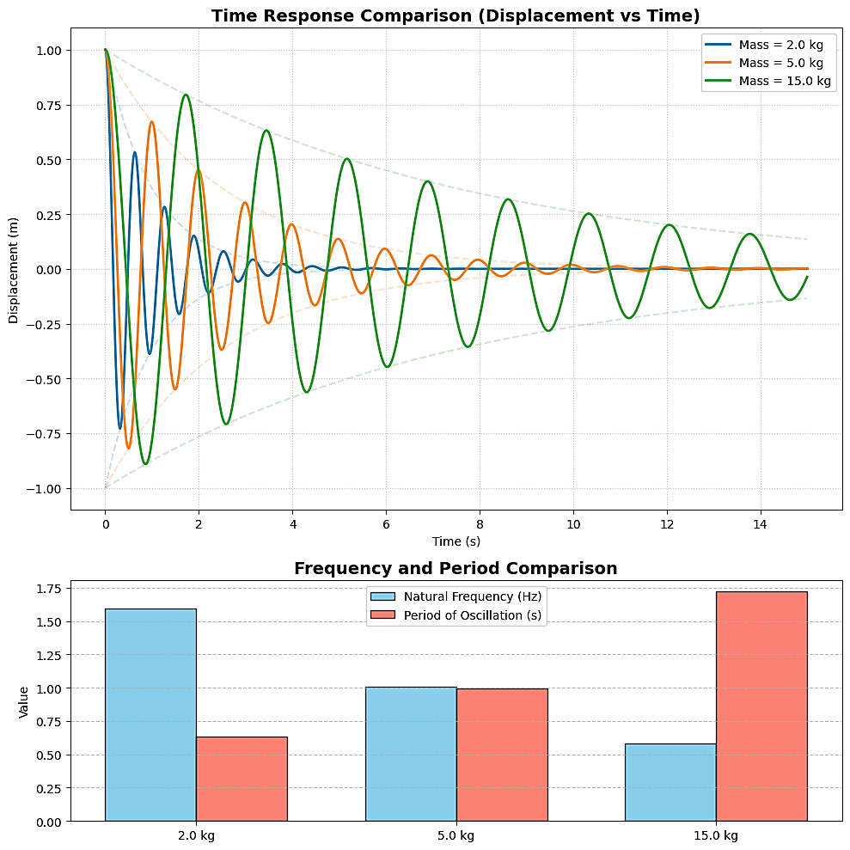

MASS ELEMENT (M): INERTIA COMPONENT
Energy Stored in Mass
$$T=\frac{1}{2}m{\dot{x}}^{2}$$
Mass contributes to the dynamic nature of vibration by opposing acceleration.

Slide 15
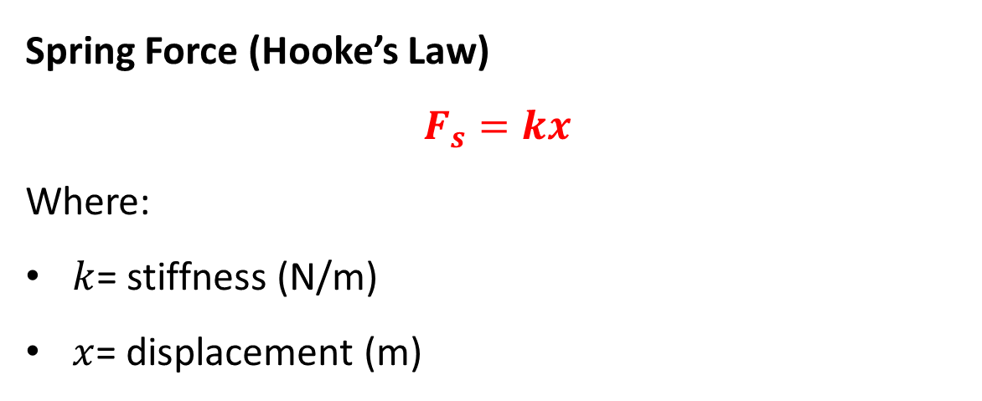
SPRING ELEMENT (K): ELASTIC RESTORING COMPONENT
Definition
The spring element represents stiffness or elasticity of the system. When displaced, it produces a restoring force that attempts to bring the system back to equilibrium.
Spring Force (Hooke’s Law)
$$F_{s}=kx$$
Where:
$k$= stiffness (N/m)
$x$= displacement (m)
Physical Concept
Spring stores potential energy
Higher stiffness → faster vibration (higher frequency)
Determines the system’s natural frequency

Slide 16
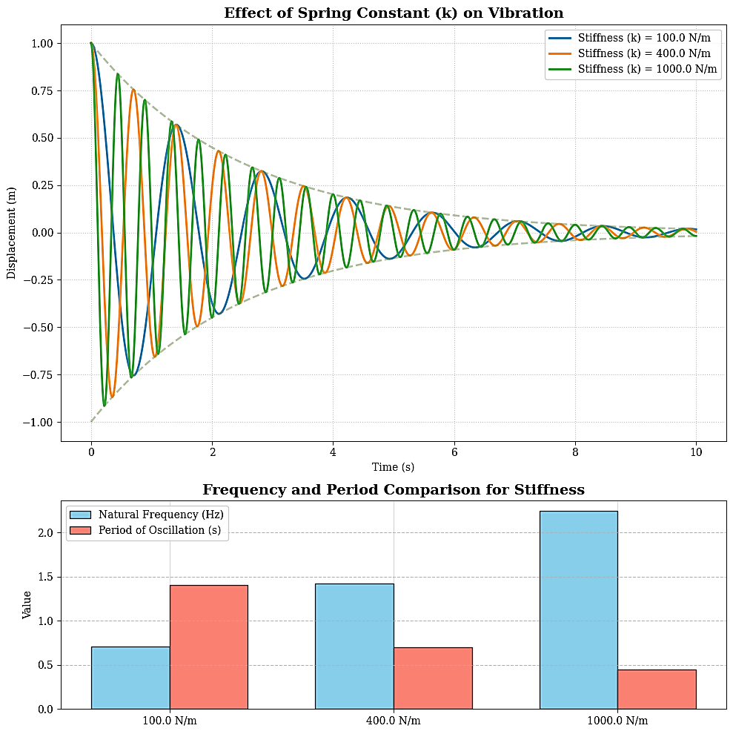

SPRING ELEMENT (K): ELASTIC RESTORING COMPONENT
Energy Stored in Spring
$$V=\frac{1}{2}kx^{2}$$
Spring is responsible for oscillatory motion in free vibration.

Slide 17
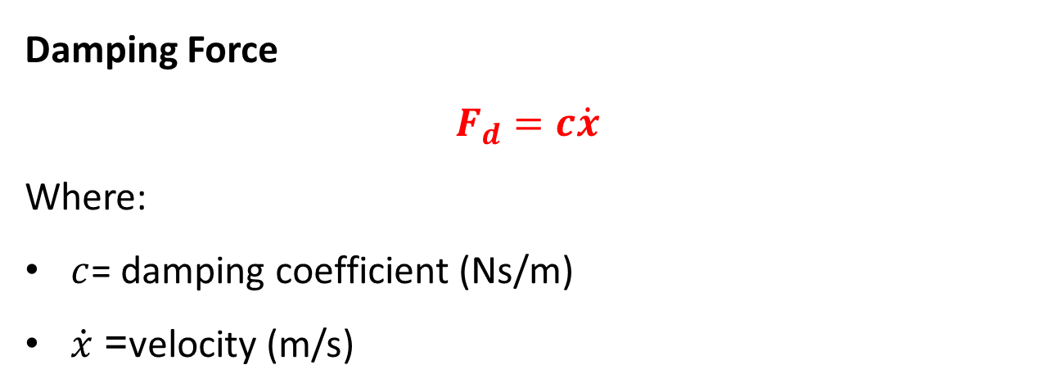
DAMPER ELEMENT (C): ENERGY DISSIPATION COMPONENT
Definition
The damper element represents resistance to motion due to friction or viscous effects. It dissipates vibrational energy and reduces oscillations over time.
Damping Force
$$F_{d}=c\dot{x}$$
Where:
$c$= damping coefficient (Ns/m)
$\dot{x}$= velocity (m/s)
Physical Concept
Damper does not store energy
It converts mechanical vibration energy into heat
Causes vibration amplitude to decay

Slide 18
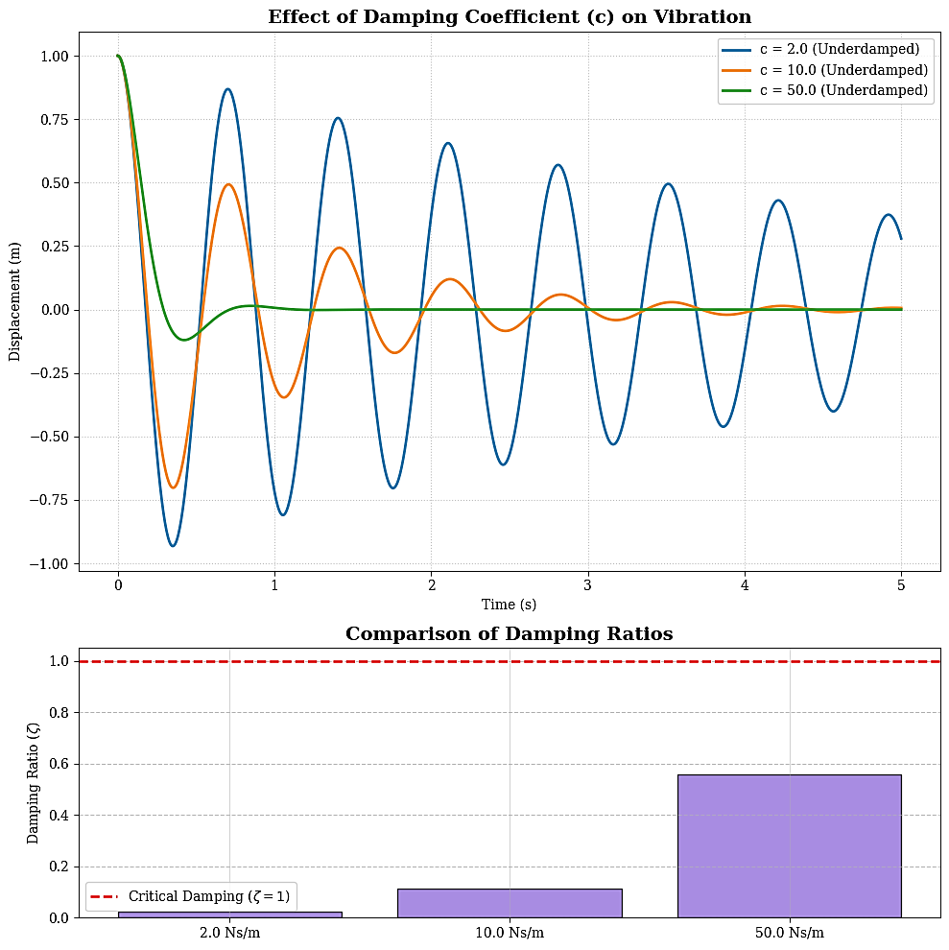
DAMPER ELEMENT (C): ENERGY DISSIPATION COMPONENT
Importance of Damping
Controls resonance response
Prevents excessive oscillations
Determines how quickly vibrations die out

