Slide 1

NOISE VIBRATION AND HARSHNESS
LECTURE 4 MODULE 1
Prepared By:
Dinesh Kumar
Assistant Professor
School of Continuing Education
DYPIU

Slide 2

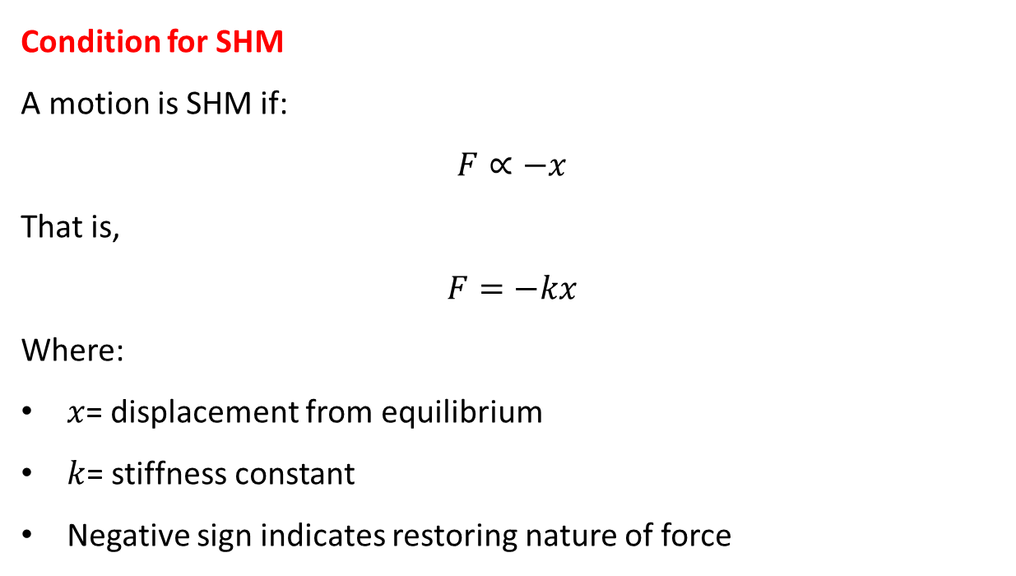
SIMPLE HARMONIC MOTION (SHM)
Simple Harmonic Motion (SHM) is the most fundamental type of periodic motion in vibration theory, in which the restoring force acting on a body is directly proportional to its displacement from equilibrium and acts in the opposite direction.
Condition for SHM
A motion is SHM if:
$$F∝−x$$
That is,
$$F=−kx$$
Where:
$x$= displacement from equilibrium
$k$= stiffness constant
Negative sign indicates restoring nature of force
Physical Meaning
Motion repeats itself after equal intervals of time
Acceleration is always directed toward the equilibrium position
SHM represents the basic model for free vibration of an undamped system

Slide 3
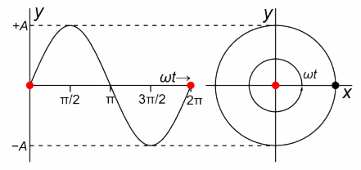
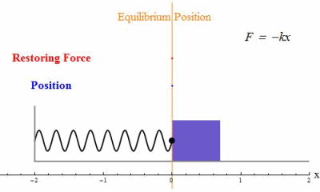
SIMPLE HARMONIC MOTION (SHM)

Slide 4
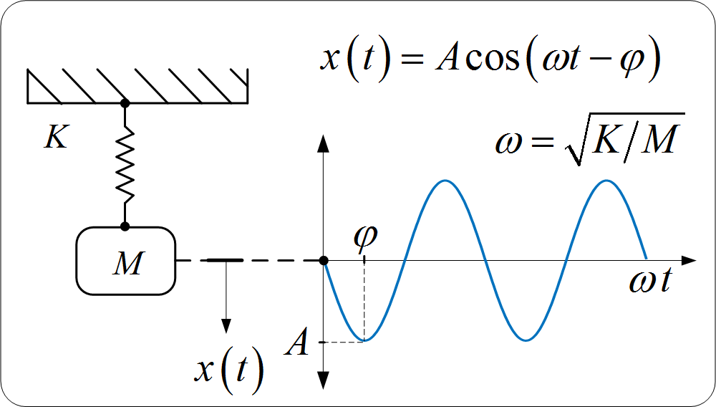
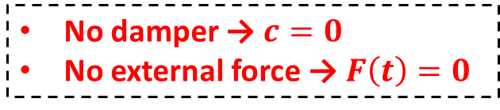
UNDAMPED FREE VIBRATION: INTRODUCTION
Free vibration occurs when a system oscillates after an initial disturbance without any external forcing function.
Undamped Free Vibration
An undamped system has no energy loss, meaning oscillations continue indefinitely.
Key Features
Motion is periodic
Total mechanical energy remains constant
System vibrates at its natural frequency
No damper → $c=0$
No external force → $F\left(t\right)=0$

Slide 5
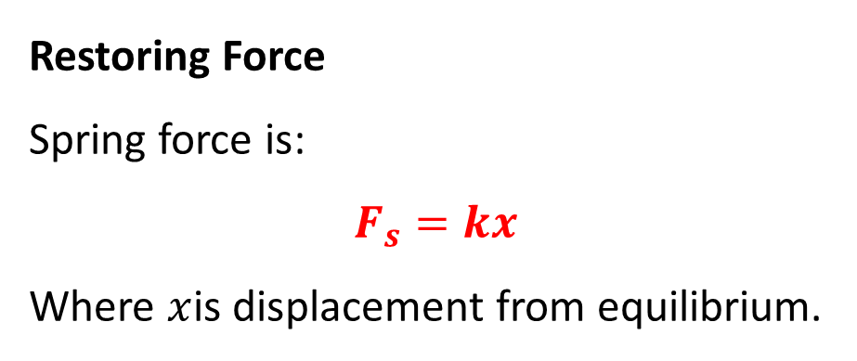
ASSUMPTIONS IN UNDAMPED FREE VIBRATION
System Assumptions
To derive the governing equation, we assume:
Single Degree of Freedom (SDOF) motion
Spring is linear (Hooke’s Law valid)
No damping forces present
No external excitation
Motion occurs along one axis only
Restoring Force
Spring force is:
$$F_{s}=kx$$
Where $x$is displacement from equilibrium.

Slide 6
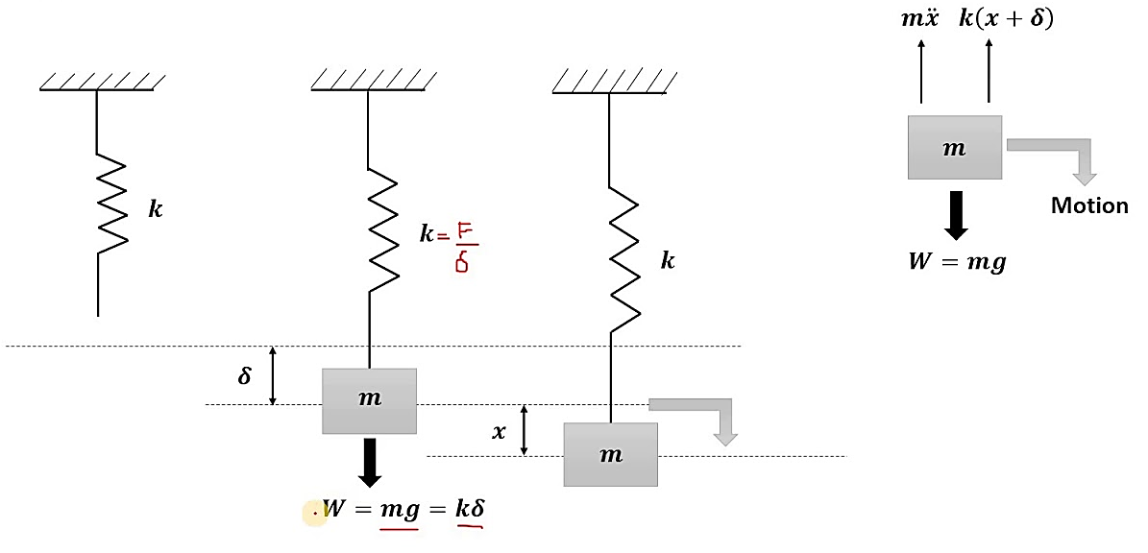
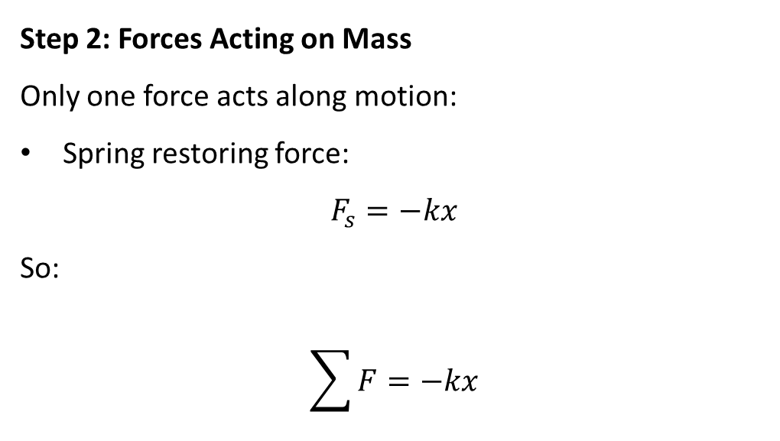
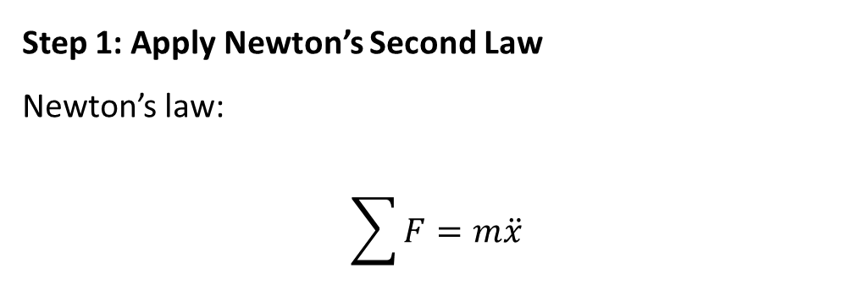
EQUATION OF MOTION USING NEWTON’S SECOND LAW
Step 1: Apply Newton’s Second Law
Newton’s law:
$$\sum{F}=m\ddot{x}$$
Step 2: Forces Acting on Mass
Only one force acts along motion:
Spring restoring force:
$$F_{s}=−kx$$
So:
$$\sum{F}=−kx$$

Slide 7
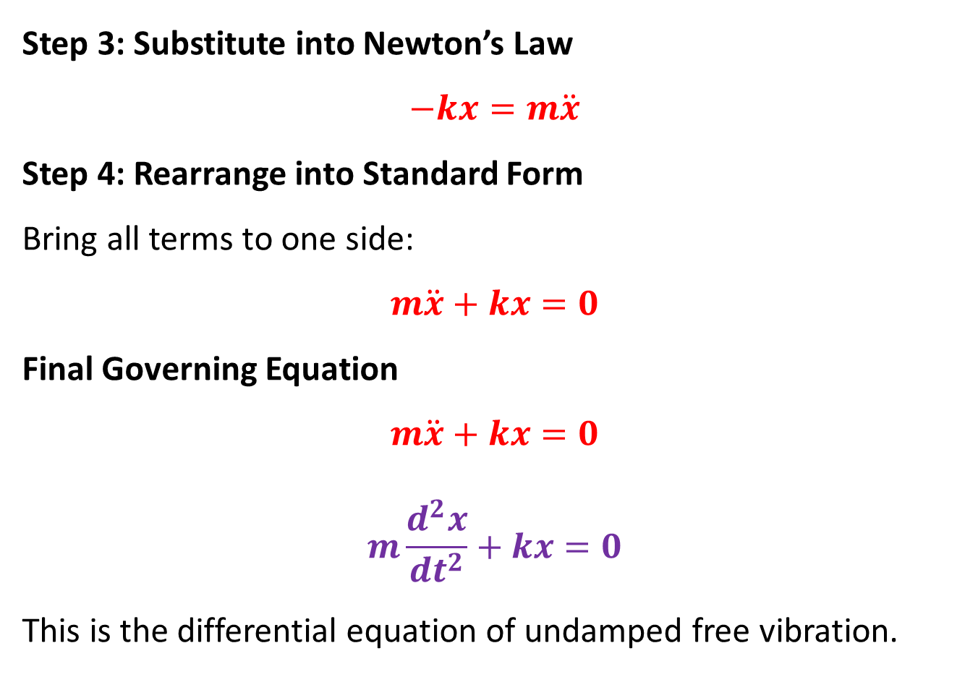
UNDAMPED FREE VIBRATION: INTRODUCTION
Step 3: Substitute into Newton’s Law
$$−kx=m\ddot{x}$$
Step 4: Rearrange into Standard Form
Bring all terms to one side:
$$m\ddot{x}+kx=0$$
Final Governing Equation
$$m\ddot{x}+kx=0$$
$$m\frac{d^{2}x}{{dt}^{2}}+kx=0$$
This is the differential equation of undamped free vibration.

Slide 8
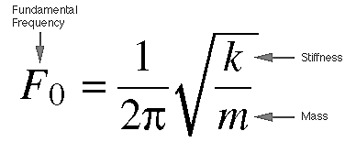
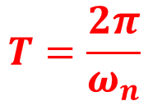
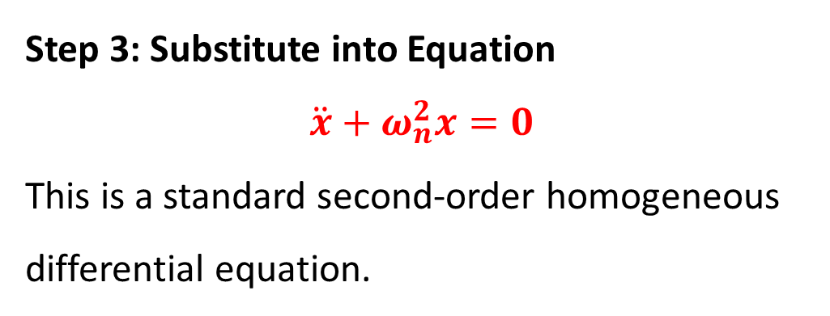

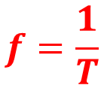
CONVERTING INTO STANDARD DIFFERENTIAL EQUATION
Step 1: Divide Entire Equation by $m$
$$\ddot{x}+\frac{k}{m}x=0$$
Step 2: Define Natural Frequency
$$ω_{n}^{2}=\frac{k}{m}$$
So:
$$ω_{n}=\sqrt{\frac{k}{m}}$$
Step 3: Substitute into Equation
$$\ddot{x}+ω_{n}^{2}x=0$$
This is a standard second-order homogeneous differential equation.
$$T=\frac{2π}{ω_{n}}$$
$$f=\frac{1}{T}$$

Slide 9
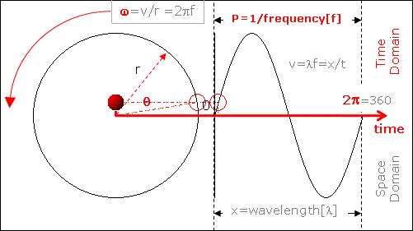


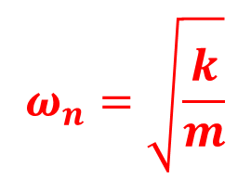
UNDAMPED FREE VIBRATION: INTRODUCTION
Angular Frequency
$$ω_{n}=\sqrt{\frac{k}{m}}$$
$$units= \frac{rad}{s}$$
$$units=hertz$$

Slide 10
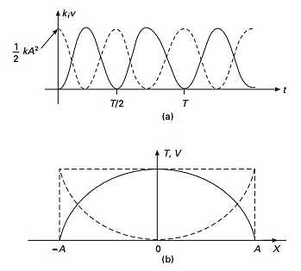
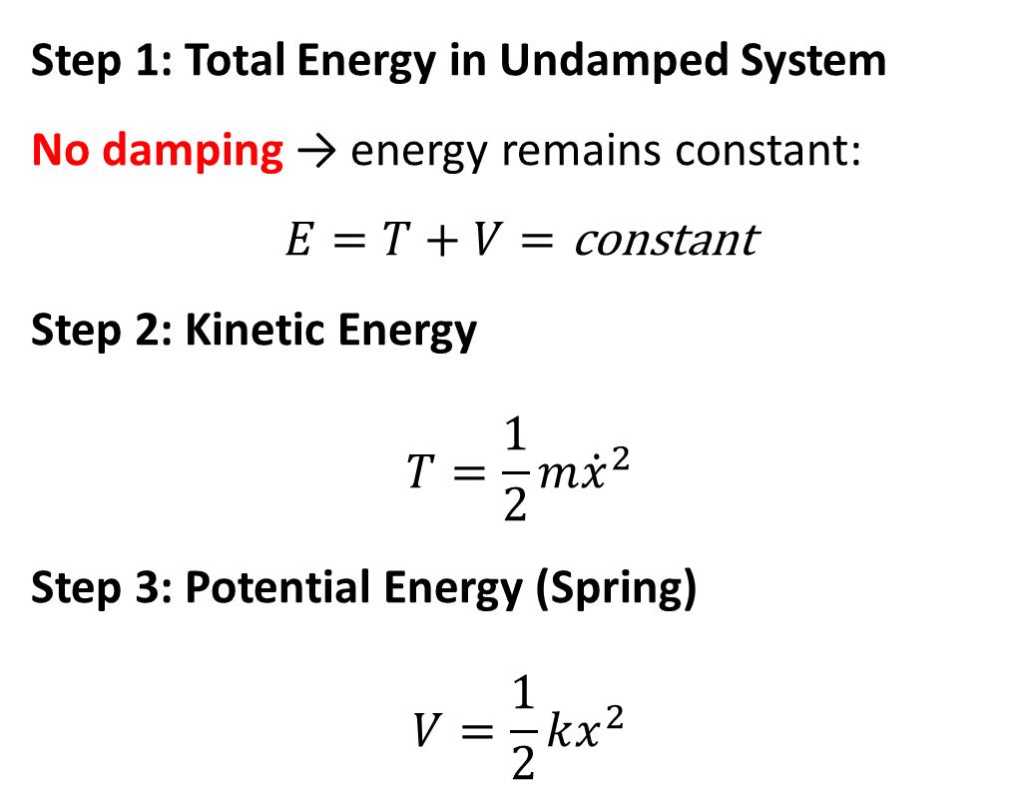
ENERGY METHOD DERIVATION
Step 1: Total Energy in Undamped System
No damping → energy remains constant:
$$E=T+V=\text{constant}$$
Step 2: Kinetic Energy
$$T=\frac{1}{2}m{\dot{x}}^{2}$$
Step 3: Potential Energy (Spring)
$$V=\frac{1}{2}kx^{2}$$

Slide 11
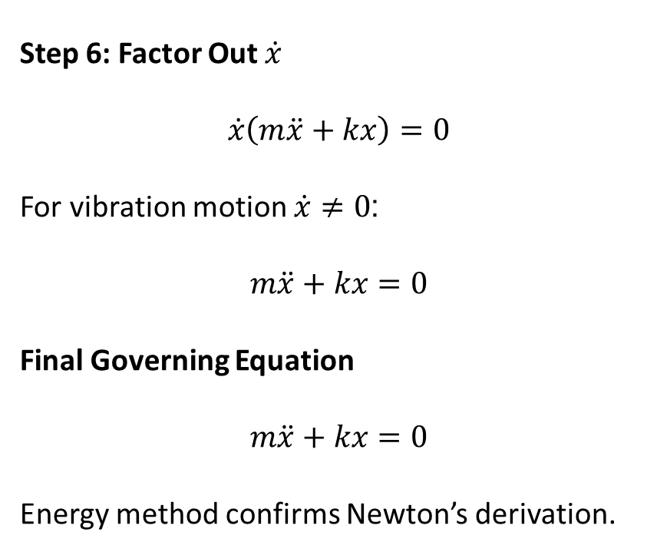
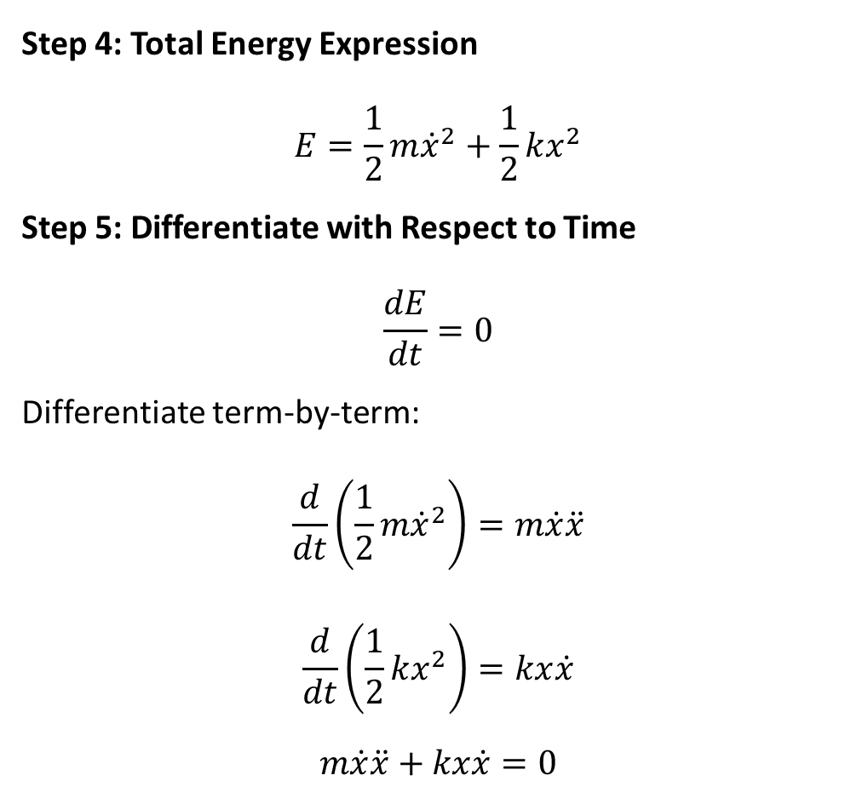
UNDAMPED FREE VIBRATION: INTRODUCTION
Step 4: Total Energy Expression
$$E=\frac{1}{2}m{\dot{x}}^{2}+\frac{1}{2}kx^{2}$$
Step 5: Differentiate with Respect to Time
$$\frac{dE}{dt}=0$$
Differentiate term-by-term:
$$\frac{d}{dt}\left(\frac{1}{2}m{\dot{x}}^{2}\right)=m\dot{x}\ddot{x}$$
$$\frac{d}{dt}\left(\frac{1}{2}kx^{2}\right)=kx\dot{x}$$
$$m\dot{x}\ddot{x}+kx\dot{x}=0$$
Step 6: Factor Out $\dot{x}$
$$\dot{x}\left(m\ddot{x}+kx\right)=0$$
For vibration motion $\dot{x}≠0$:
$$m\ddot{x}+kx=0$$
Final Governing Equation
$$m\ddot{x}+kx=0$$
Energy method confirms Newton’s derivation.

Slide 12
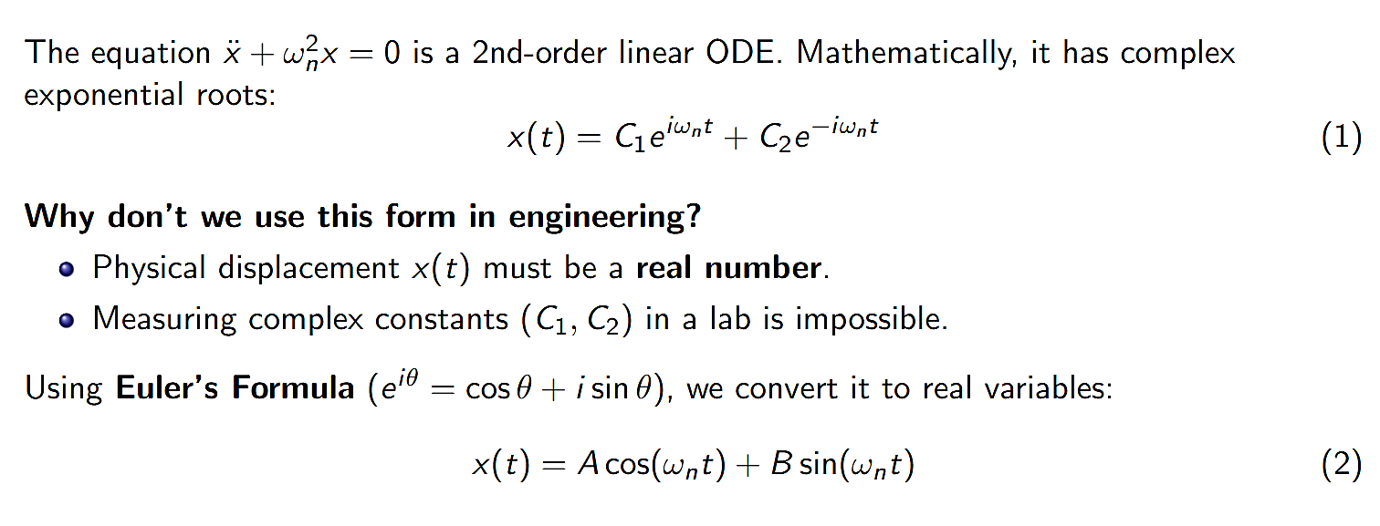
UNDAMPED FREE VIBRATION: INTRODUCTION

Slide 13
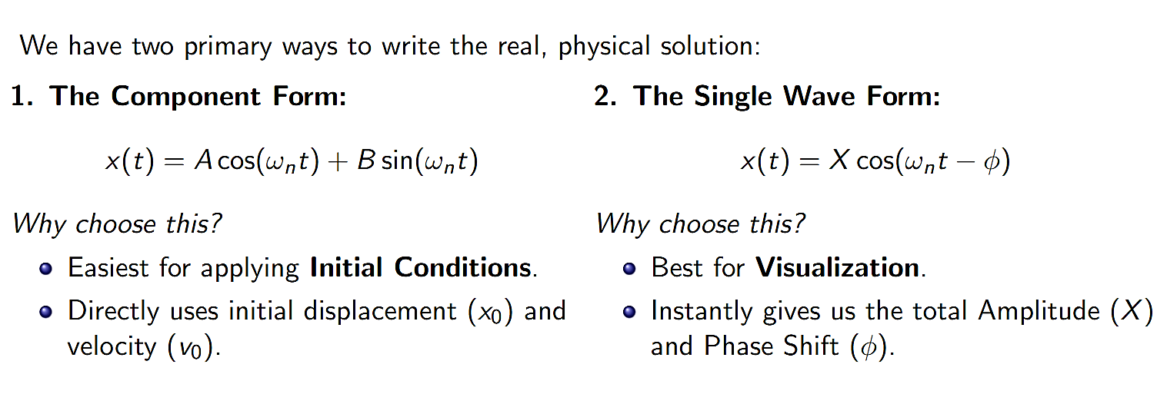
UNDAMPED FREE VIBRATION: INTRODUCTION

Slide 14
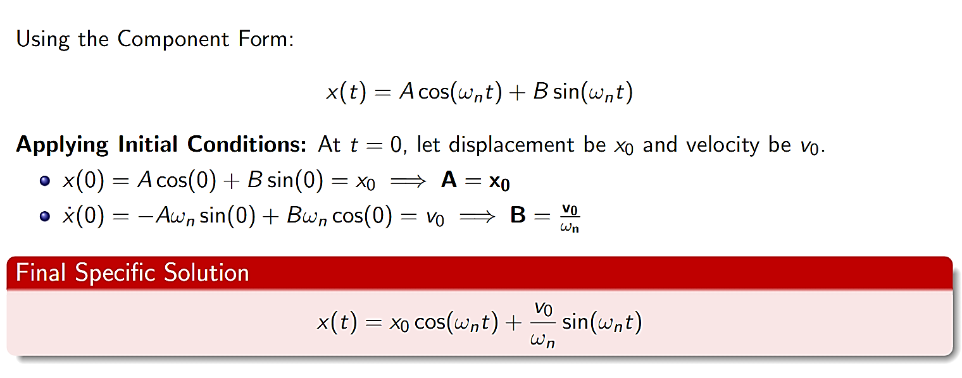
UNDAMPED FREE VIBRATION: INTRODUCTION

