Slide 1
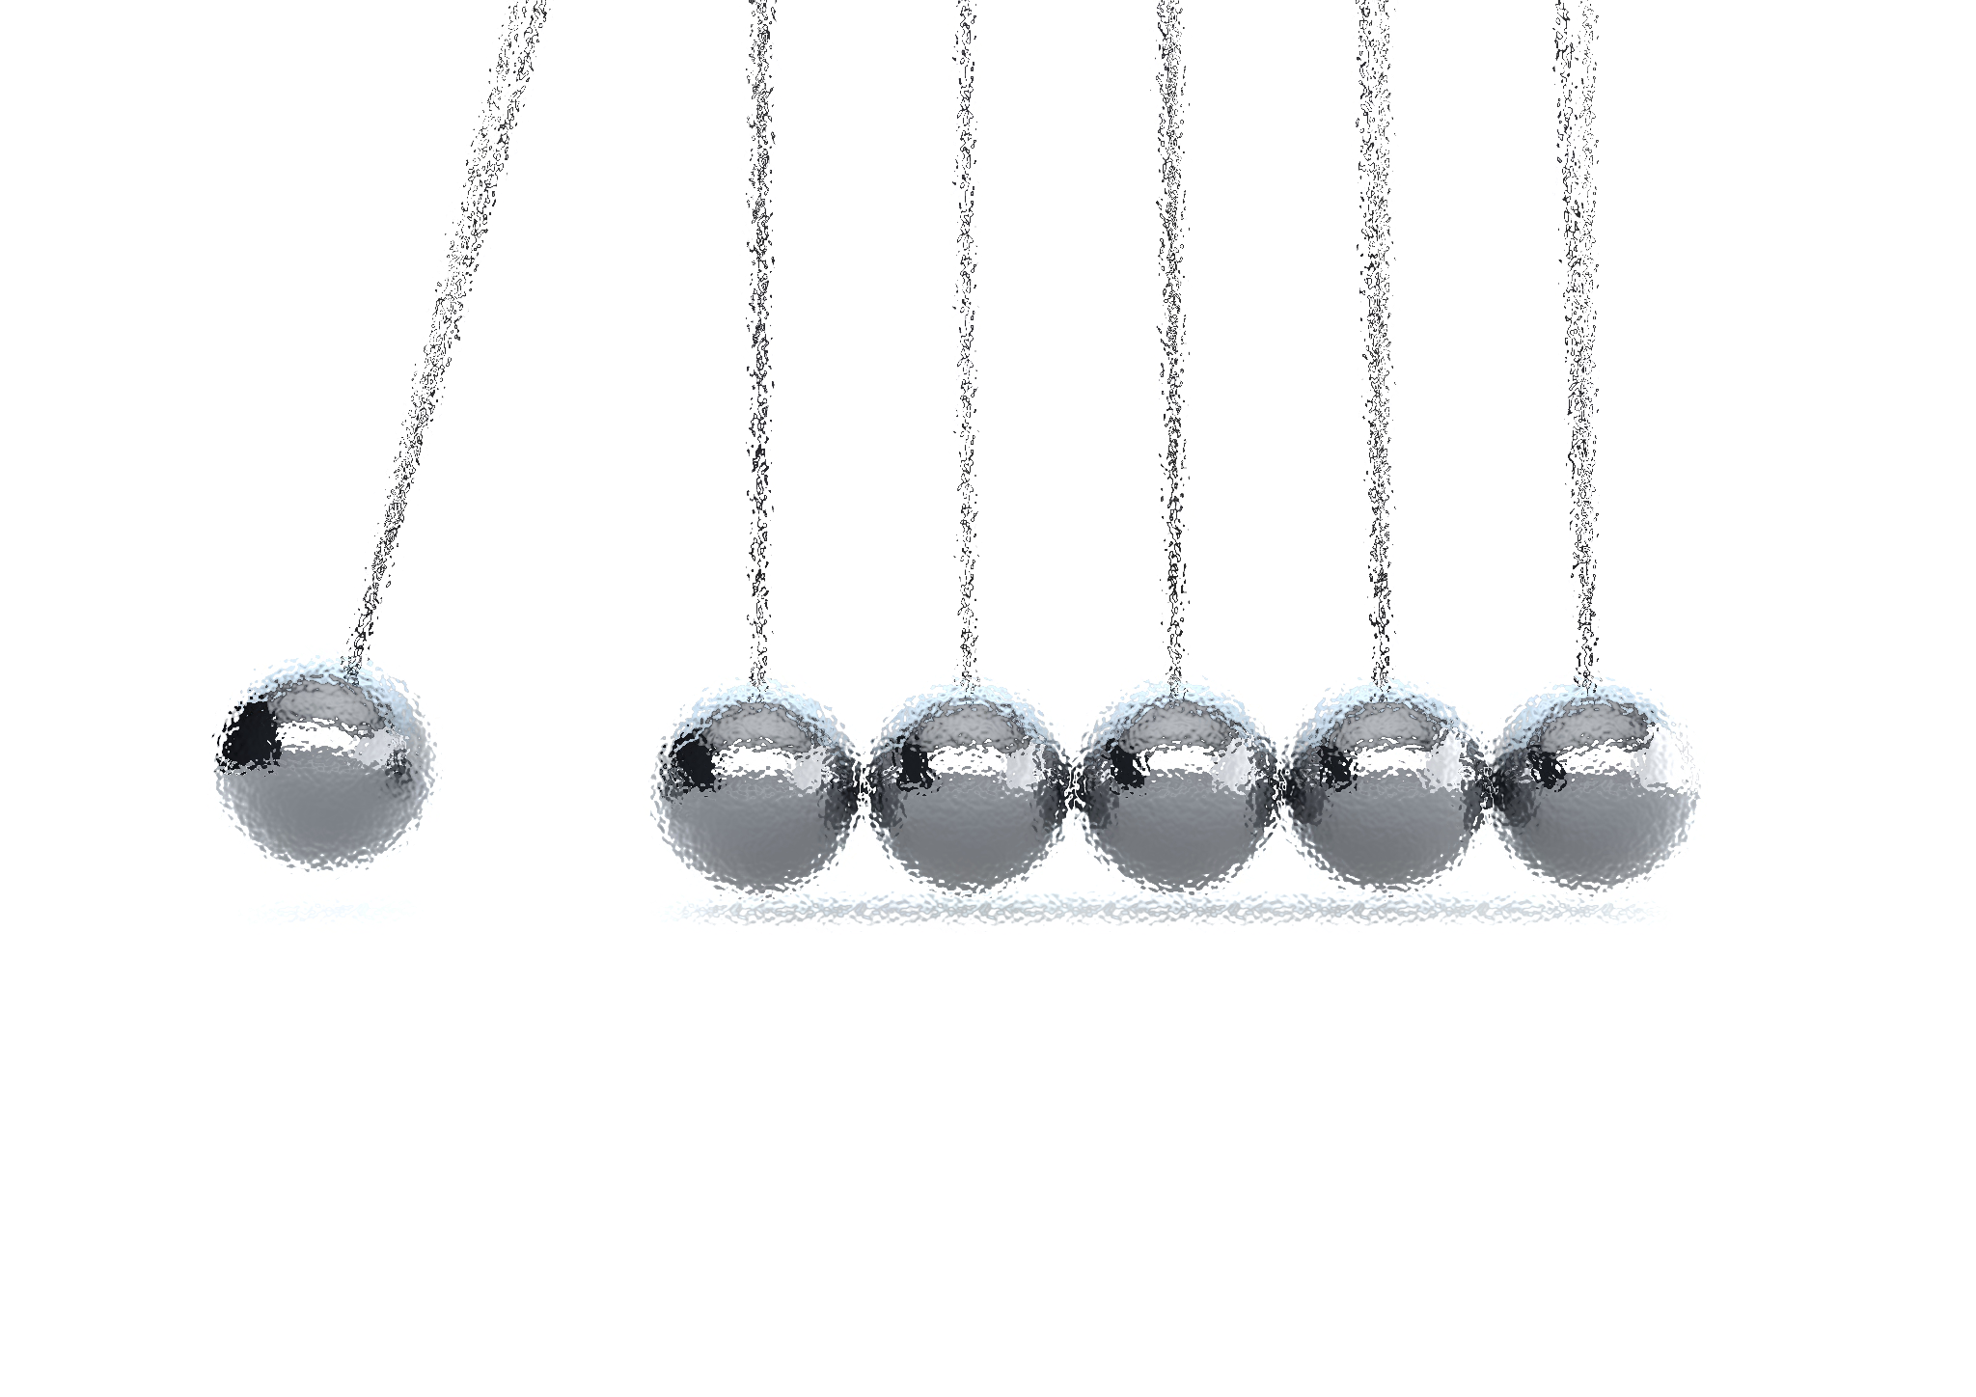
NOISE VIBRATION AND HARSHNESS
LECTURE 5 MODULE 1
Prepared By:
Dinesh Kumar
Assistant Professor
School of Continuing Education
DYPIU

Slide 2
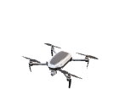
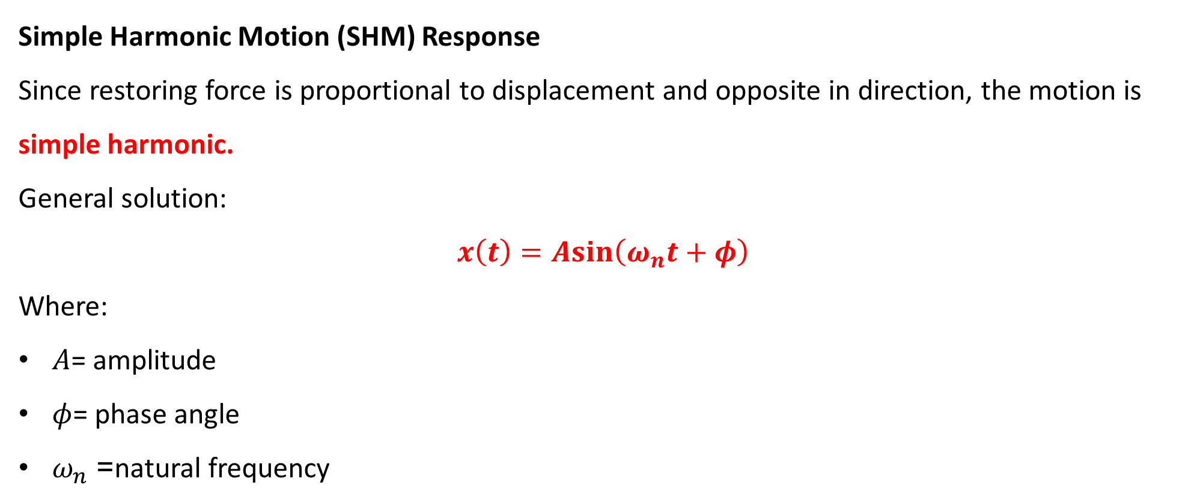
UNDAMPED FREE VIBRATION: INTRODUCTION
Simple Harmonic Motion (SHM) Response
Since restoring force is proportional to displacement and opposite in direction, the motion is simple harmonic.
General solution:
$$x\left(t\right)=Asin⁡\left(ω_{n}t+φ\right)$$
Where:
$A$= amplitude
$φ$= phase angle
$ω_{n}$= natural frequency

Slide 3
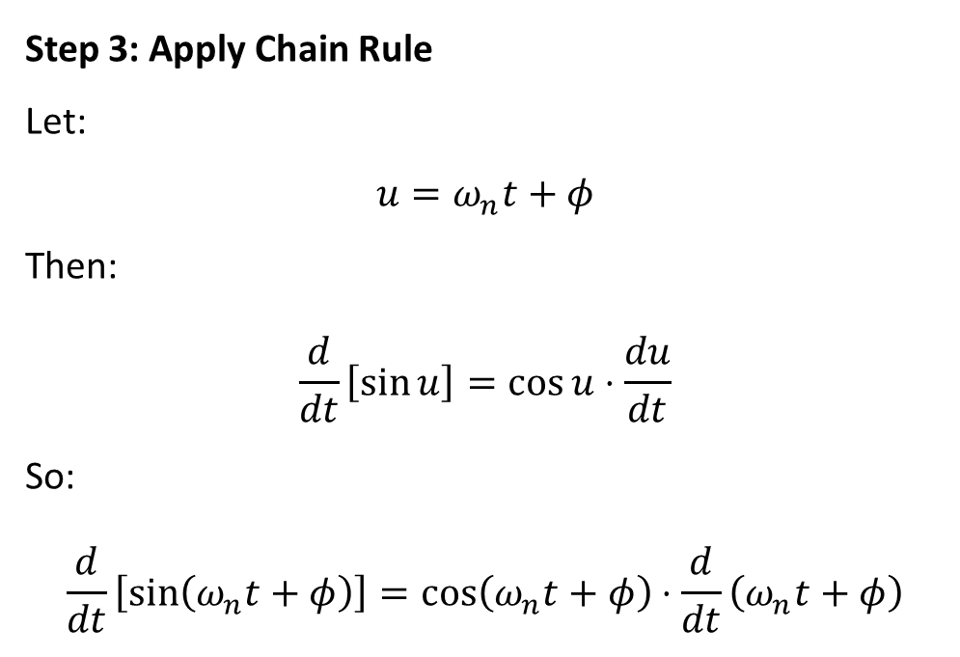
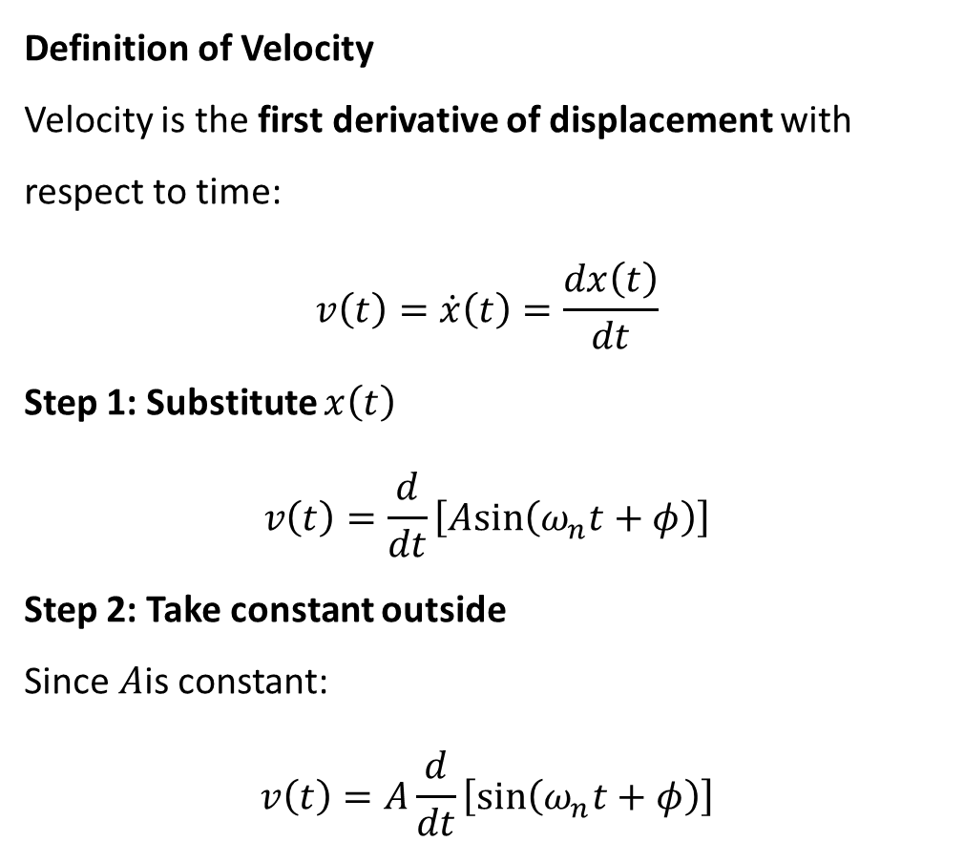
UNDAMPED FREE VIBRATION: INTRODUCTION
Definition of Velocity
Velocity is the first derivative of displacement with respect to time:
$$v\left(t\right)=\dot{x}\left(t\right)=\frac{dx\left(t\right)}{dt}$$
Step 1: Substitute $x\left(t\right)$
$$v\left(t\right)=\frac{d}{dt}\left[Asin⁡\left(ω_{n}t+φ\right)\right]$$
Step 2: Take constant outside
Since $A$is constant:
$$v\left(t\right)=A\frac{d}{dt}\left[sin⁡\left(ω_{n}t+φ\right)\right]$$
Step 3: Apply Chain Rule
Let:
$$u=ω_{n}t+φ$$
Then:
$$\frac{d}{dt}\left[\sin{u}\right]=\cos{u}⋅\frac{du}{dt}$$
So:
$$\frac{d}{dt}\left[sin⁡\left(ω_{n}t+φ\right)\right]=cos⁡\left(ω_{n}t+φ\right)⋅\frac{d}{dt}\left(ω_{n}t+φ\right)$$

Slide 4
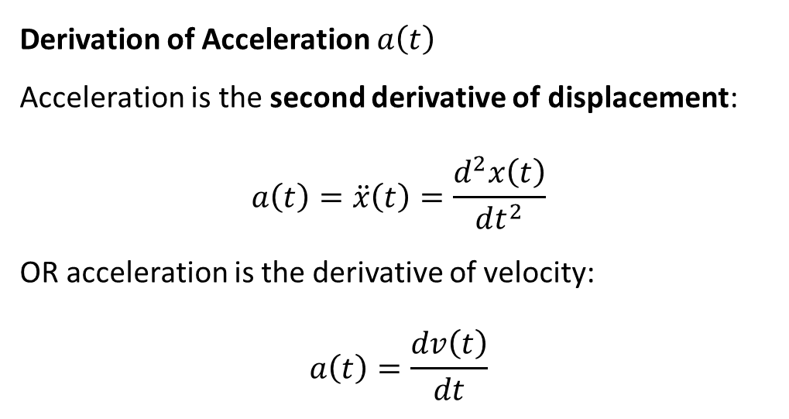
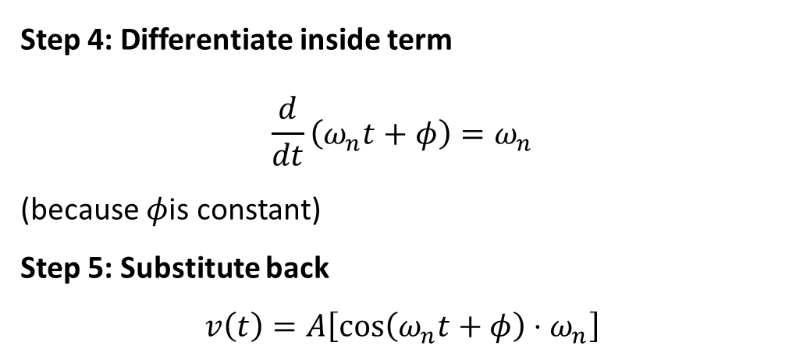
UNDAMPED FREE VIBRATION: INTRODUCTION
Step 4: Differentiate inside term
$$\frac{d}{dt}\left(ω_{n}t+φ\right)=ω_{n}$$
(because $φ$is constant)
Step 5: Substitute back
$$v\left(t\right)=A\left[cos⁡\left(ω_{n}t+φ\right)⋅ω_{n}\right]$$
Important Note
Velocity leads displacement by 90° phase difference.
Derivation of Acceleration $a\left(t\right)$
Acceleration is the second derivative of displacement:
$$a\left(t\right)=\ddot{x}\left(t\right)=\frac{d^{2}x\left(t\right)}{dt^{2}}$$
OR acceleration is the derivative of velocity:
$$a\left(t\right)=\frac{dv\left(t\right)}{dt}$$

Slide 5
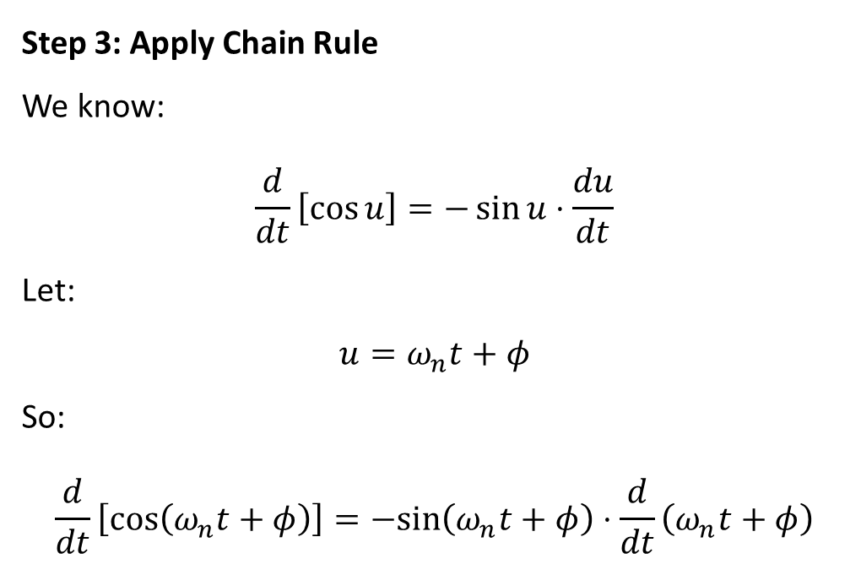
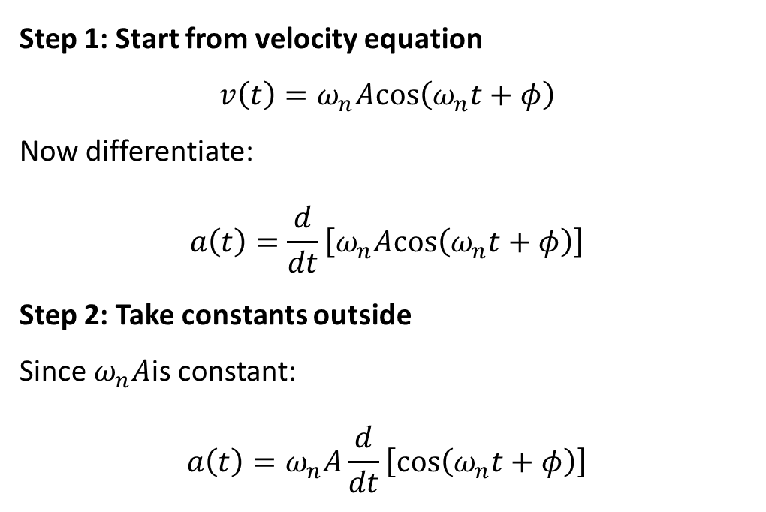
UNDAMPED FREE VIBRATION: INTRODUCTION
Step 1: Start from velocity equation
$$v\left(t\right)=ω_{n}Acos⁡\left(ω_{n}t+φ\right)$$
Now differentiate:
$$a\left(t\right)=\frac{d}{dt}\left[ω_{n}Acos⁡\left(ω_{n}t+φ\right)\right]$$
Step 2: Take constants outside
Since $ω_{n}A$is constant:
$$a\left(t\right)=ω_{n}A\frac{d}{dt}\left[cos⁡\left(ω_{n}t+φ\right)\right]$$
Step 3: Apply Chain Rule
We know:
$$\frac{d}{dt}\left[\cos{u}\right]=−\sin{u}⋅\frac{du}{dt}$$
Let:
$$u=ω_{n}t+φ$$
So:
$$\frac{d}{dt}\left[cos⁡\left(ω_{n}t+φ\right)\right]=−sin⁡\left(ω_{n}t+φ\right)⋅\frac{d}{dt}\left(ω_{n}t+φ\right)$$

Slide 6
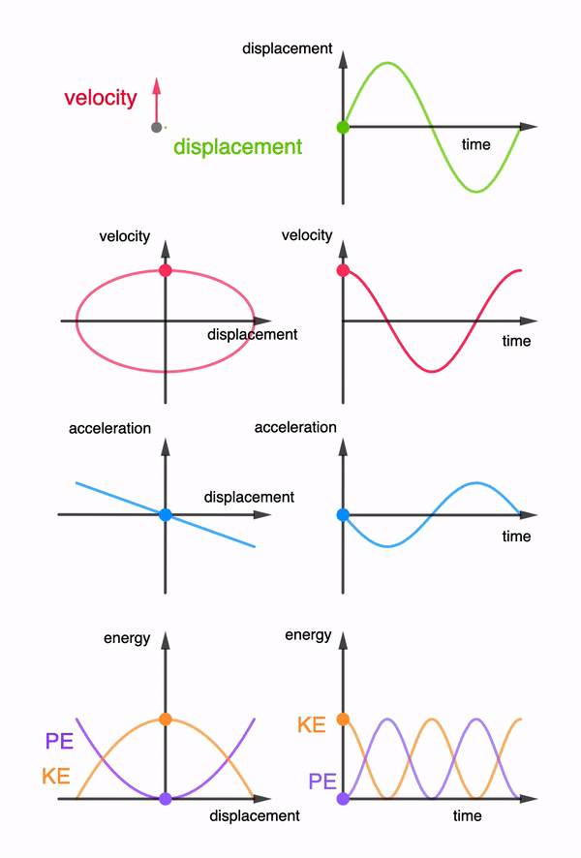
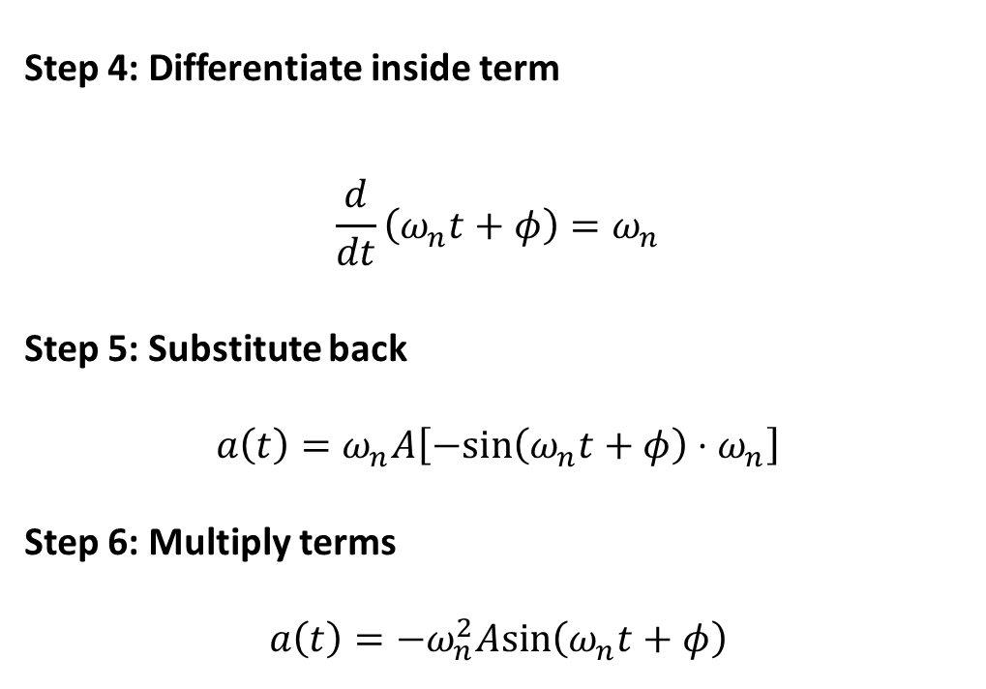
UNDAMPED FREE VIBRATION: INTRODUCTION
Step 4: Differentiate inside term
$$\frac{d}{dt}\left(ω_{n}t+φ\right)=ω_{n}$$
Step 5: Substitute back
$$a\left(t\right)=ω_{n}A\left[−sin⁡\left(ω_{n}t+φ\right)⋅ω_{n}\right]$$
Step 6: Multiply terms
$$a\left(t\right)=−ω_{n}^{2}Asin⁡\left(ω_{n}t+φ\right)$$

