Slide 1
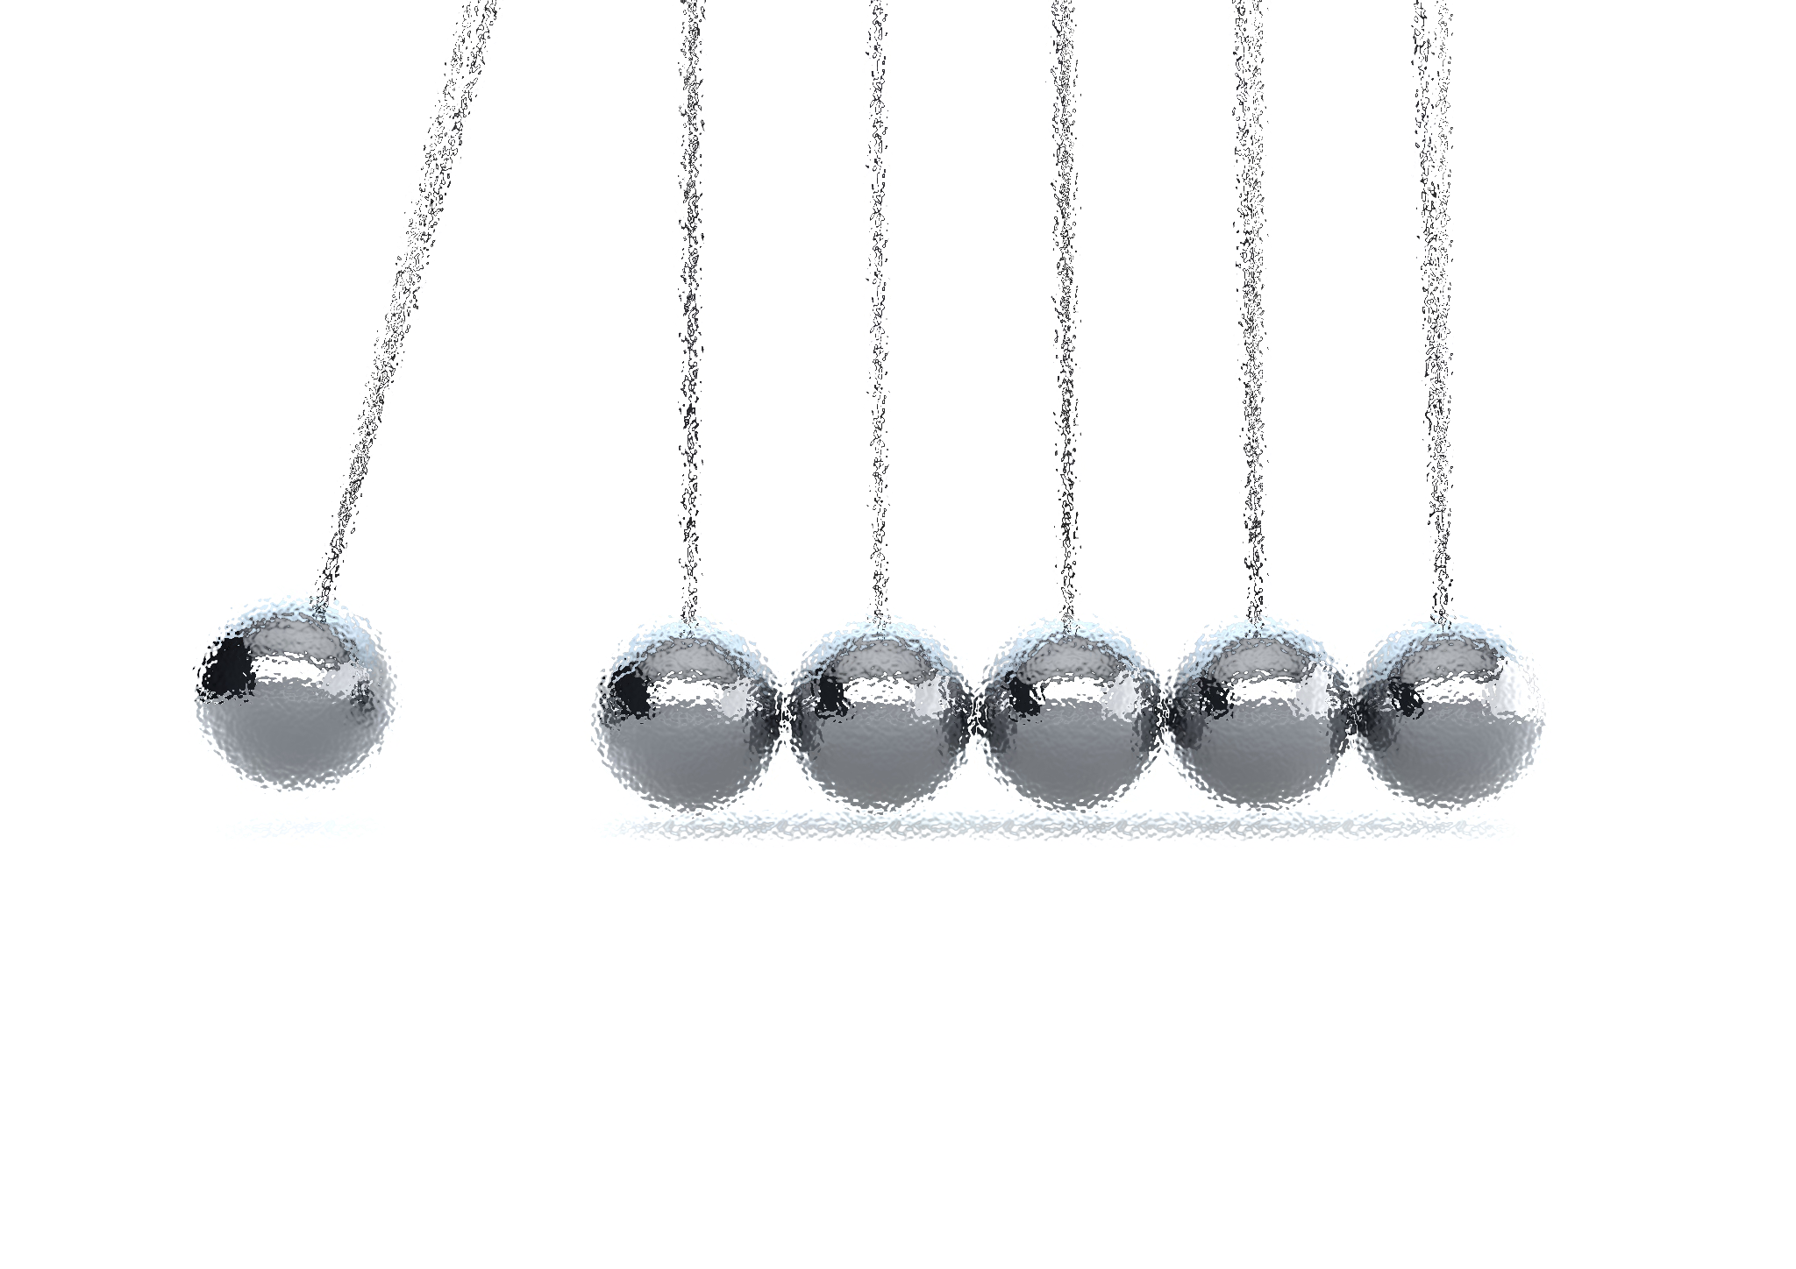
NOISE VIBRATION AND HARSHNESS
LECTURE 6 MODULE 1
Prepared By:
Dinesh Kumar
Assistant Professor
School of Continuing Education
DYPIU

Slide 2
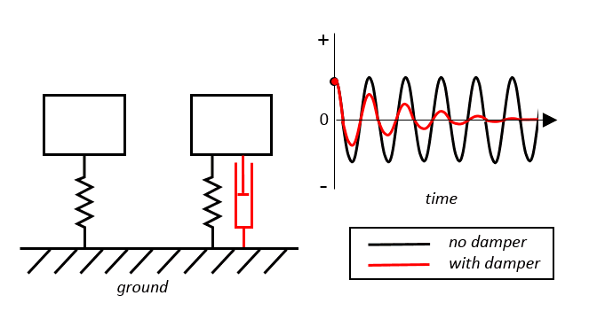
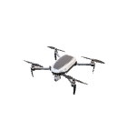
INTRODUCTION TO DAMPING
In an ideal spring-mass system, motion continues indefinitely (Perpetual motion).
Reality: Energy is lost through friction, air resistance, or internal molecular friction.
Viscous Damping: The damping force is assumed to be proportional to the velocity.
Common in hydraulic actuators and shock absorbers.

Slide 3
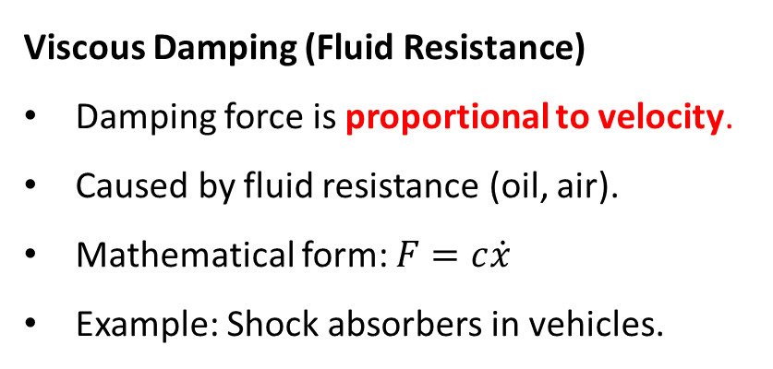
TYPES OF DAMPING
Viscous Damping (Fluid Resistance)
Damping force is proportional to velocity.
Caused by fluid resistance (oil, air).
Mathematical form: $F=c\dot{x}$
Example: Shock absorbers in vehicles.
Coulomb Damping (Dry Friction)
Damping force is constant in magnitude and opposes motion direction.
Caused by dry surface contact (friction between solids).
Independent of velocity.
Example: Sliding block on a rough surface.

Slide 4
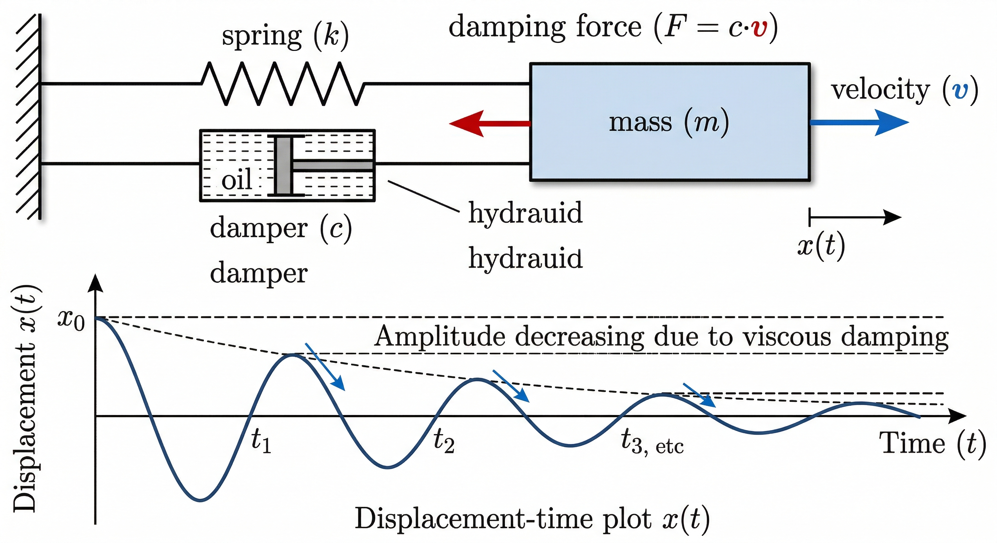
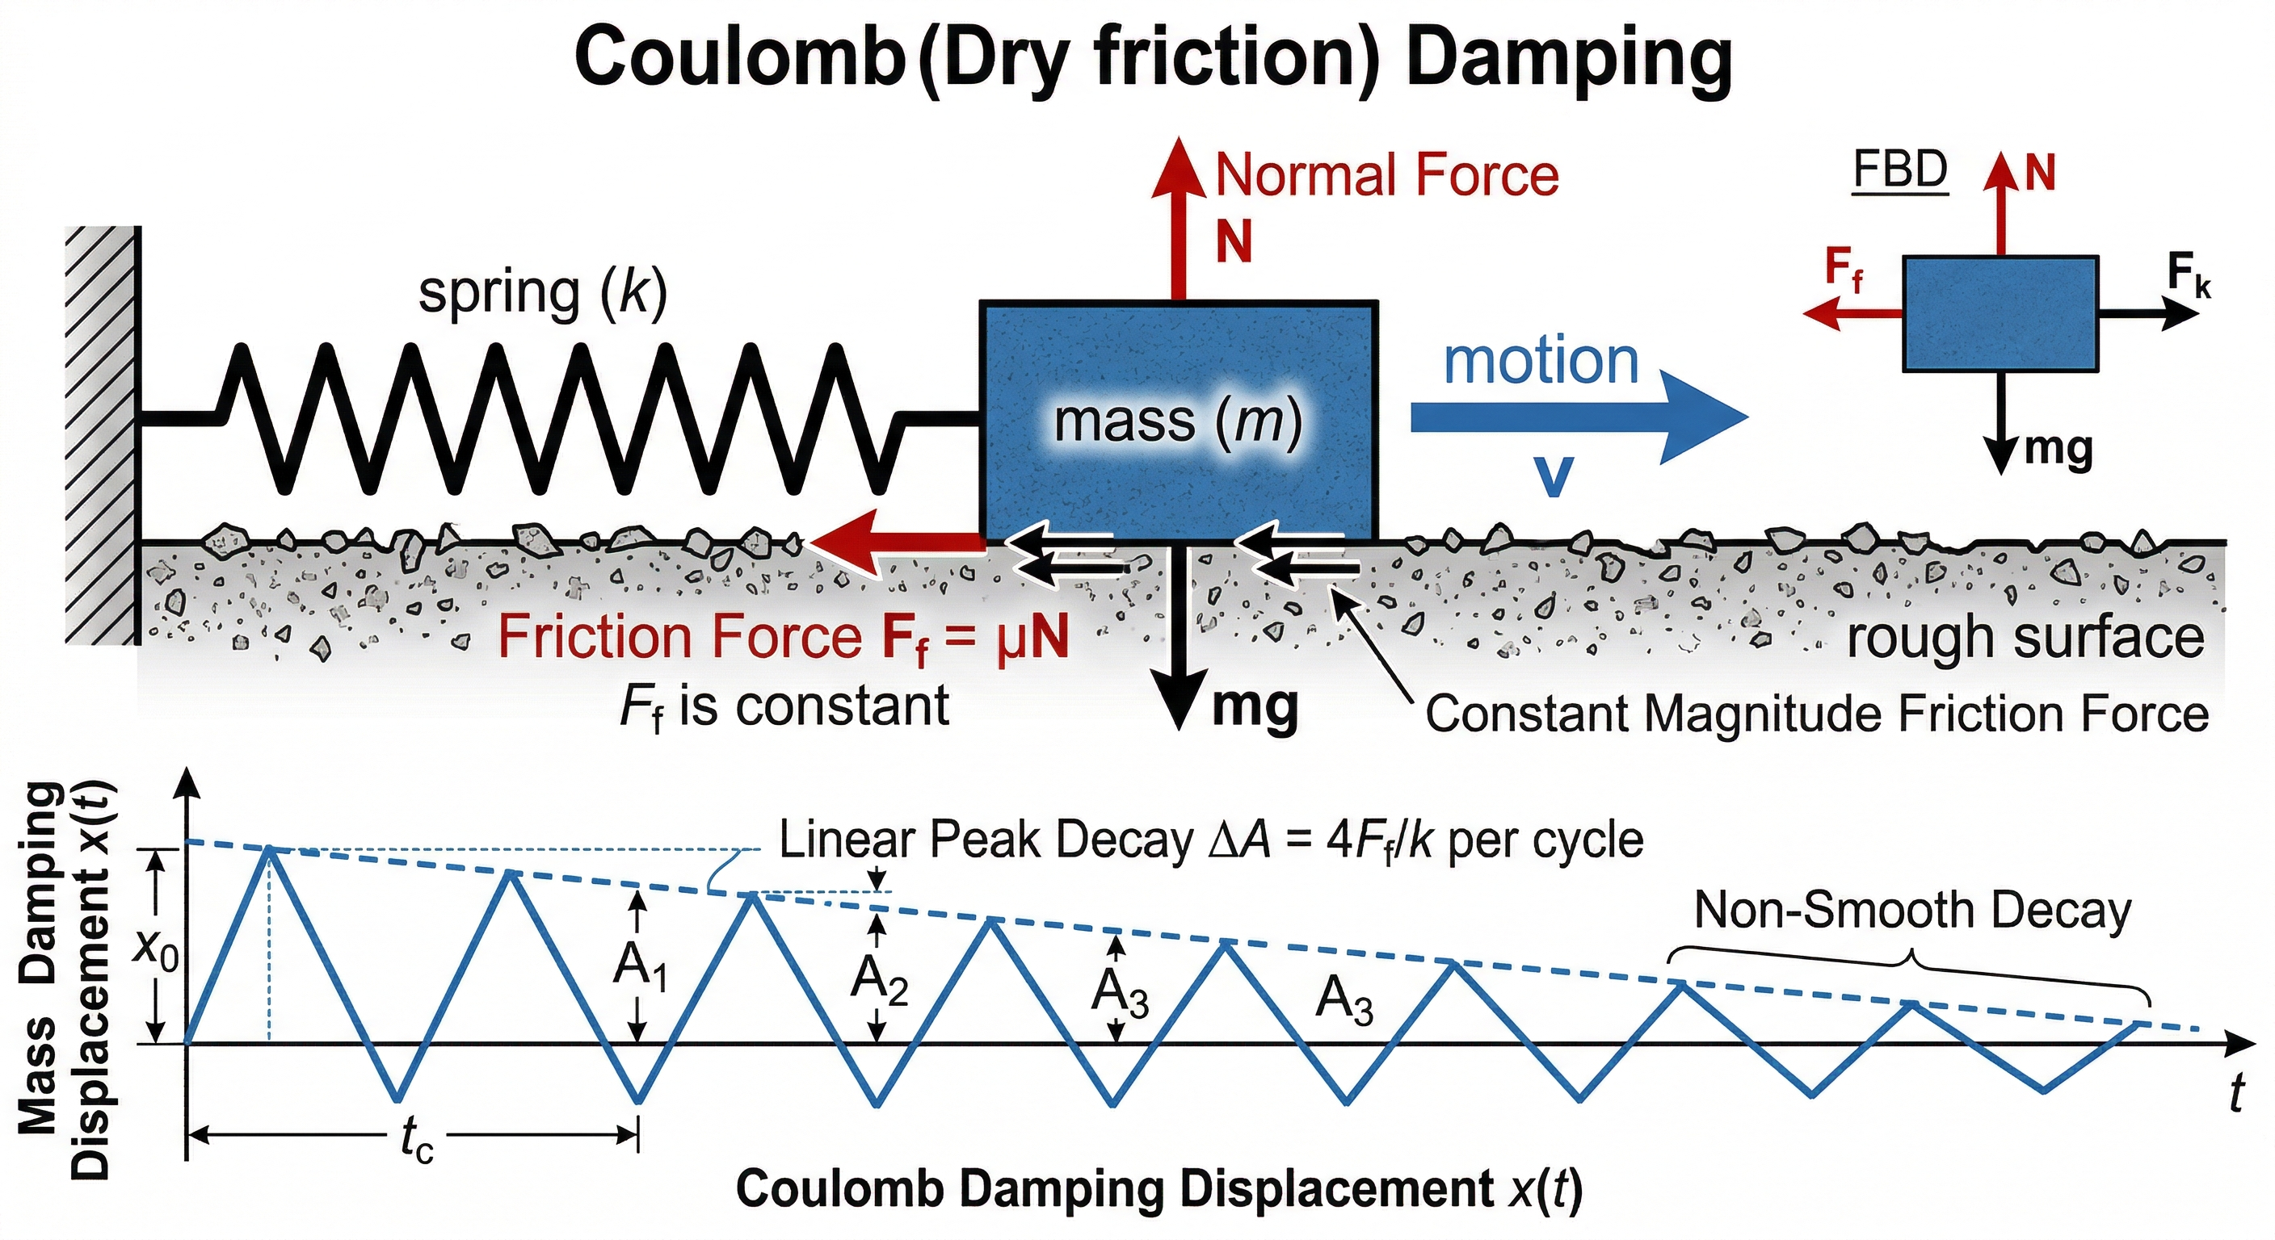
TYPES OF DAMPING
Viscous Damping (Fluid Resistance)
Coulomb Damping (Dry Friction)

Slide 5
TYPES OF DAMPING
Non-linear Damping (Complex Interfaces)
Damping force is not proportional to velocity (non-linear relation).
Occurs in systems with complex interactions (gaps, impacts, joints).
Behavior changes with amplitude and conditions.
Example: Rubber mounts, mechanical joints with clearance.
Structural Damping (Material Internal Friction)
Energy loss occurs due to internal deformation of material.
Present in materials like metals, polymers.
Depends on material properties and stress–strain behavior.
Example: Vibrations in beams or machine structures.

Slide 6
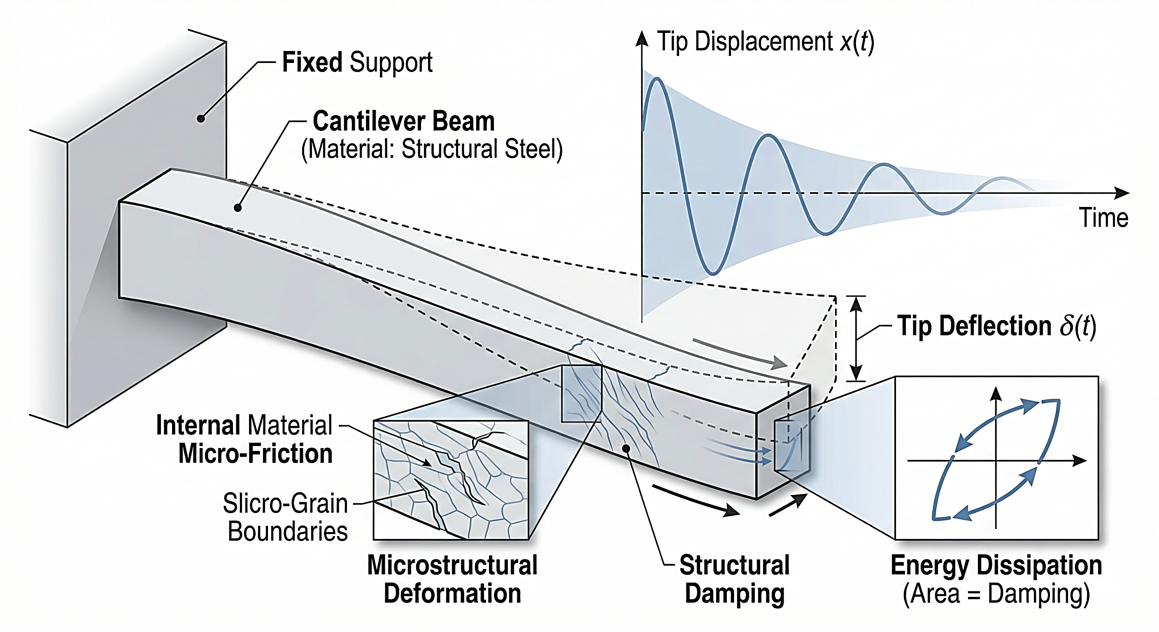
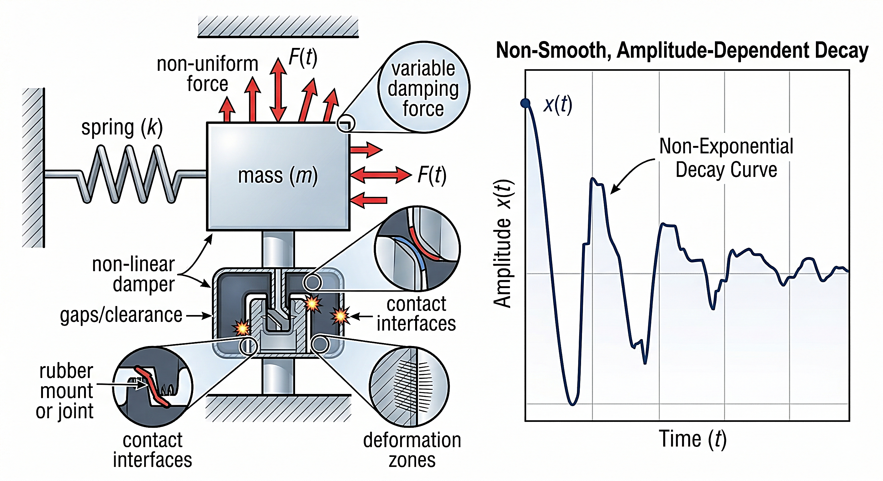
TYPES OF DAMPING
Structural Damping (Material Internal Friction)
Non-linear Damping (Complex Interfaces)

Slide 7
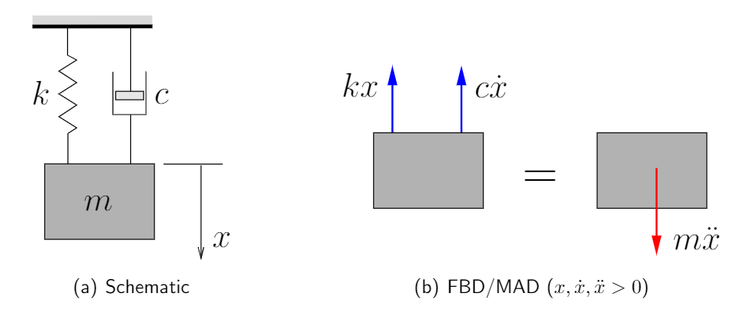
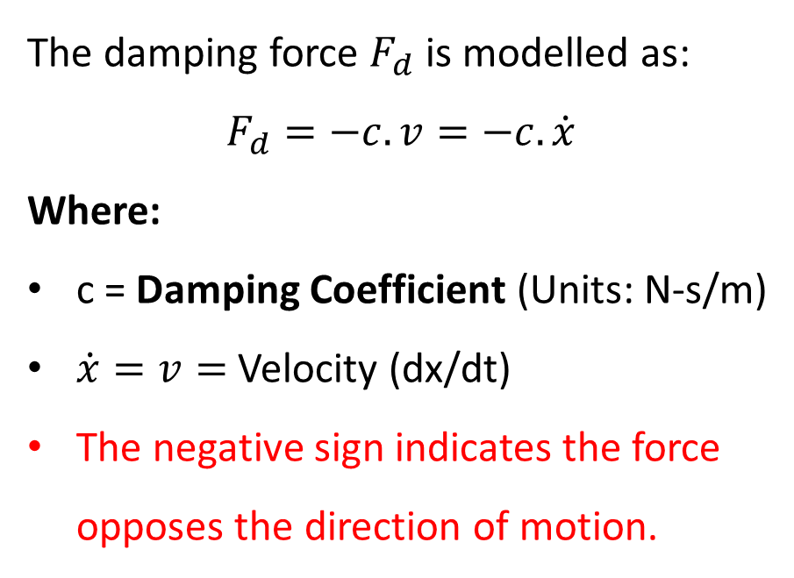
THE VISCOUS DAMPER (DASHPOT)
The damping force $F_{d}$​ is modelled as:
$$F_{d}=−c.v=−c.\dot{x}$$
Where:
c = Damping Coefficient (Units: N-s/m)
$\dot{x}=v=$ Velocity (dx/dt)
The negative sign indicates the force opposes the direction of motion.

Slide 8
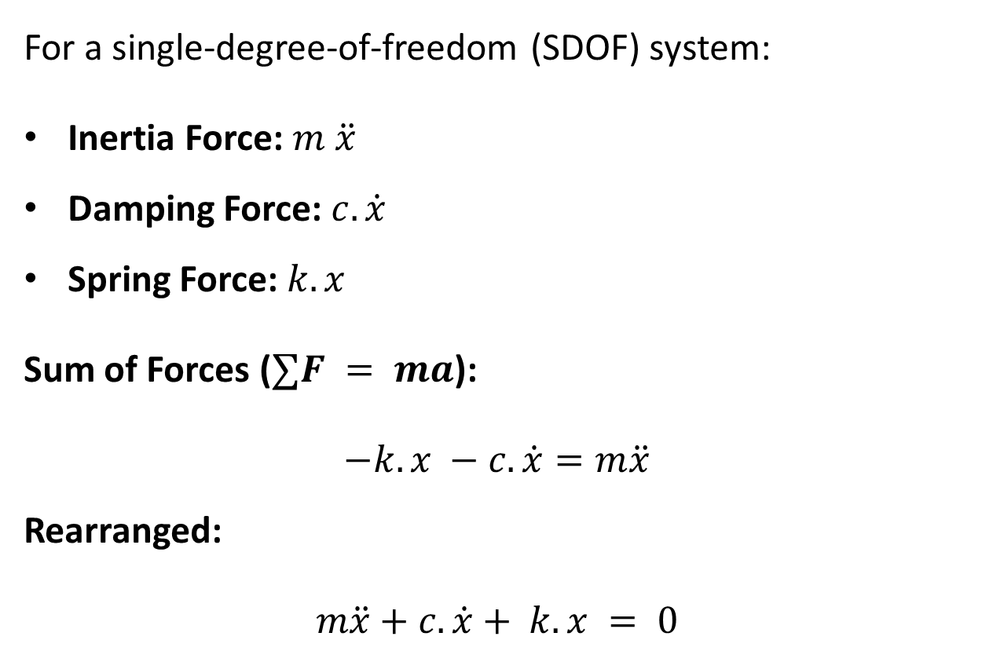
FREE BODY DIAGRAM & EQUATION OF MOTION
For a single-degree-of-freedom (SDOF) system:
Inertia Force: $m \ddot{x}$
Damping Force: $c.\dot{x}$
Spring Force: $k.x$
Sum of Forces ($∑F = ma$):
$$−k.x −c.\dot{x}=m\ddot{x}$$
Rearranged:
$$m\ddot{x}+c.\dot{x}+ k.x = 0$$
This is a Linear, Homogeneous, Second-order Differential Equation.

Slide 9
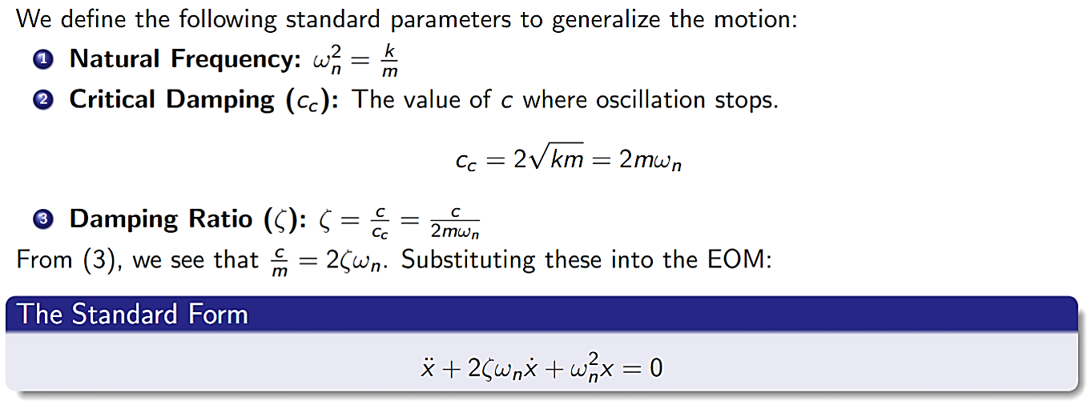
STANDARD FORM OF THE EOM

Slide 10
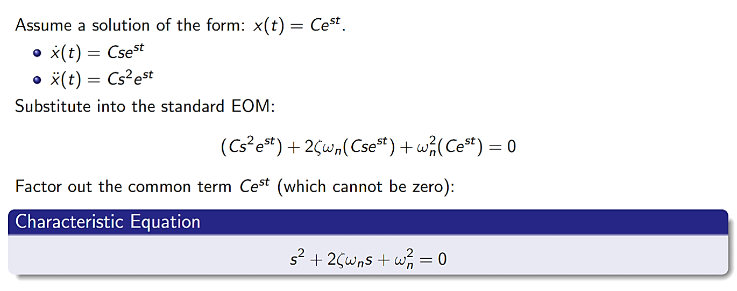
STANDARD FORM OF THE EOM

Slide 11
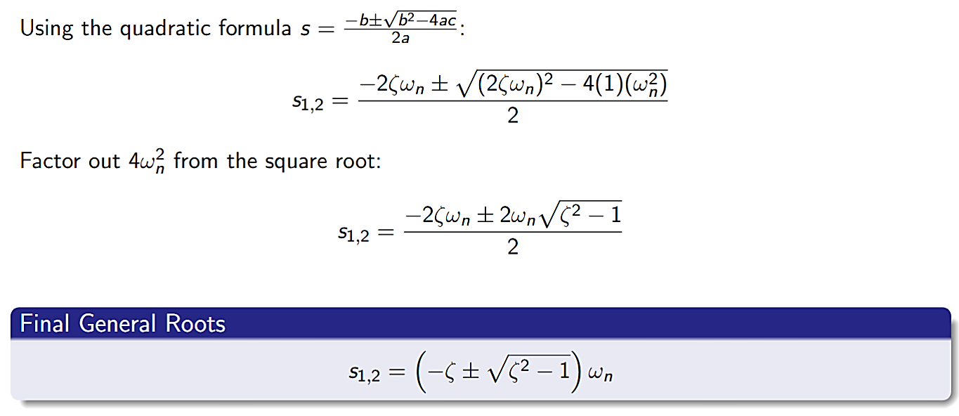
STANDARD FORM OF THE EOM

Slide 12
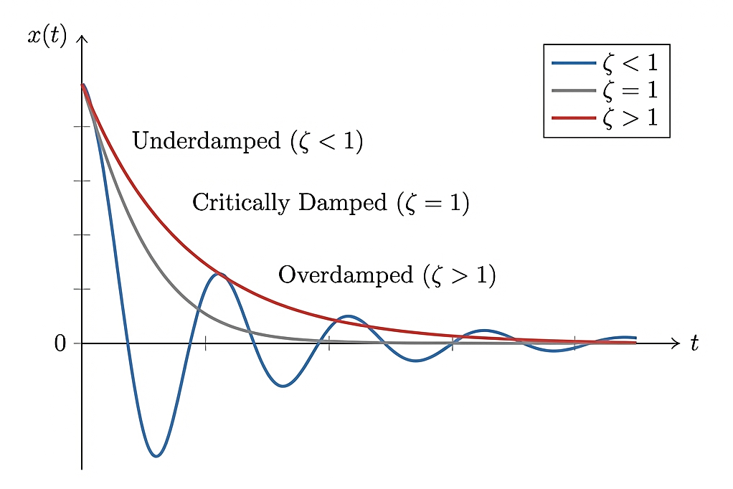
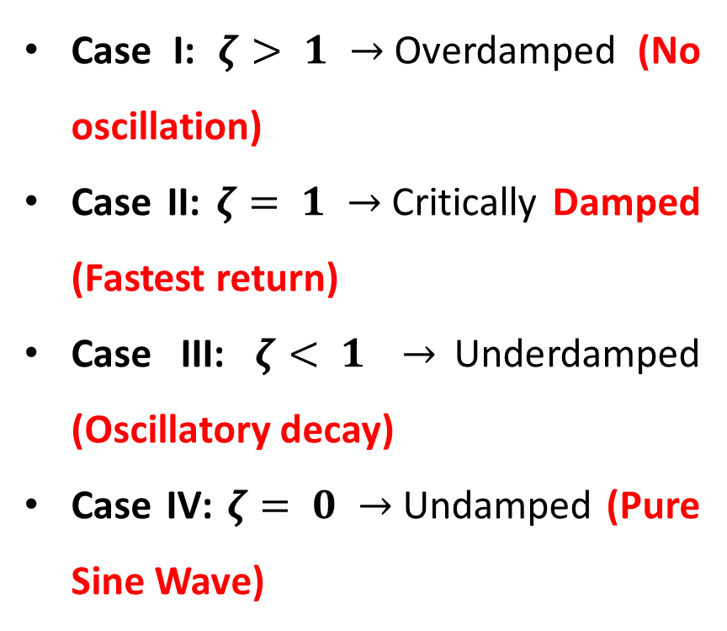
CLASSIFICATION OF DAMPING LEVELS
The term $\left(ζ^{2}− 1\right)$ determines if the system oscillates, crawls, or returns to zero instantly.
Case I: $ζ> 1$ $→$Overdamped (No oscillation)
Case II: $ζ= 1 →$Critically Damped (Fastest return)
Case III: $ζ< 1$ $→$Underdamped (Oscillatory decay)
Case IV: $ζ= 0 →$Undamped (Pure Sine Wave)

Slide 13

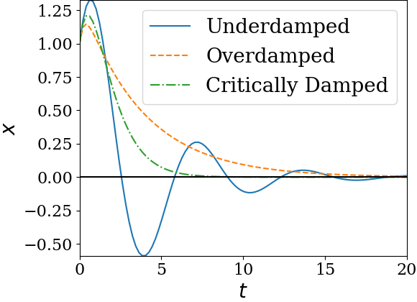
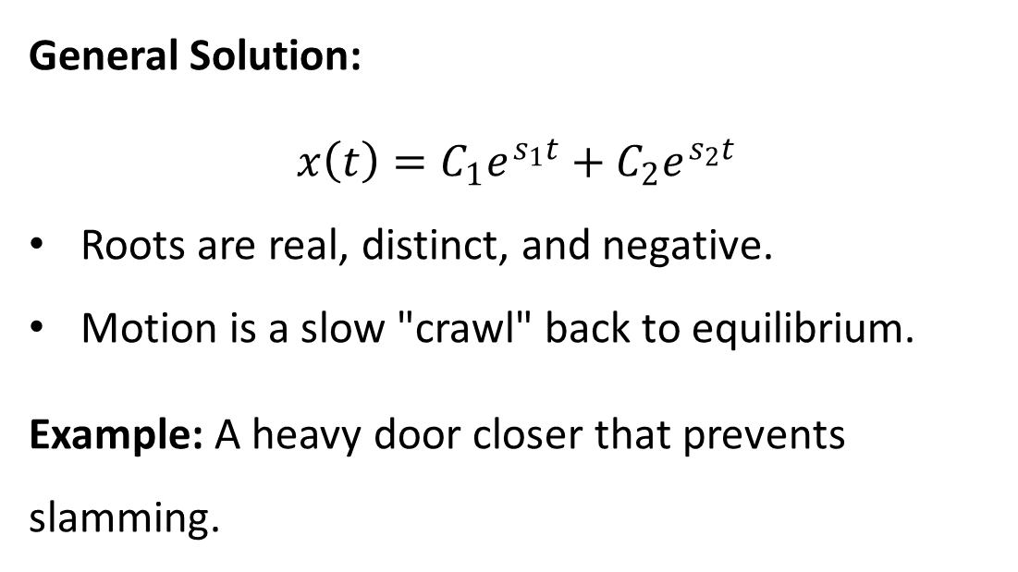
CASE I - OVERDAMPED ($ζ>1$)
General Solution:
$$x\left(t\right)=C_{1}e^{s_{1}t}+C_{2}e^{s_{2}t}$$
Roots are real, distinct, and negative.
Motion is a slow "crawl" back to equilibrium.
Example: A heavy door closer that prevents slamming.

Slide 14
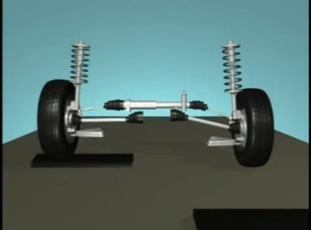
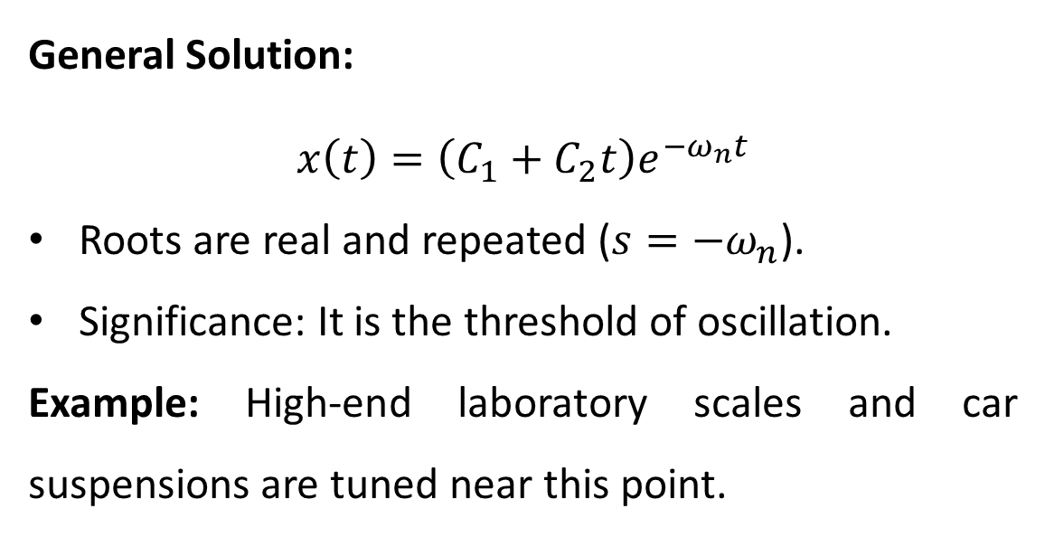
Case II - Critically Damped ($ζ= 1$)
General Solution:
$$x\left(t\right)=\left(C_{1}+C_{2}t\right)e^{−ω_{n}t}$$
Roots are real and repeated ($s=−ω_{n}$).
Significance: It is the threshold of oscillation.
Example: High-end laboratory scales and car suspensions are tuned near this point.

Slide 15

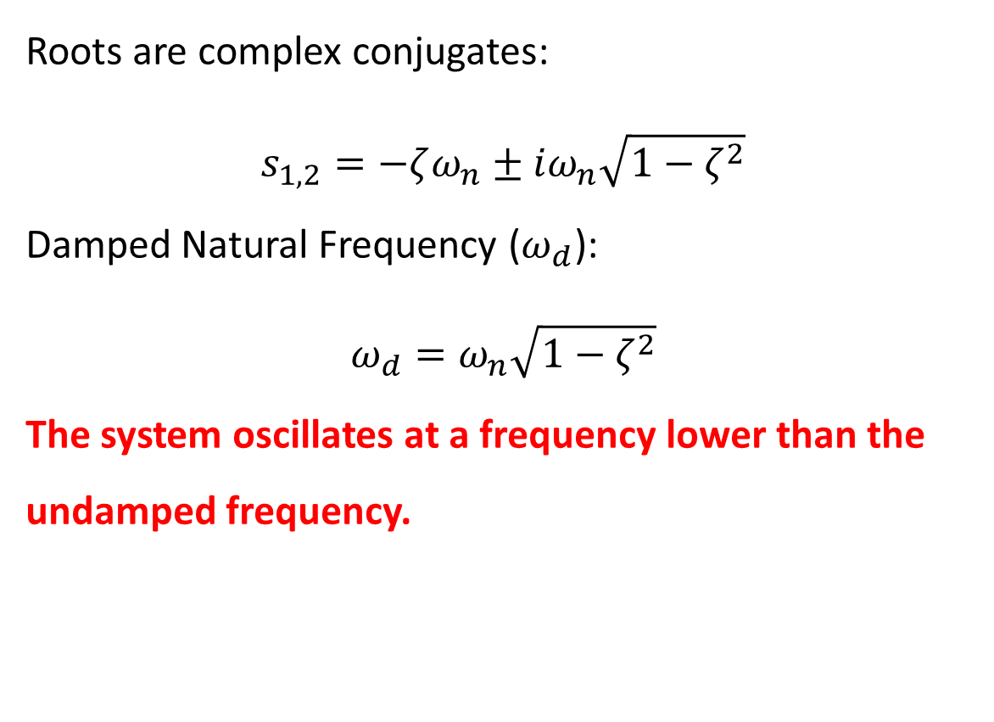
Case III - Underdamped ($ζ< 1$)
Roots are complex conjugates:
$$s_{1,2}=−ζω_{n}±iω_{n}\sqrt{1−ζ^{2}}$$
Damped Natural Frequency ($ω_{d}$):
$$ω_{d}=ω_{n}\sqrt{1−ζ^{2}}$$
The system oscillates at a frequency lower than the undamped frequency.

Slide 16
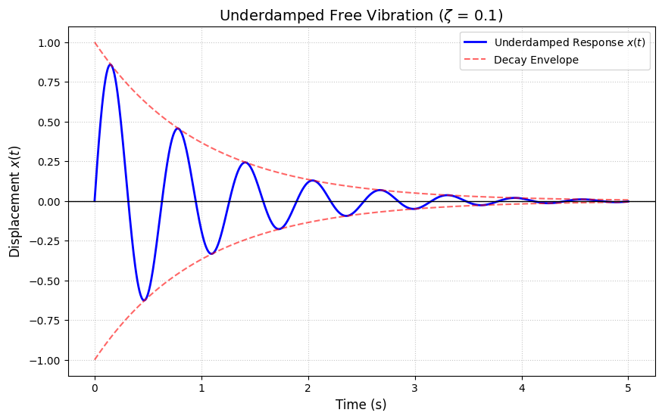
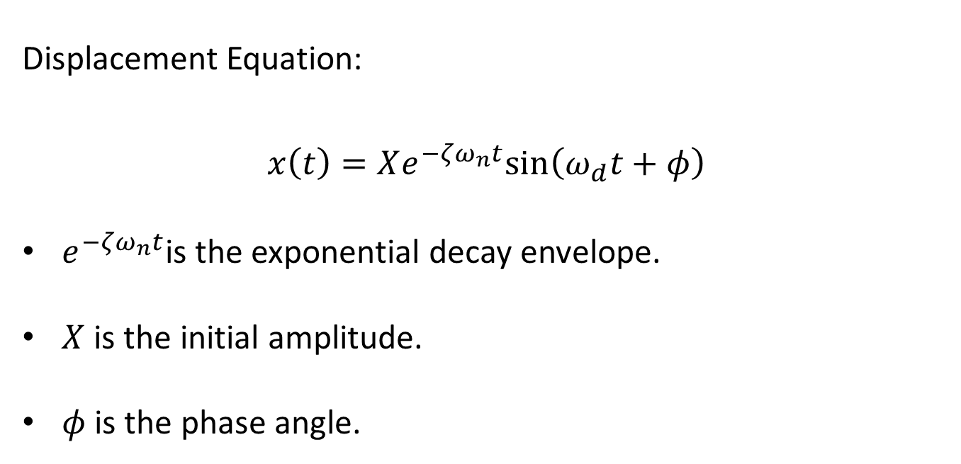
UNDERDAMPED SOLUTION & DECAY
Displacement Equation:
$$x\left(t\right)=Xe^{−ζω_{n}t}sin\left(ω_{d}t+φ\right)$$
$e^{−ζω_{n}t}$is the exponential decay envelope.
$X$ is the initial amplitude.
$φ$ is the phase angle.

Slide 17
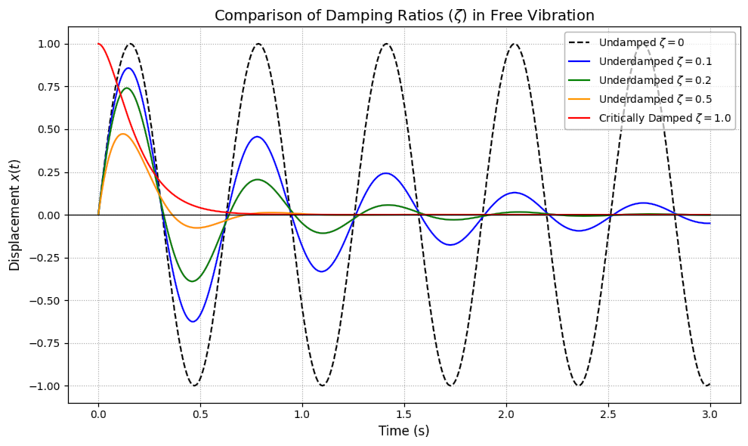
UNDERDAMPED SOLUTION & DECAY

Slide 18
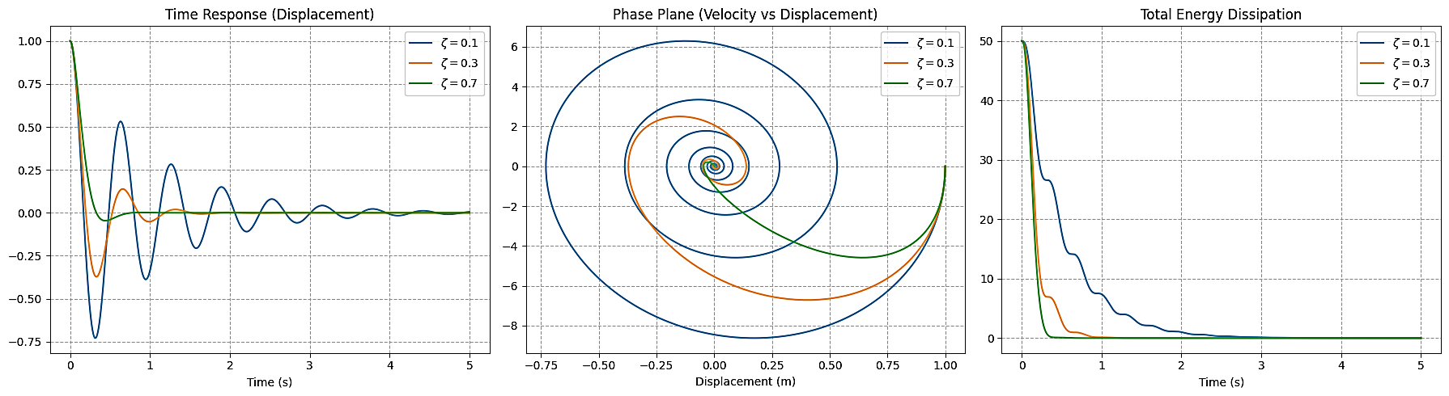
UNDERDAMPED SOLUTION & DECAY

Slide 19
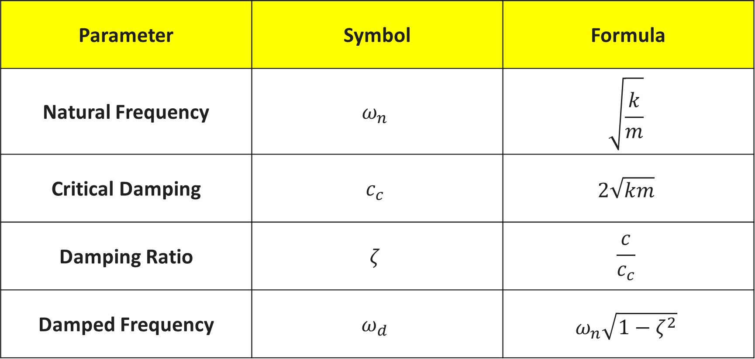
UNDAMPED FREE VIBRATION: INTRODUCTION
Parameter | Symbol | Formula
Natural Frequency | $$ω_{n}$$ | $$\sqrt{\frac{k}{m}}$$
Critical Damping | $$c_{c}$$ | $$2\sqrt{km}$$
Damping Ratio | $$ζ$$ | $$\frac{c}{c_{c}}$$
Damped Frequency | $$ω_{d}$$ | $$ω_{n}\sqrt{1−ζ^{2}}$$

