Slide 1

NOISE VIBRATION AND HARSHNESS
LECTURE 7 MODULE 1
Prepared By:
Dinesh Kumar
Assistant Professor
School of Continuing Education
DYPIU

Slide 2

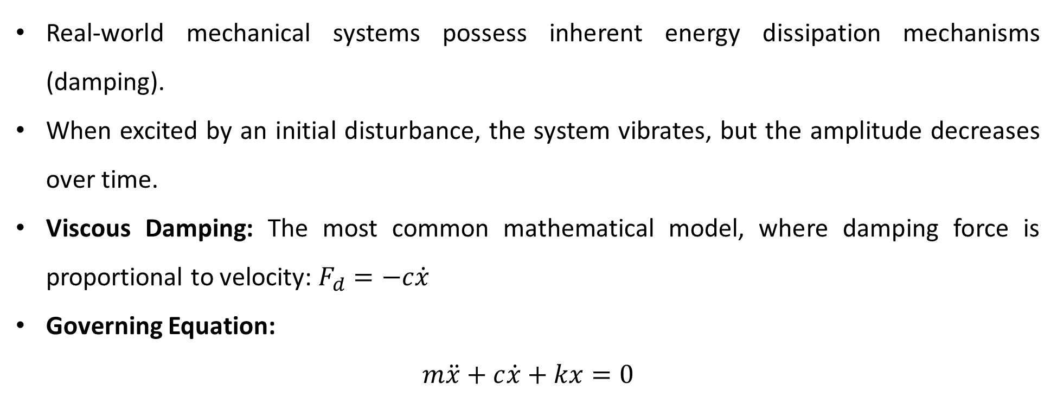
DAMPED FREE VIBRATIONS
Damped Free Vibrations
Real-world mechanical systems possess inherent energy dissipation mechanisms (damping).
When excited by an initial disturbance, the system vibrates, but the amplitude decreases over time.
Viscous Damping: The most common mathematical model, where damping force is proportional to velocity: $F_{d}=−c\dot{x}$
Governing Equation:
$$m\ddot{x}+c\dot{x}+kx=0$$

Slide 3
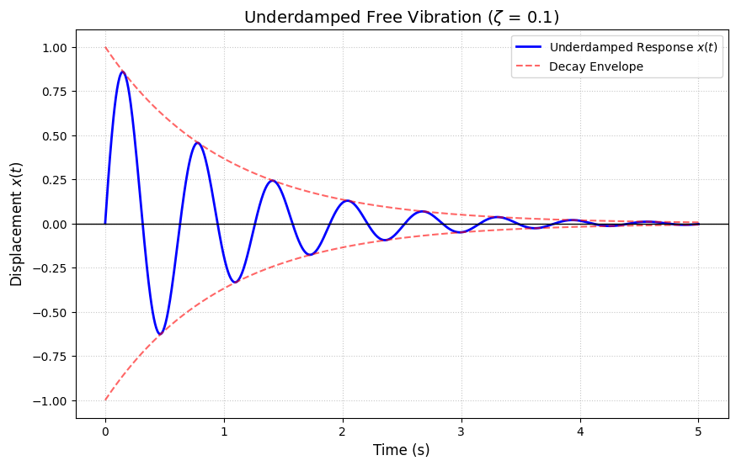
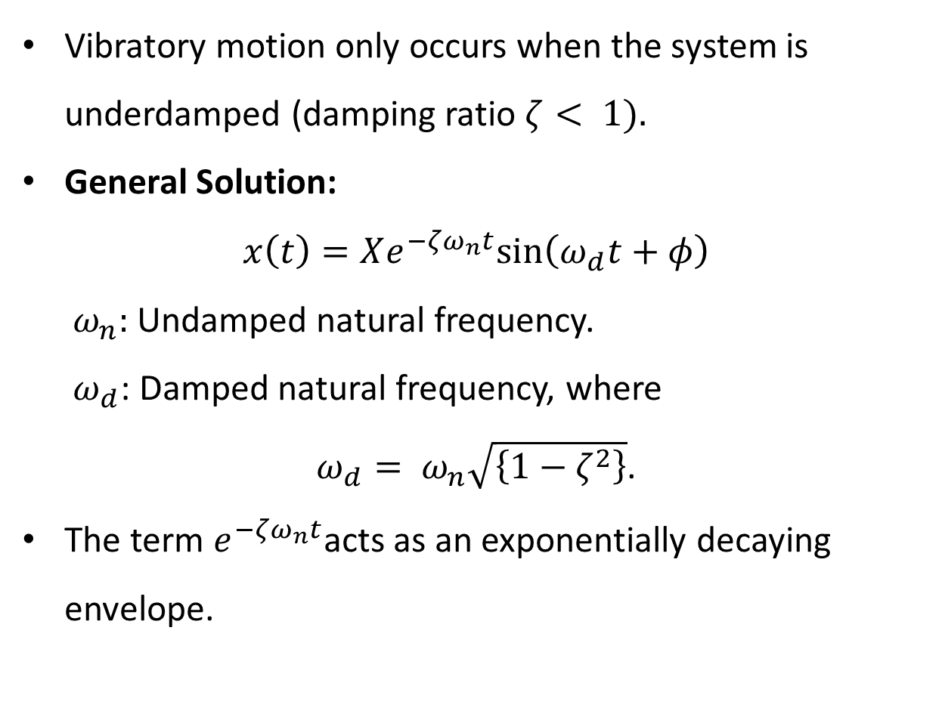
THE UNDERDAMPED RESPONSE ($ζ< 1$)
Vibratory motion only occurs when the system is underdamped (damping ratio $ζ< 1).$
General Solution:
$x\left(t\right)=Xe^{−ζω_{n}t}sin\left(ω_{d}t+φ\right)$
$ω_{n}:$Undamped natural frequency.
$ω_{d}$: Damped natural frequency, where
$ω_{d}= ω_{n}\sqrt{\left\{1−ζ^{2}\right\}}$.
The term $e^{−ζω_{n}t}$acts as an exponentially decaying envelope.

Slide 4
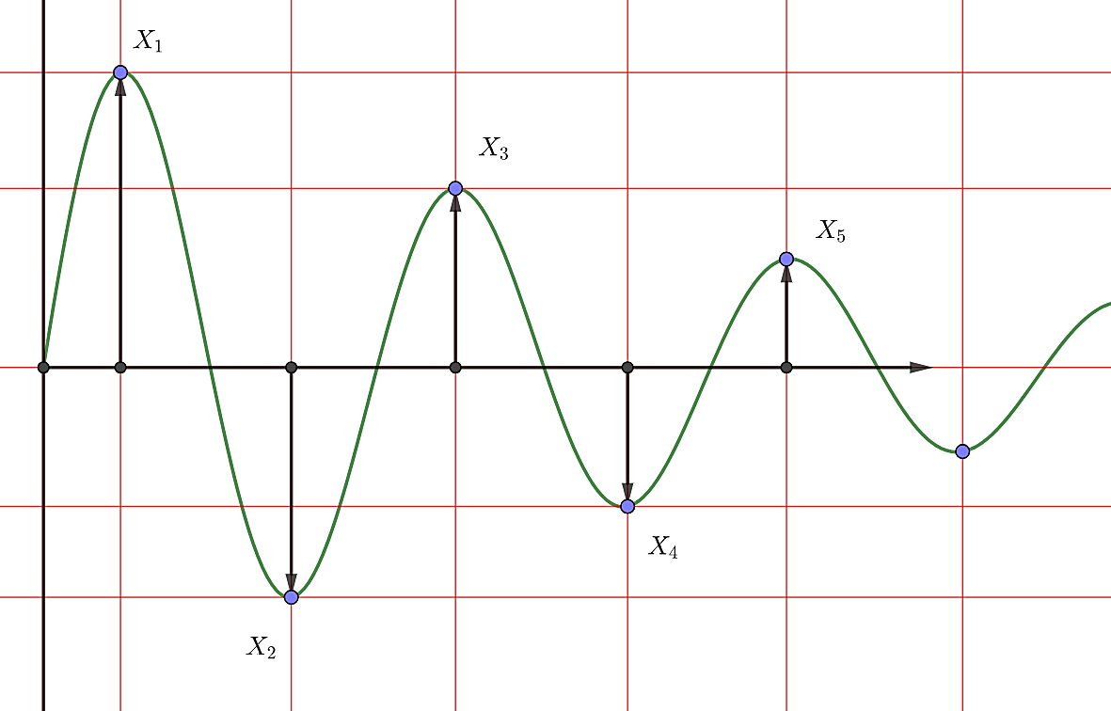
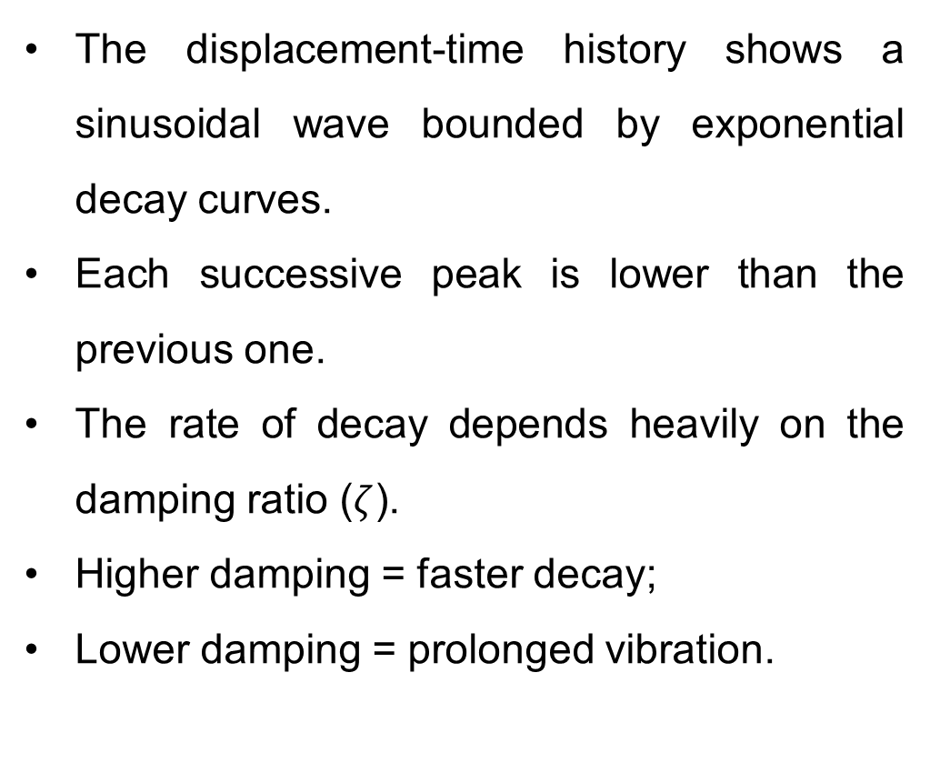
CONCEPT OF VIBRATION DECAY
The displacement-time history shows a sinusoidal wave bounded by exponential decay curves.
Each successive peak is lower than the previous one.
The rate of decay depends heavily on the damping ratio ($ζ$).
Higher damping = faster decay;
Lower damping = prolonged vibration.

Slide 5
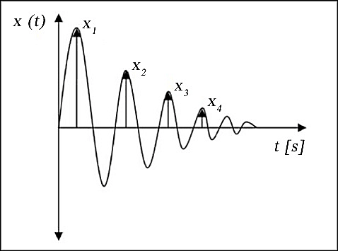
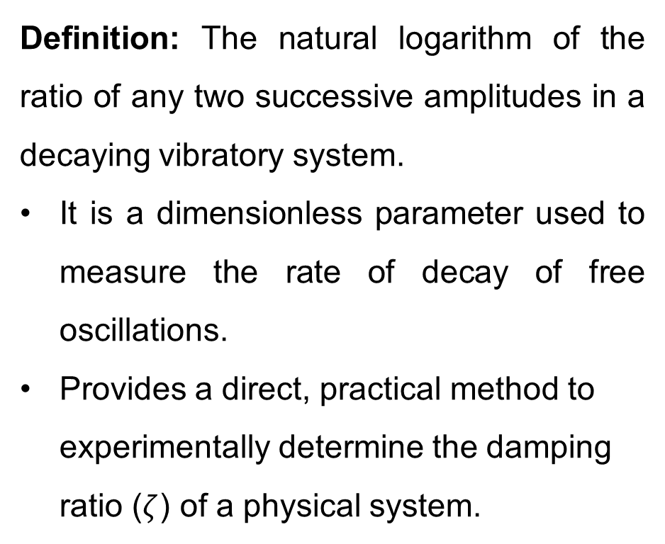
INTRODUCTION TO LOGARITHMIC DECREMENT ($δ$)
Definition: The natural logarithm of the ratio of any two successive amplitudes in a decaying vibratory system.
It is a dimensionless parameter used to measure the rate of decay of free oscillations.
Provides a direct, practical method to experimentally determine the damping ratio ($ζ$) of a physical system.

Slide 6
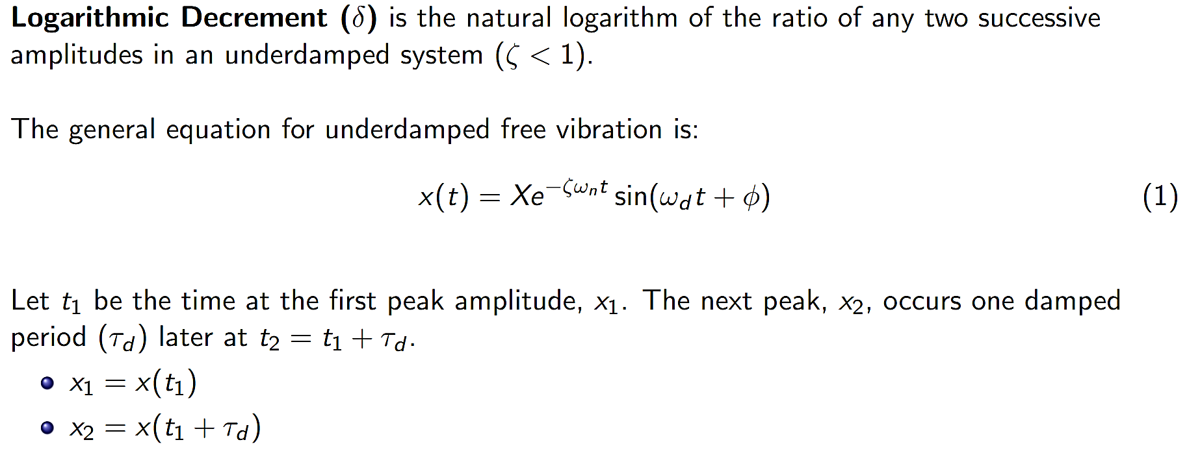
DERIVATION OF LOGARITHMIC DECREMENT

Slide 7
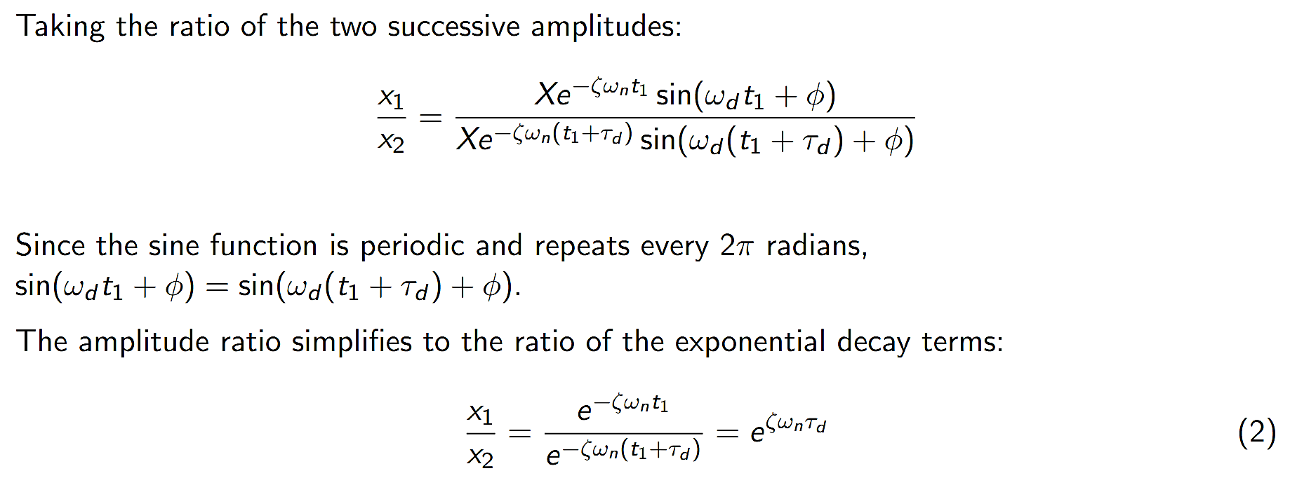
DERIVATION OF LOGARITHMIC DECREMENT

Slide 8
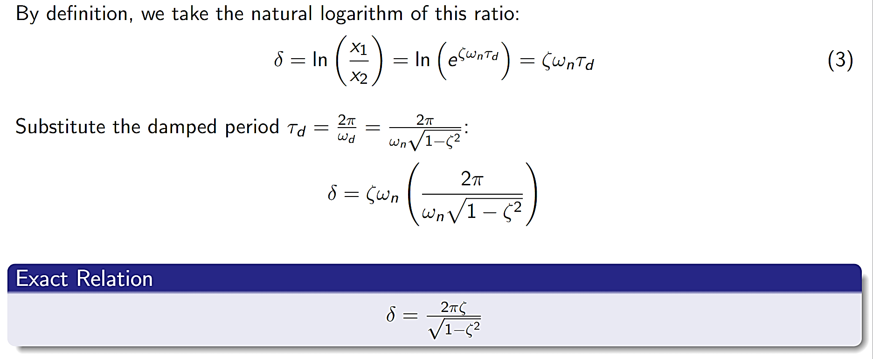
DERIVATION OF LOGARITHMIC DECREMENT

Slide 9

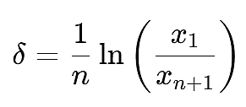
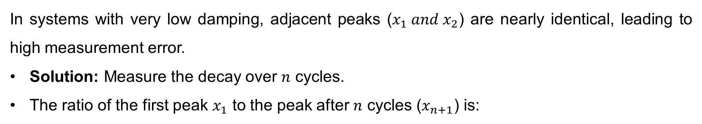
LOGARITHMIC DECREMENT OVER $n$ CYCLES
In systems with very low damping, adjacent peaks ($x_{1} and{ x}_{2}$) are nearly identical, leading to high measurement error.
Solution: Measure the decay over $n$ cycles.
The ratio of the first peak $x_{1}$ to the peak after $n$ cycles ($x_{n+1}$) is:
Practical Formula:

Slide 10
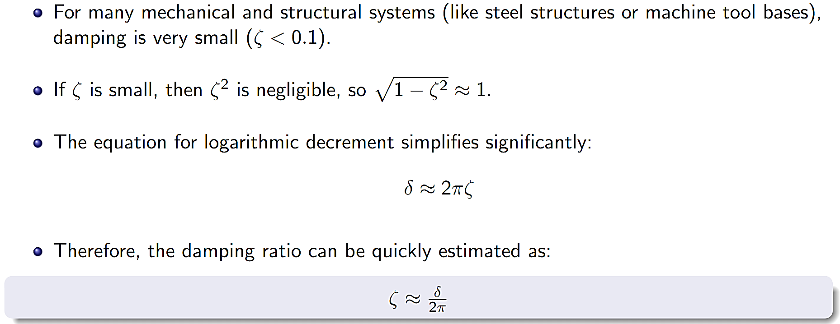
SMALL DAMPING APPROXIMATION (Ζ ≪ 1)

Slide 11
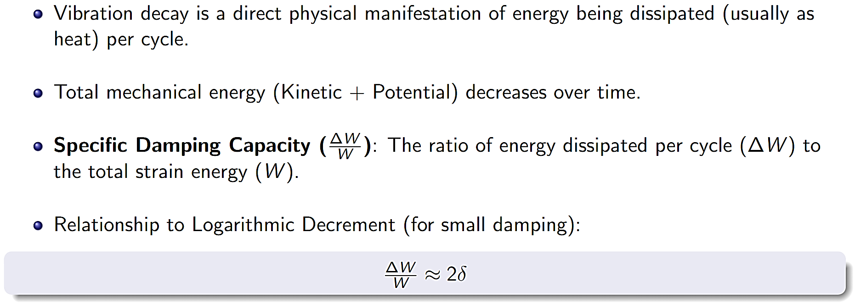
ENERGY LOSS IN DAMPED SYSTEMS

Slide 12
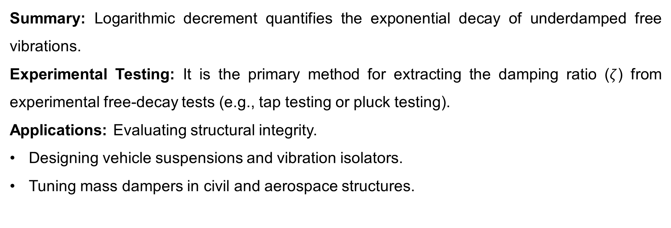
UNDAMPED FREE VIBRATION: INTRODUCTION
Summary: Logarithmic decrement quantifies the exponential decay of underdamped free vibrations.
Experimental Testing: It is the primary method for extracting the damping ratio ($ζ$) from experimental free-decay tests (e.g., tap testing or pluck testing).
Applications: Evaluating structural integrity.
Designing vehicle suspensions and vibration isolators.
Tuning mass dampers in civil and aerospace structures.

Slide 13
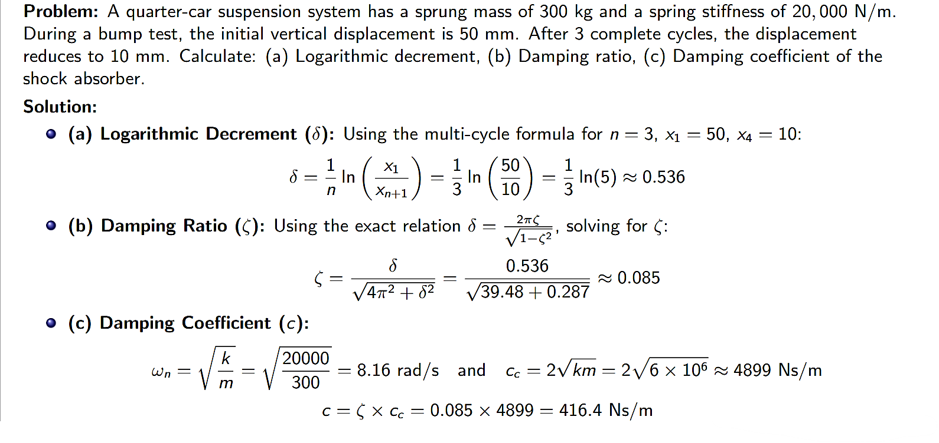
UNDAMPED FREE VIBRATION: INTRODUCTION

Slide 14
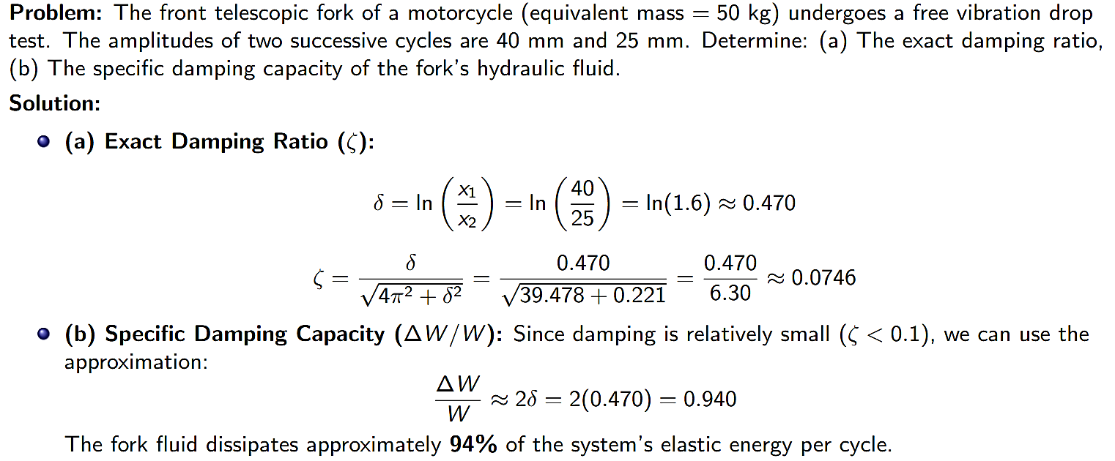
UNDAMPED FREE VIBRATION: INTRODUCTION

Slide 15
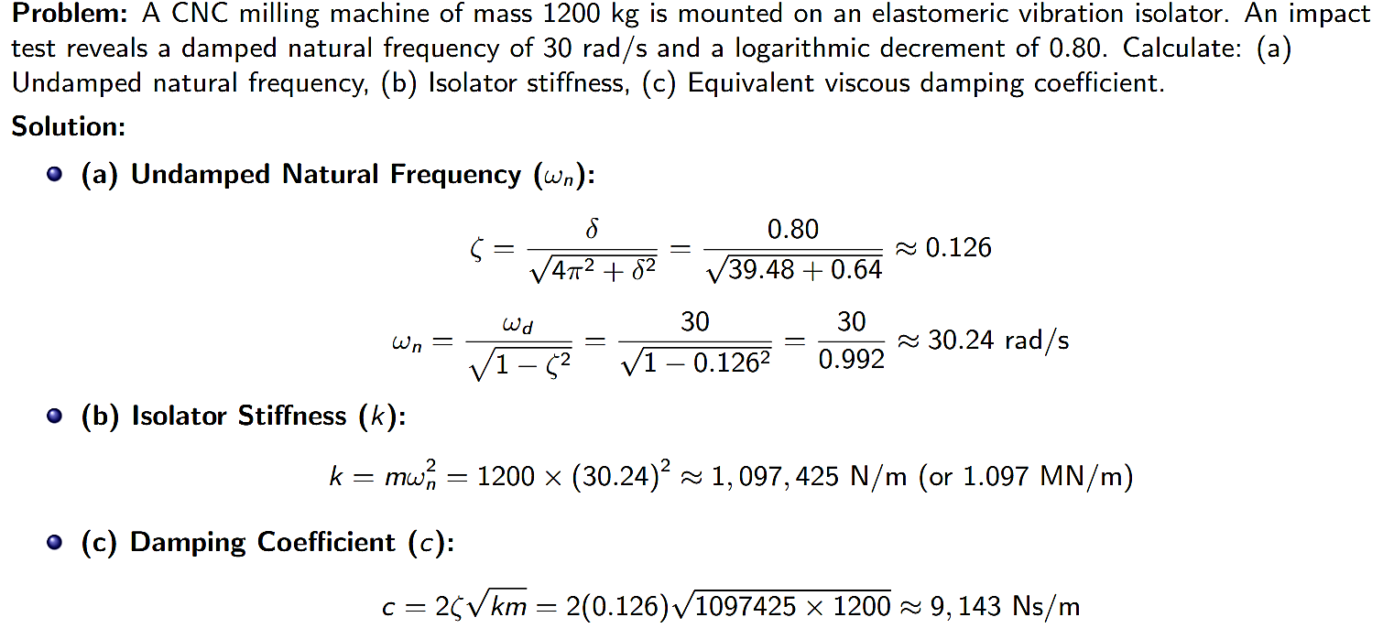
UNDAMPED FREE VIBRATION: INTRODUCTION

Slide 16
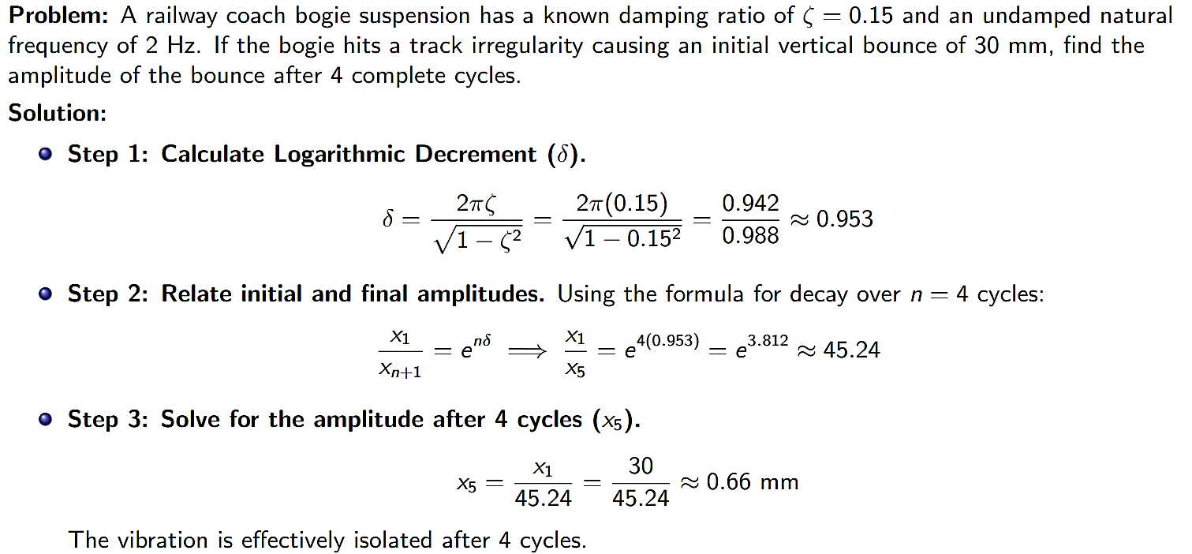
UNDAMPED FREE VIBRATION: INTRODUCTION

Slide 17
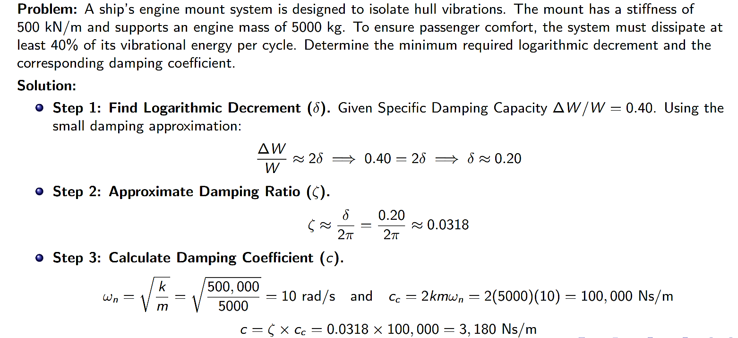
UNDAMPED FREE VIBRATION: INTRODUCTION

