Slide 1

NOISE VIBRATION AND HARSHNESS
LECTURE 8 MODULE 2
Prepared By:
Dinesh Kumar
Assistant Professor
School of Continuing Education
DYPIU

Slide 2
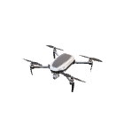
LEARNING OUTCOMES
By the end of this lecture, students should be able to:
Define forced vibration and harmonic excitation.
Write the governing equation for an undamped SDOF system under external periodic force.
Distinguish transient response and steady-state response.
Derive the displacement response for harmonic forcing.
Explain the concept of dynamic magnification factor.
State the resonance condition and discuss its physical significance.

Slide 3
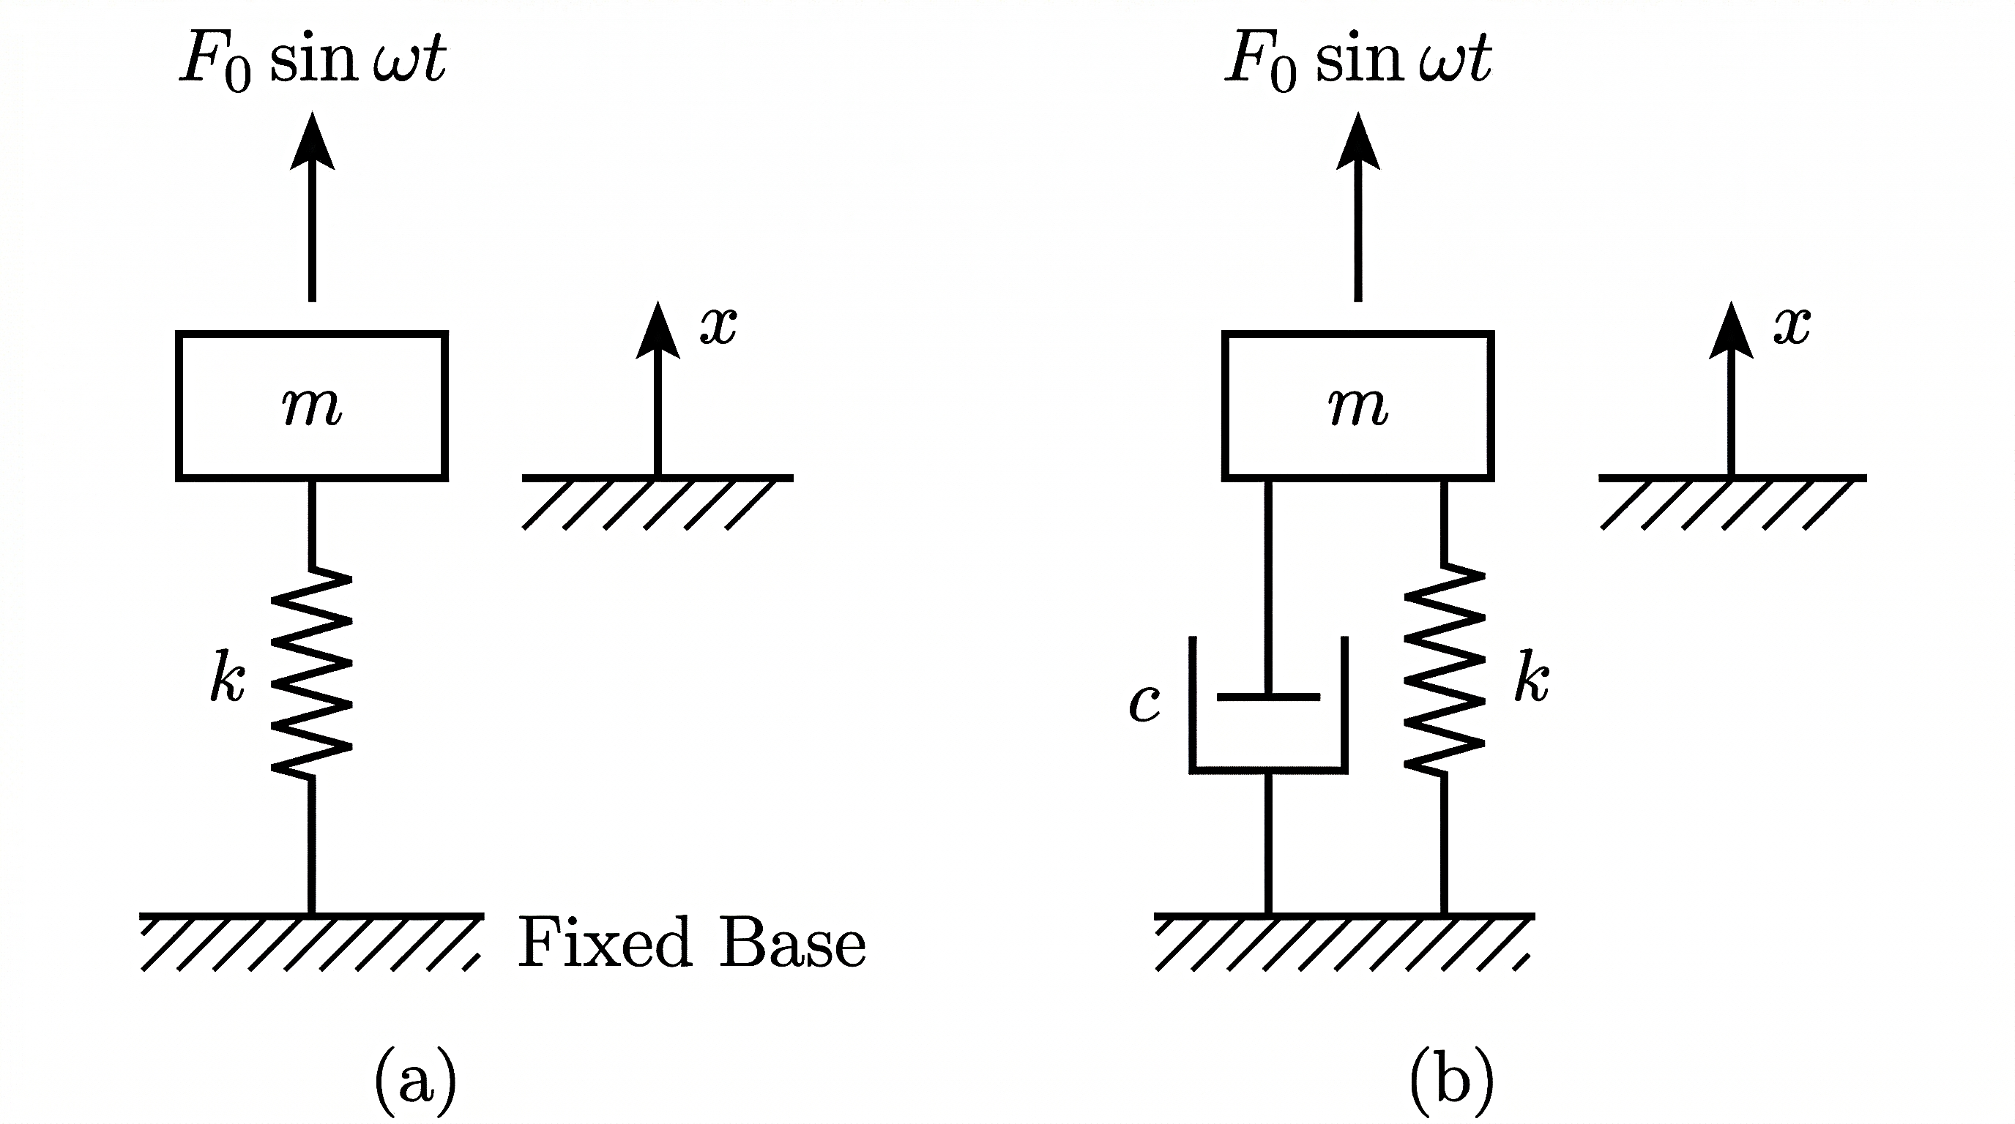

INTRODUCTION TO FORCED VIBRATION
Forced vibration occurs when a system is subjected to an external time-varying excitation.
The vibration continues because energy is supplied from outside the system.
The excitation may be harmonic, periodic, impulsive, or random; in this lecture, only harmonic excitation is considered.
Typical forcing sources include rotating unbalance, reciprocating machines, gear mesh forces, and road-induced periodic loading.

Slide 4
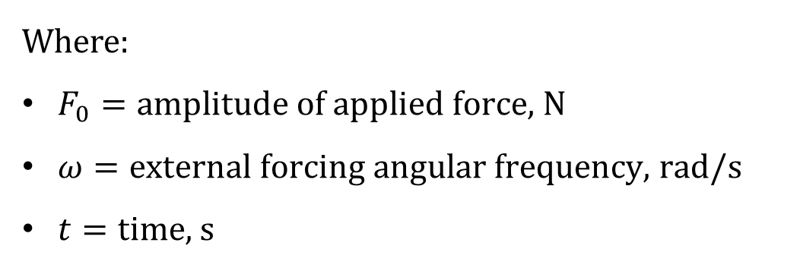

HARMONIC EXCITATION
A harmonic excitation is represented as:
$${F\left(t\right)=F}_{0}Sin(ωt)$$
Where:
$F_{0}=\text{amplitude} \text{of} \text{applied} \text{force}\text{, }\text{N}$
$ω=\text{external} \text{forcing} \text{angular} \text{frequency}\text{, }\text{rad}\text{/}\text{s}$
$t=\text{time}\text{, }\text{s}$

Slide 5
UNDAMPED SDOF FORCED SYSTEM
Consider a spring–mass system:
Assumptions:
Linear elastic spring.
Rigid lumped mass.
Small displacement motion.
No energy dissipation.
Single degree of freedom motion along one axis.
Remark: This is an idealized model used to establish the basic theory of resonance.

Slide 6
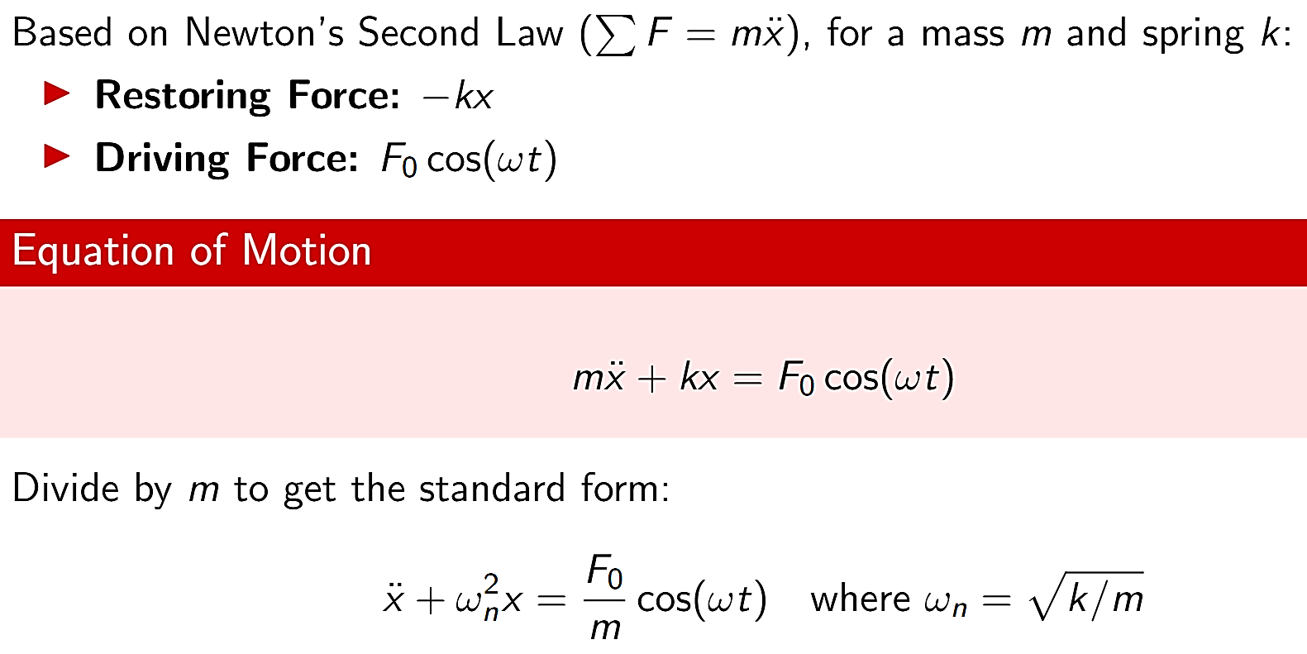
UNDAMPED SDOF FORCED SYSTEM

Slide 7
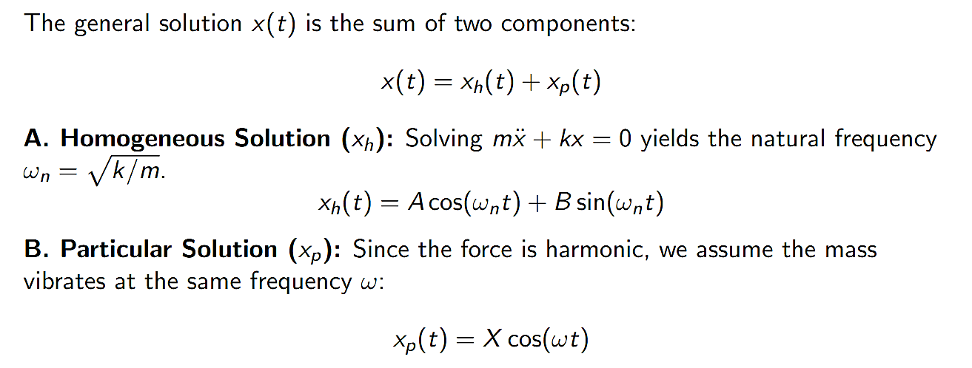
UNDAMPED SDOF FORCED SYSTEM

Slide 8
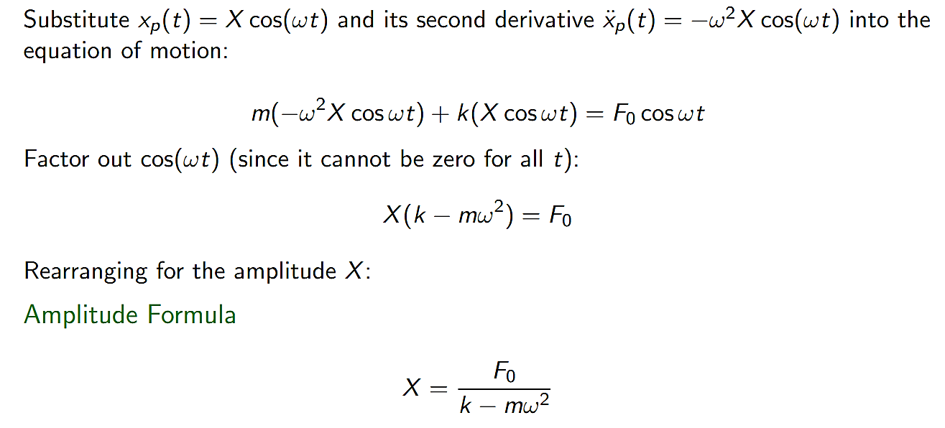
UNDAMPED SDOF FORCED SYSTEM

Slide 9
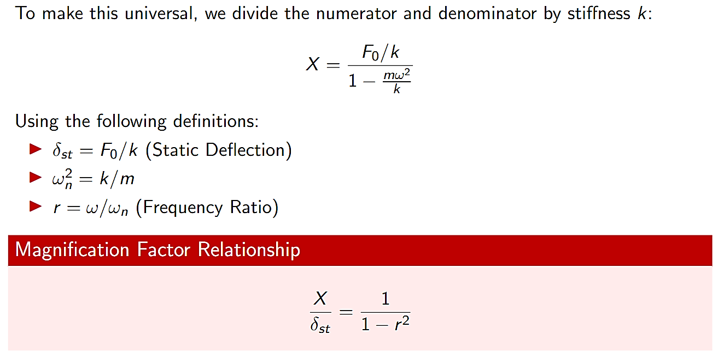
UNDAMPED SDOF FORCED SYSTEM

Slide 10
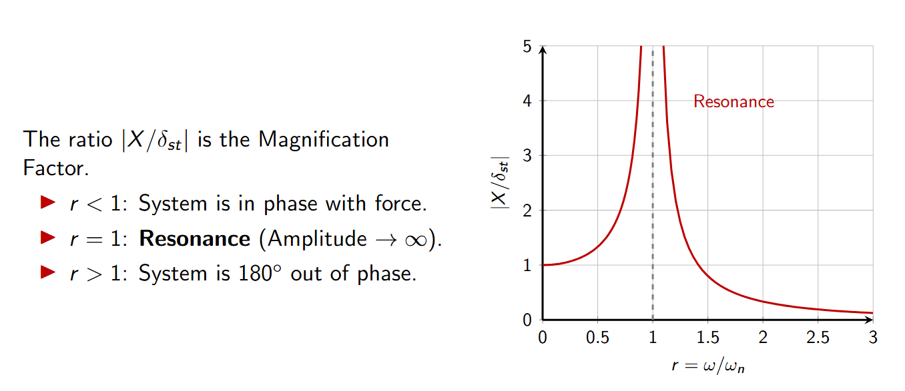
UNDAMPED SDOF FORCED SYSTEM

Slide 11
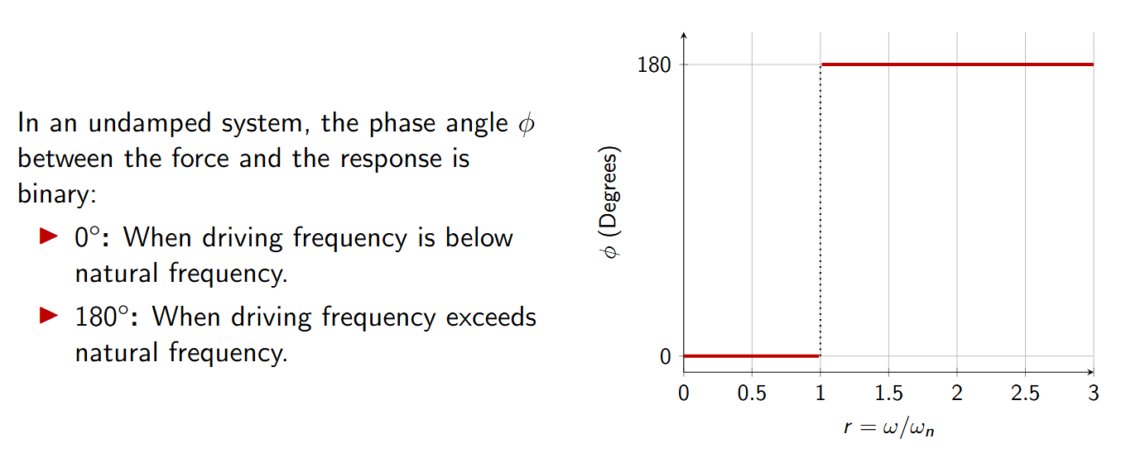
UNDAMPED SDOF FORCED SYSTEM

Slide 12
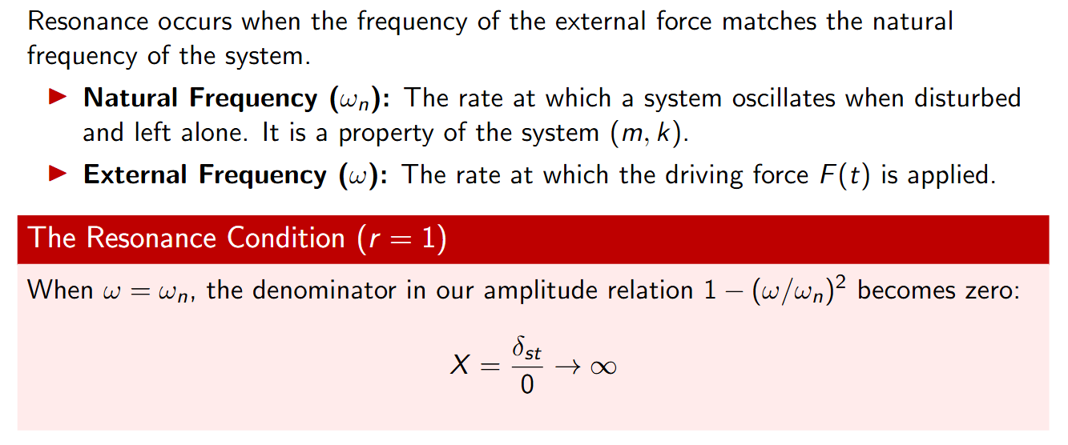
UNDAMPED SDOF FORCED SYSTEM

Slide 13
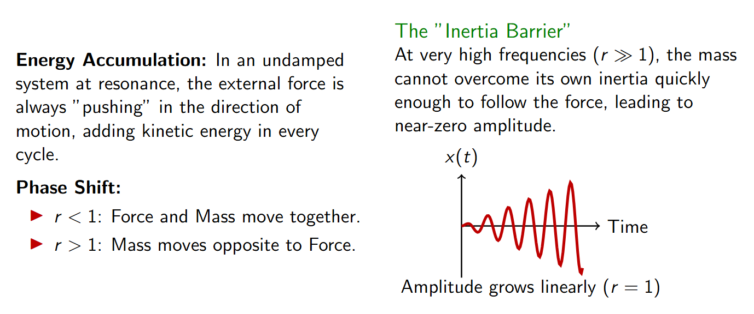
UNDAMPED SDOF FORCED SYSTEM

Slide 14
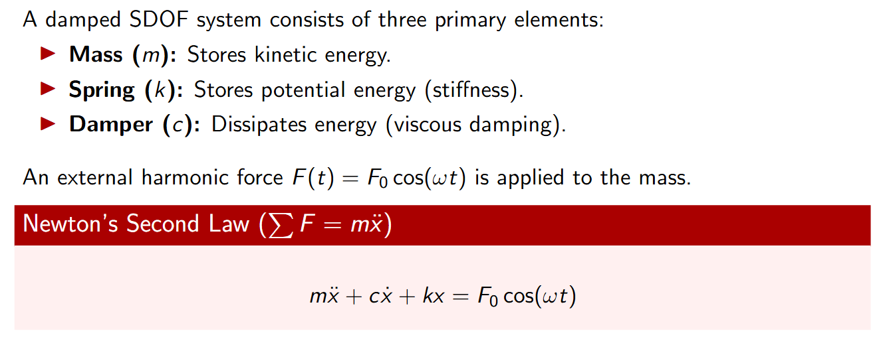
DAMPED SDOF FORCED SYSTEM

Slide 15
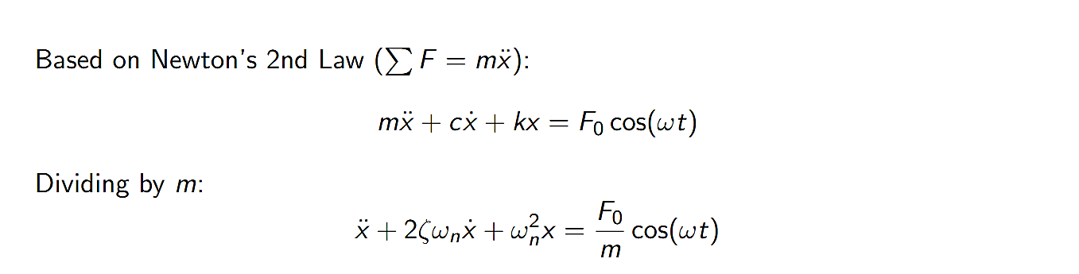
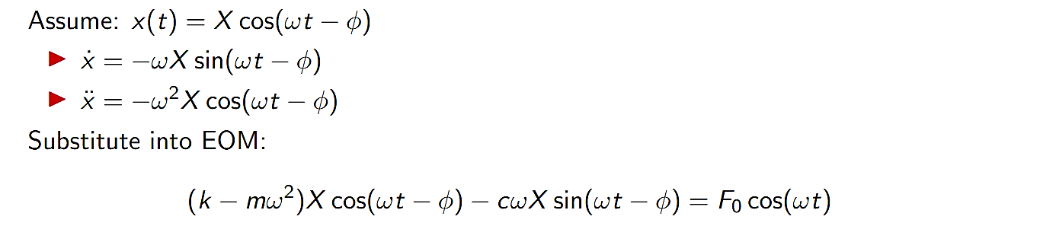
DAMPED SDOF FORCED SYSTEM

Slide 16
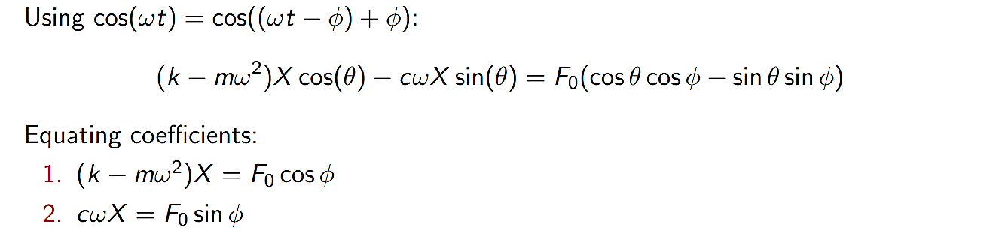
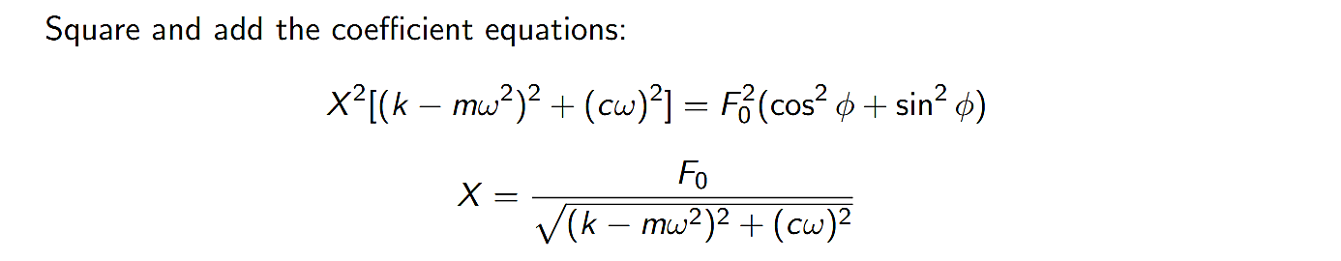
DAMPED SDOF FORCED SYSTEM

Slide 17
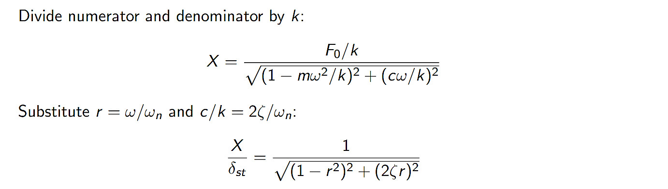
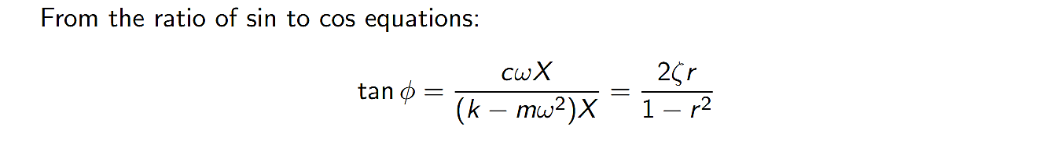
DAMPED SDOF FORCED SYSTEM

Slide 18
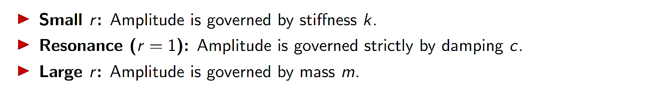
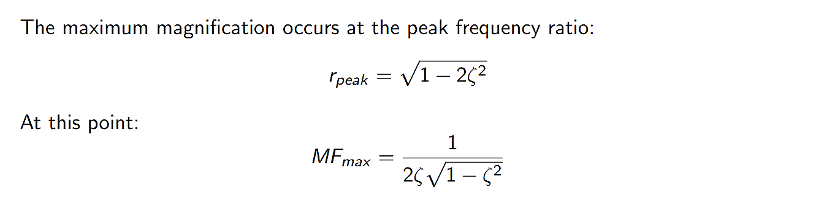
DAMPED SDOF FORCED SYSTEM

Slide 19
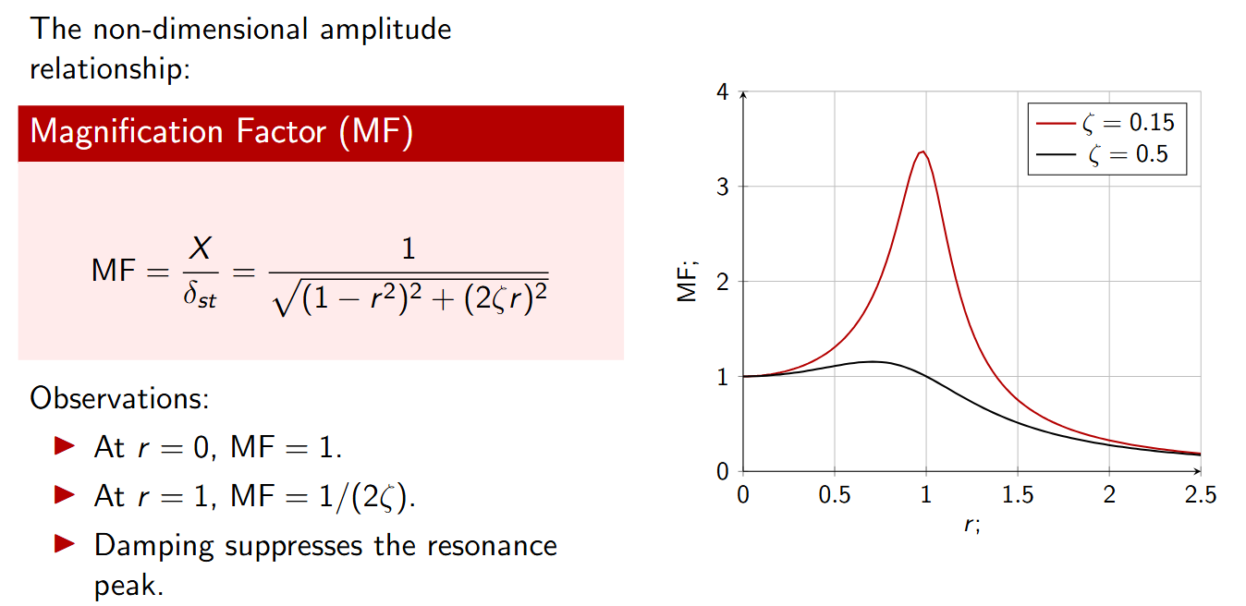
DAMPED SDOF FORCED SYSTEM

Slide 20
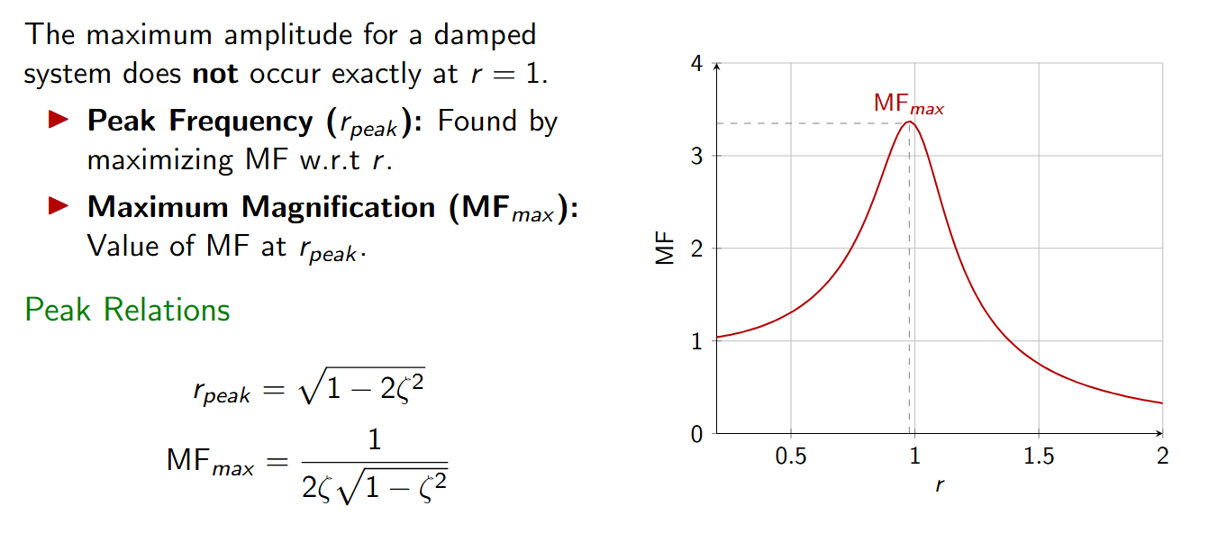
DAMPED SDOF FORCED SYSTEM

Slide 21
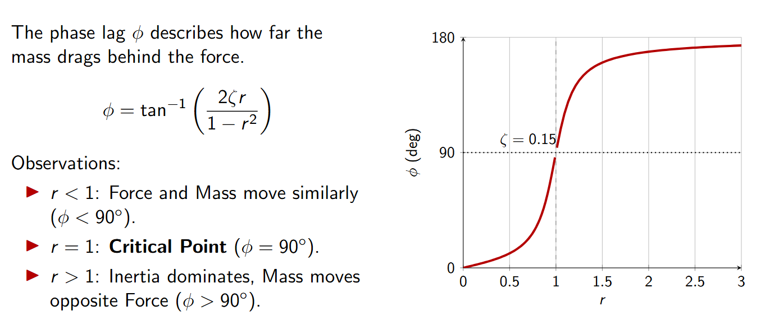
DAMPED SDOF FORCED SYSTEM

Slide 22
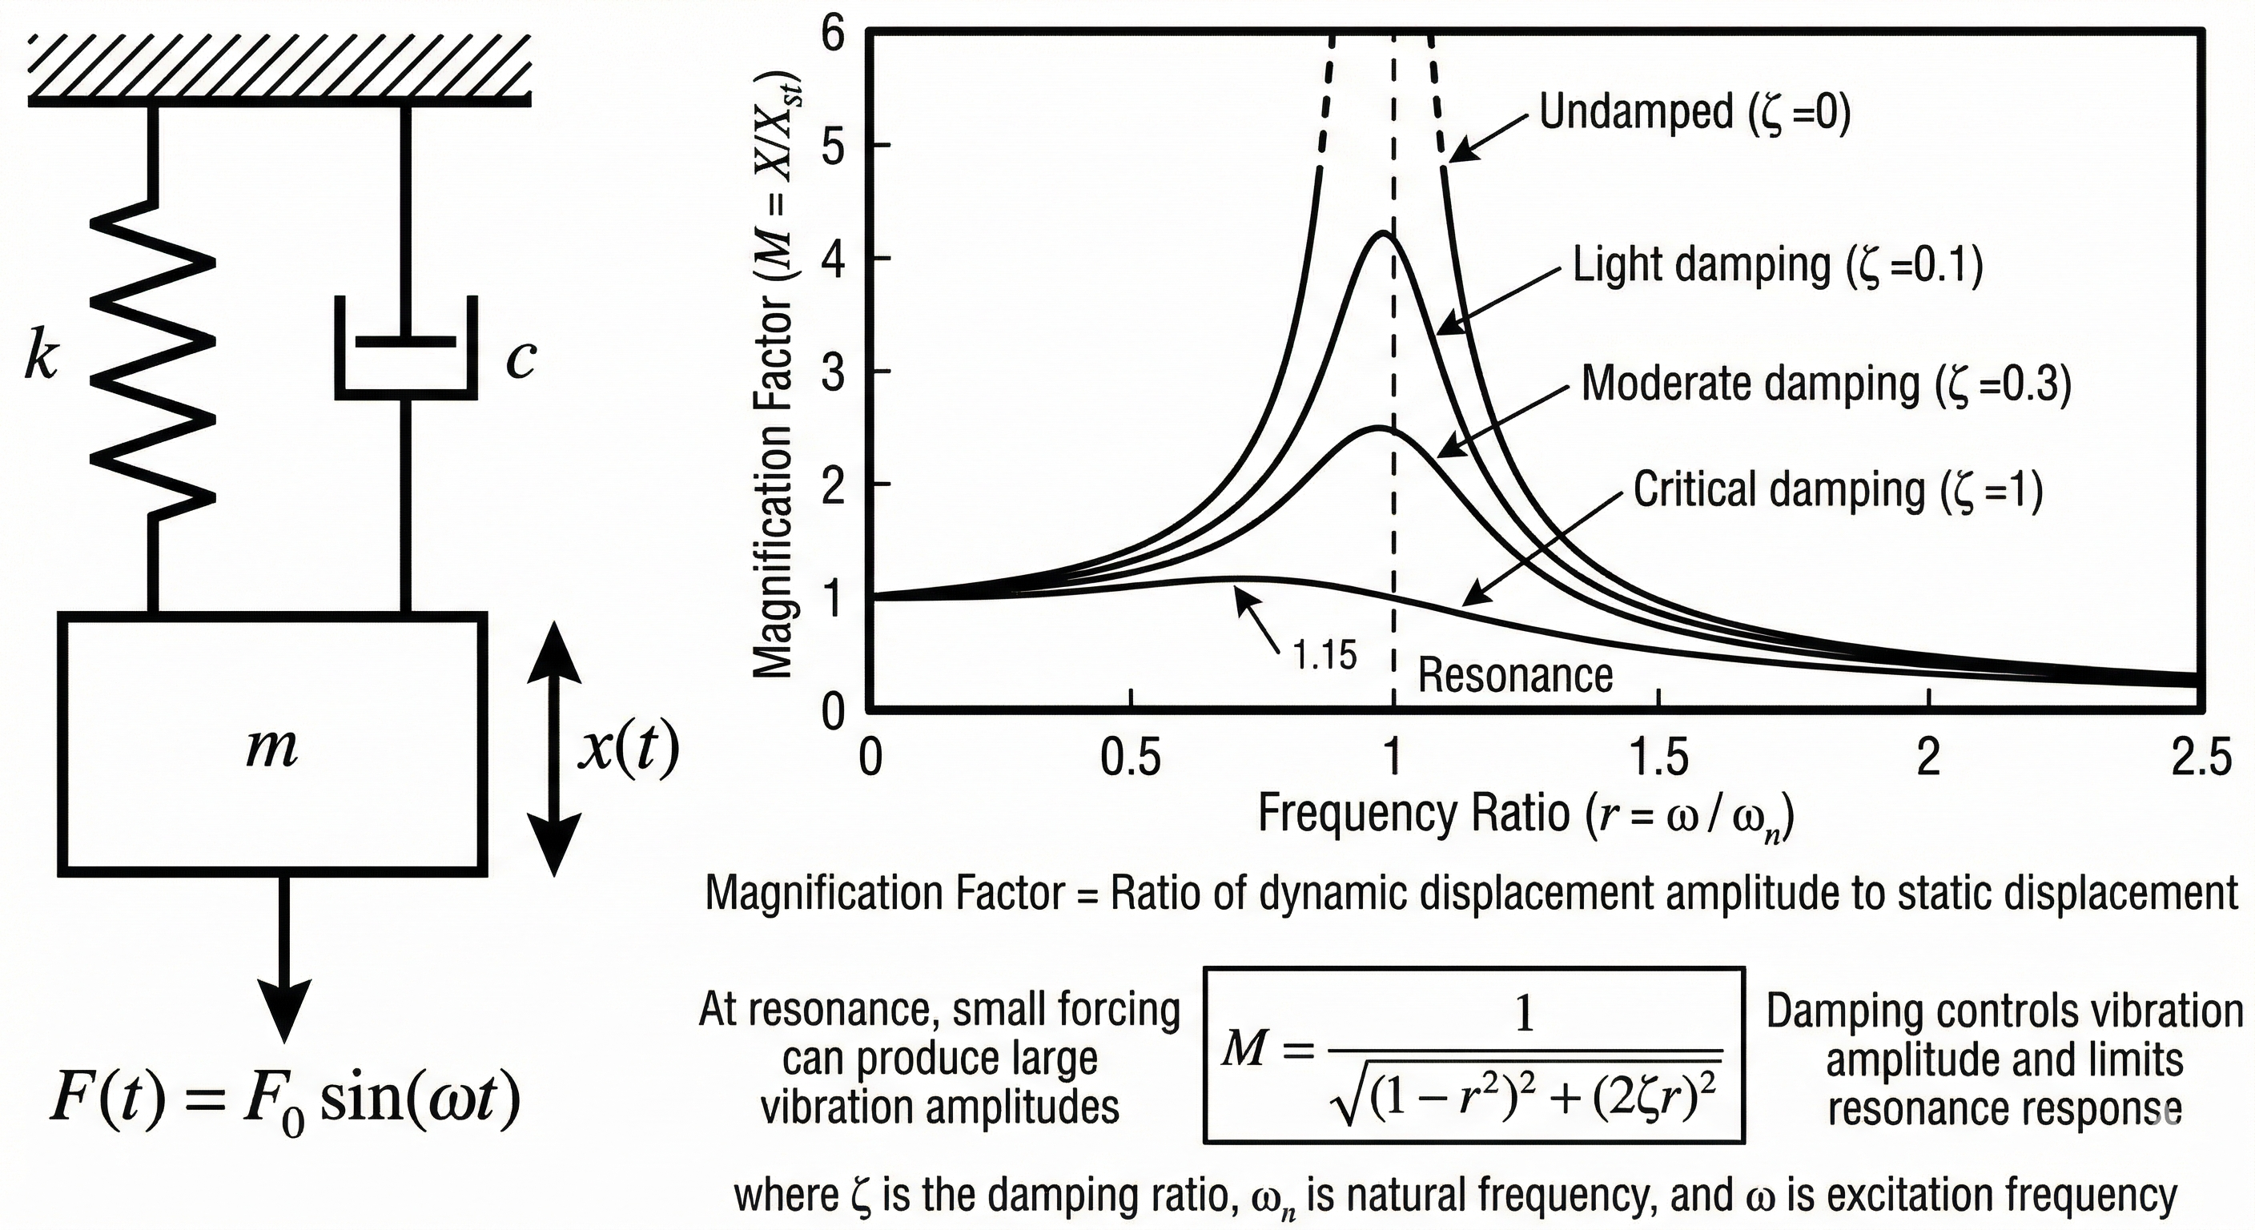
DAMPED SDOF FORCED SYSTEM

Slide 23
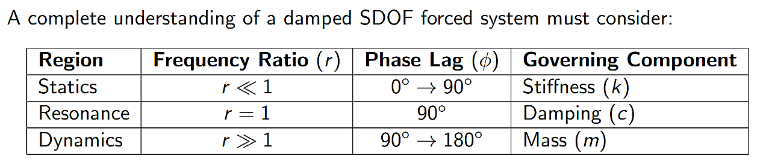
DAMPED SDOF FORCED SYSTEM

