Slide 1

NOISE VIBRATION AND HARSHNESS
LECTURE 9 MODULE 1
Prepared By:
Dinesh Kumar
Assistant Professor
School of Continuing Education
DYPIU

Slide 2
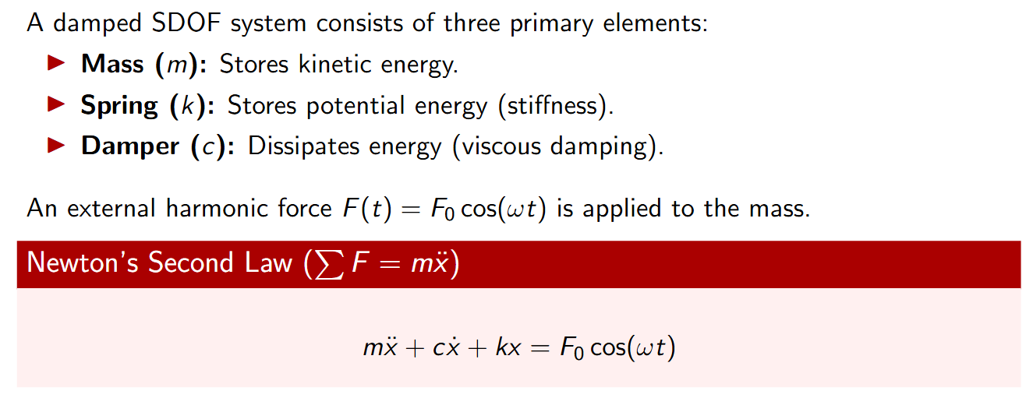
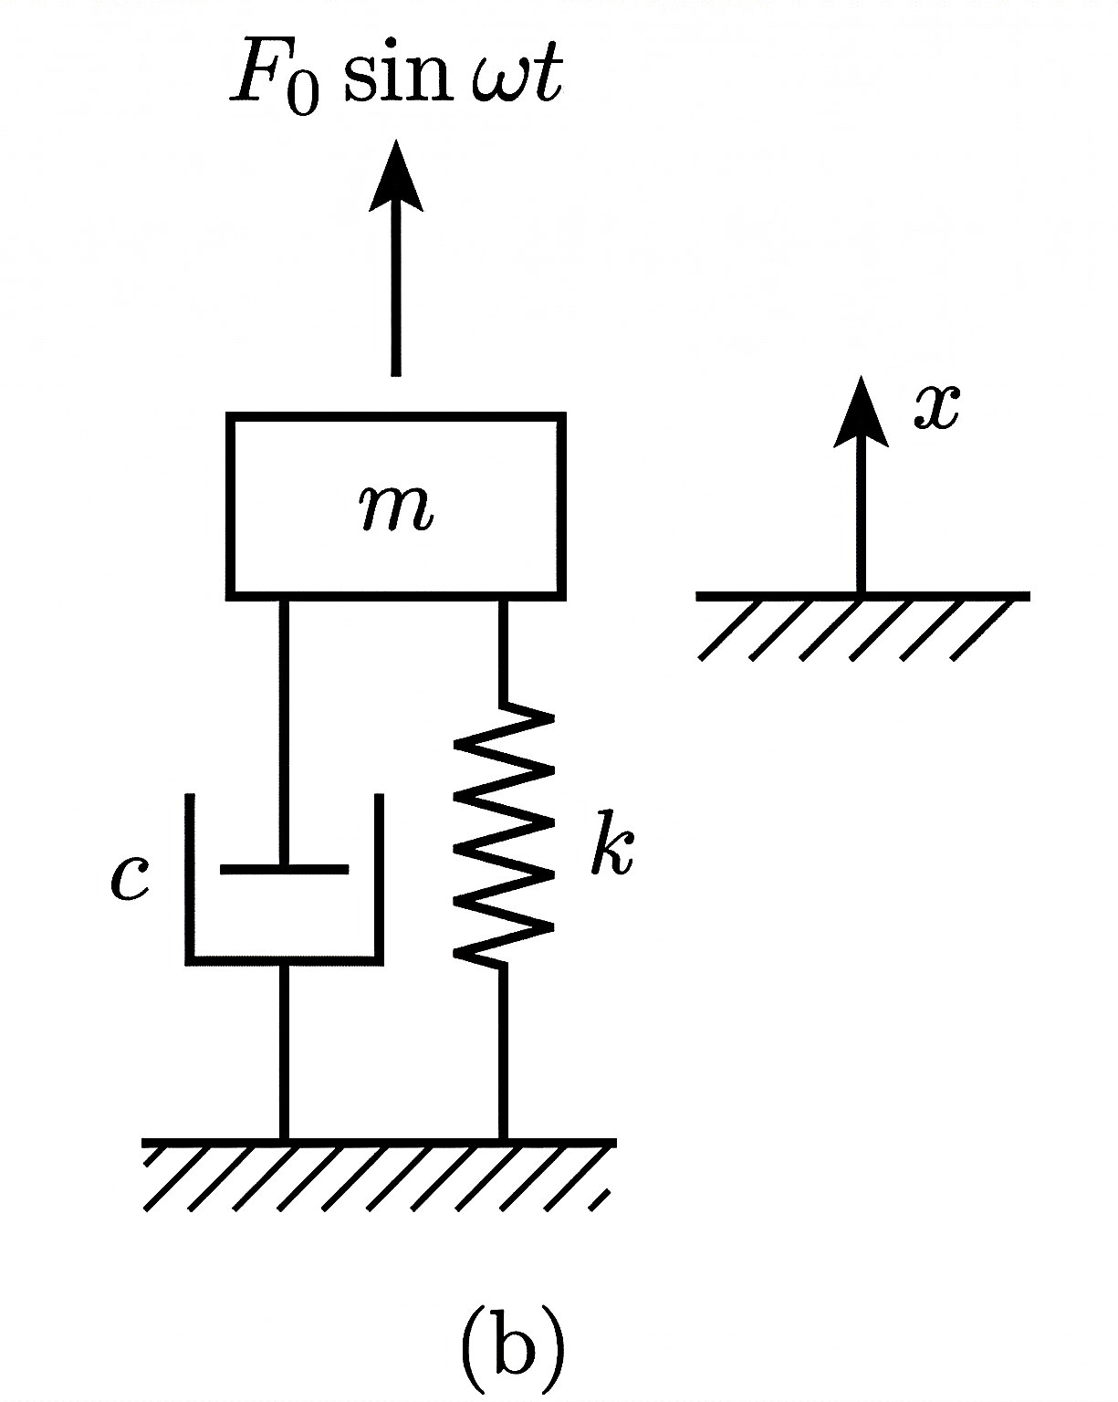
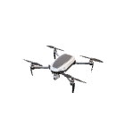
DAMPED SDOF FORCED SYSTEM

Slide 3
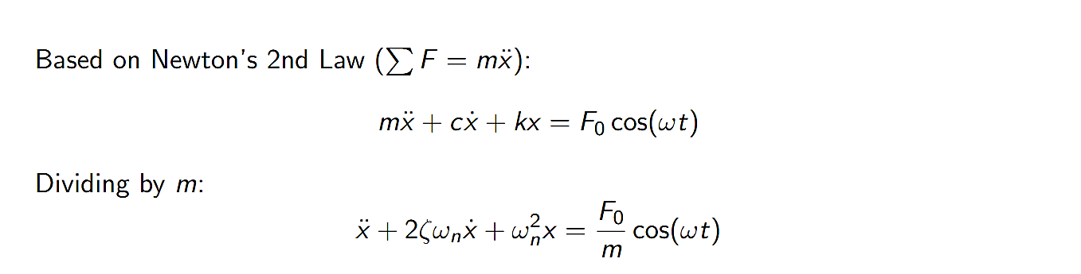
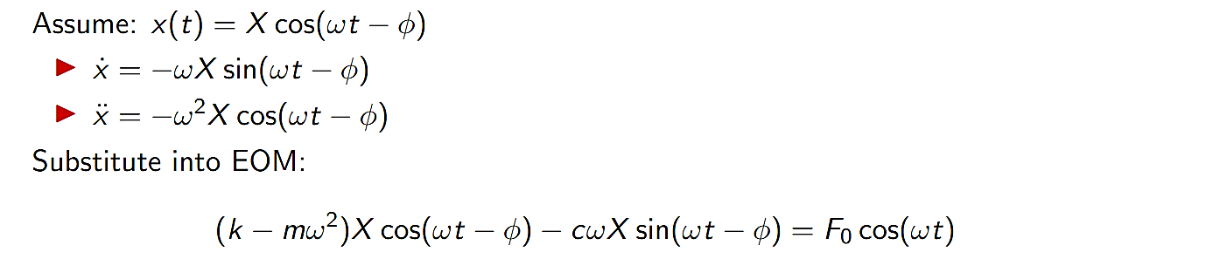
DAMPED SDOF FORCED SYSTEM

Slide 4
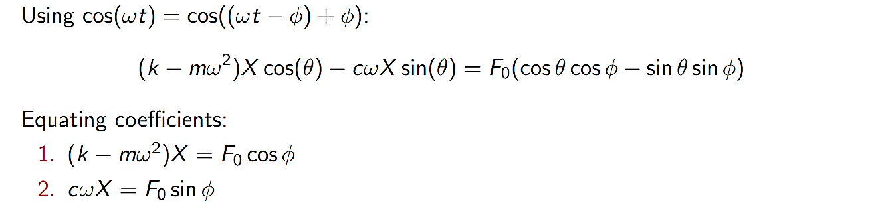
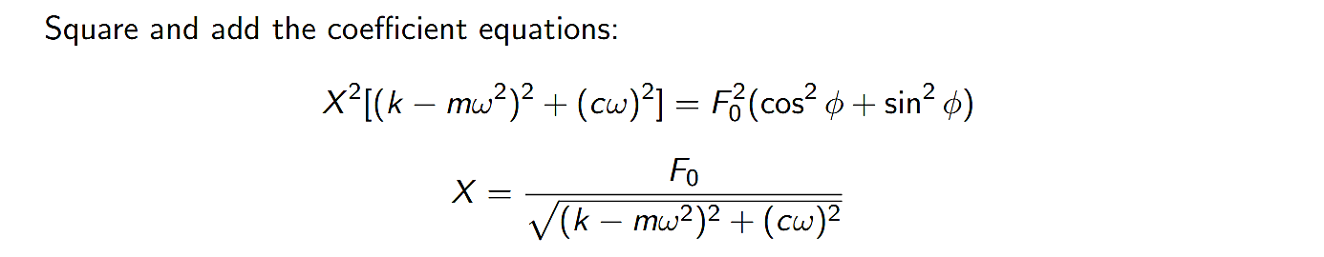
DAMPED SDOF FORCED SYSTEM

Slide 5
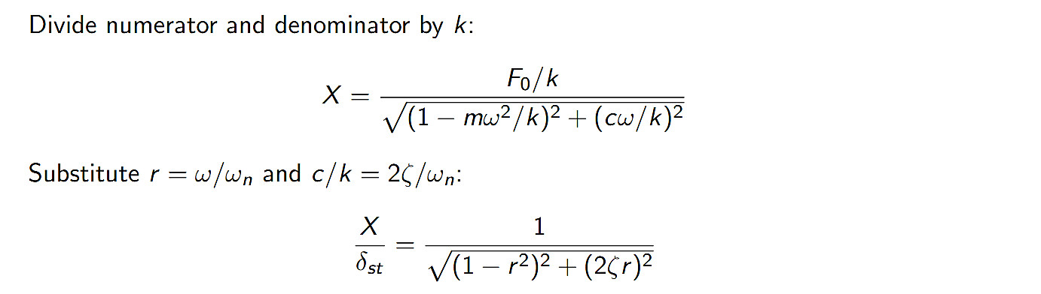
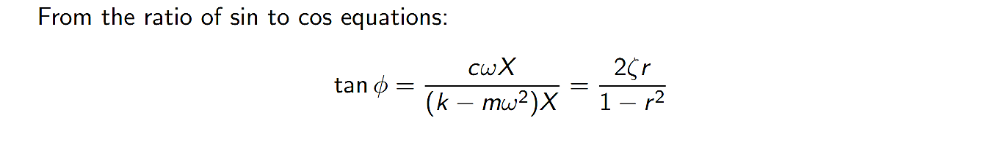
DAMPED SDOF FORCED SYSTEM

Slide 6
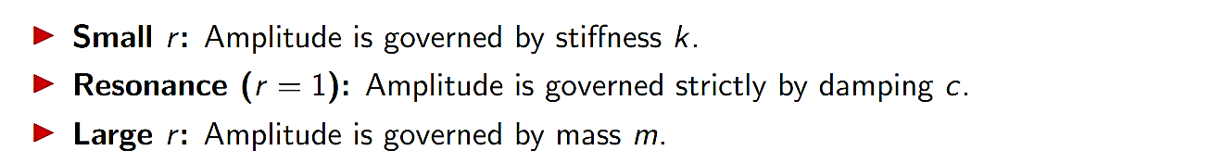
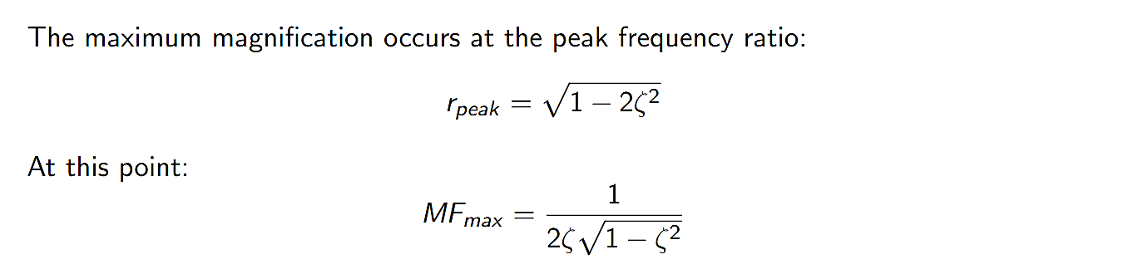
DAMPED SDOF FORCED SYSTEM

Slide 7
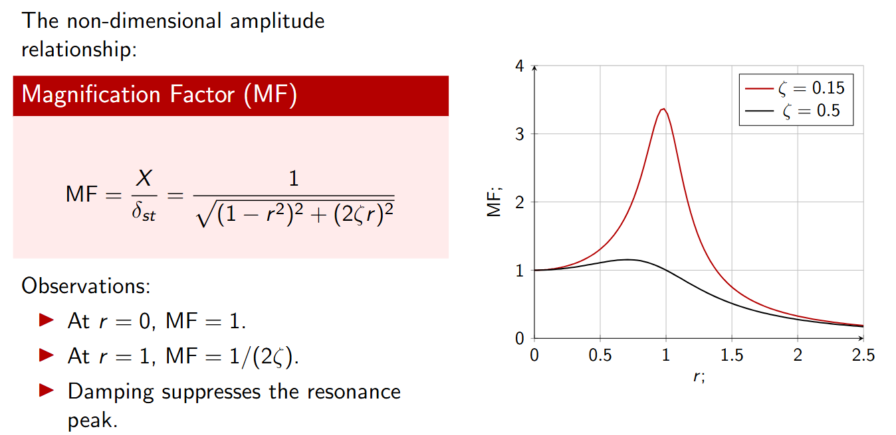
DAMPED SDOF FORCED SYSTEM

Slide 8
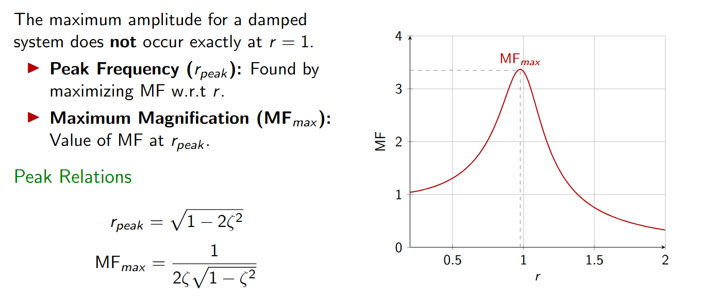
DAMPED SDOF FORCED SYSTEM

Slide 9
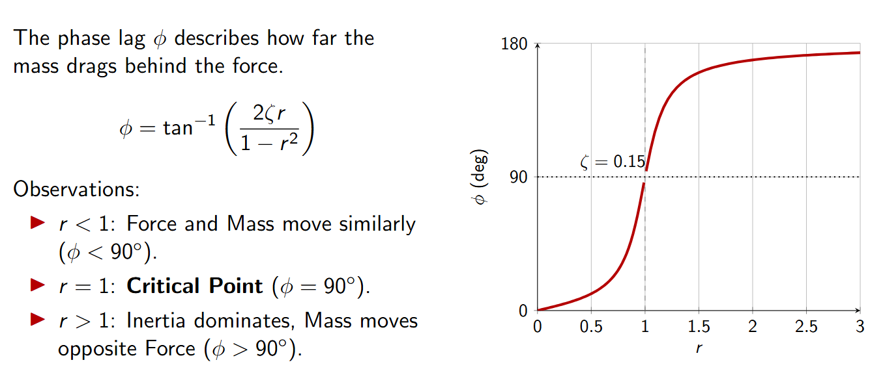
DAMPED SDOF FORCED SYSTEM

Slide 10
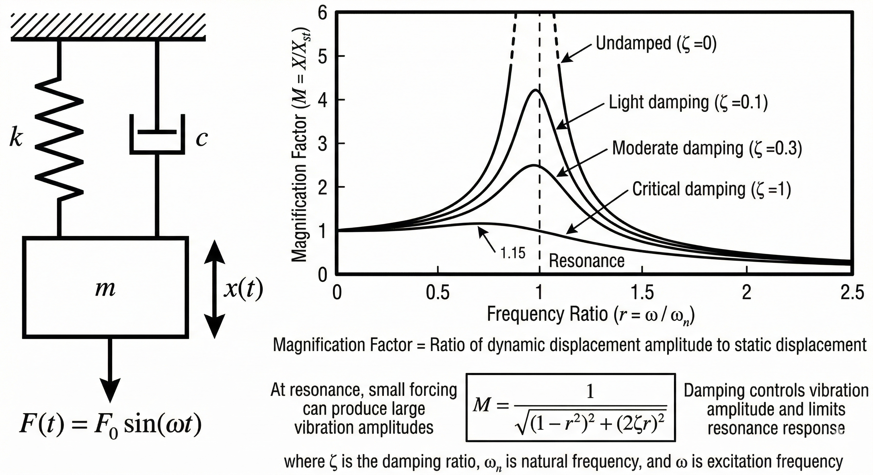
DAMPED SDOF FORCED SYSTEM

Slide 11
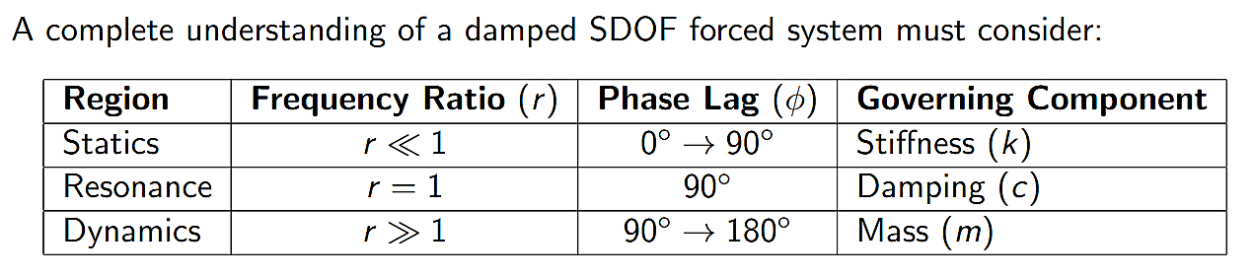
DAMPED SDOF FORCED SYSTEM

Slide 12
DAMPED SDOF FORCED SYSTEM

